Slide 1
Families, Poverty, and Other Features of IPUMS-CPS
IPUMS CPS Summer Data Workshop
June 6, 2018
Jose Pacas

Slide 2
Overview
Tying up loose ends and covering some other things to consider:
ASEC oversample… one last time
MARBASEC and ASEC split panels in 2016/2017
Families and poverty and “attach characteristics”
Data quality flags, imputations, tax model
Trivia question(s)

Slide 3
ASEC Oversample

Slide 4
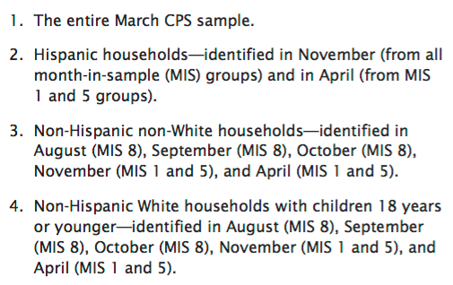
ASEC Oversample…again

Slide 5
Revisiting MARBASEC

Slide 6
MARBASECID
ASEC
March Basic
Hispanic oversample
SCHIP Oversample
MARBASECID

Slide 7
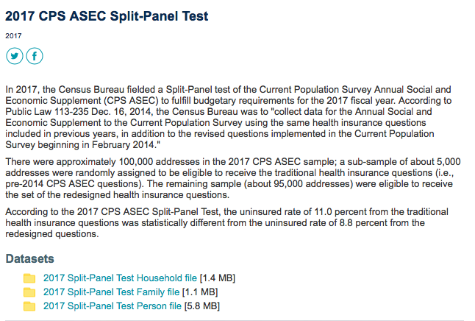
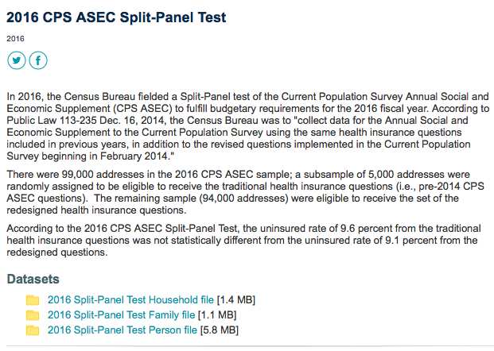
ASEC split sample in 2016 2017
Year | Obs. from March Basic not linked to ASEC
2017 | 8,615
2016 | 8,638
1996 | 951
1995 | 3
How did the questionnaire change in the CPS ASEC affect health insurance estimates in 2016?
April 2018
Working Paper Number: SEHSD-WP2018-01
Brett O’Hara and Marina Vornovitsky
https://www.census.gov/library/working-papers/2018/demo/SEHSD-WP2018-01.html
Notes:
Keep only 2017 and 2016

Slide 8
Linking families

Slide 9
Families in IPUMS CPS
Official Poverty Families
Supplemental Poverty Families
IPUMS CPS Families

Slide 10
Families and Poverty

Slide 11
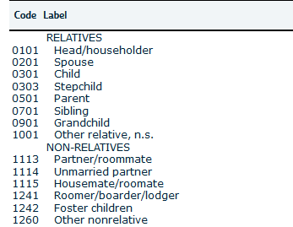
Families and Poverty
OPM
SPM

Slide 12
IPUMS Family Interrelationship
Prior to 2007, sub-family interrelationships are not available in the CPS
Cohabitors and same-sex couples are identified as well
Gorsuch and Williams. “Family matters: Development of new family interrelationship variables for US IPUMS data projects.” Journal of Economic and Social Measurement, 2017.

Slide 13
Non-householder parent locations
Parent
Child

Slide 14
Cohabitors’ children
Parent
Child
Parent

Slide 15
Same sex couples
Female
Female
Notes:
SHOW THE ATTACH CHARACTERISTICS.

Slide 16
Arrival of family member
Roster T1 | CPSIDP | Roster T2 | CPSIDP
Householder | 1000001
Spouse | 1000002
Child | 1000003

Slide 17
Arrival of family member
Roster T1 | CPSIDP | Roster T2 | CPSIDP
Householder | 1000001 | Householder | 1000001
Spouse | 1000002 | Spouse | 1000002
Child | 1000003 | Child | 1000003
 |  | Newborn | 1000004
Link using CPSIDP
Keep if _merge==3

Slide 18
Arrival of family member
Roster T1 | CPSIDP | Roster T2 | CPSIDP
Householder | 1000001 | Householder | 1000001
Spouse | 1000002 | Spouse | 1000002
Child | 1000003 | Child | 1000003
 |  | Newborn | 1000004
Link using CPSIDP
Keep if _merge==3
Roster T1 | CPSIDP | Roster T2 | CPSIDP
Householder | 1000001 | Householder | 1000001
Spouse | 1000002 | Spouse | 1000002
Child | 1000003 | Child | 1000003
 |  | Newborn | 1000004

Slide 19
Arrival of family member
Roster T1 | CPSIDP | Roster T2 | CPSIDP
Householder | 1000001 | Householder | 1000001
Spouse | 1000002 | Spouse | 1000002
Child | 1000003 | Child | 1000003
 |  | Newborn | 1000004
Drop if sex_t1!=sex_t2
Drop if race_t1!=race_t2
Run validation code
Drop if age_diff>2
Roster T1 | CPSIDP | Roster T2 | CPSIDP
Householder | 1000001 | Householder | 1000001
Spouse | 1000002 | Spouse | 1000002
Child | 1000003 | Child | 1000003
 |  | Newborn | 1000004

Slide 20
Departure and arrival
Roster T1 | CPSIDP | Roster T2 | CPSIDP
Householder | 2000001
Spouse | 2000002

Slide 21
Departure and arrival
Roster T1 | CPSIDP | Roster T2 | CPSIDP
Householder | 2000001
Spouse | 2000002 | Householder | 2000002
 |  | Adult (Child) | 2000003

Slide 22
Departure and arrival
Roster T1 | CPSIDP | Roster T2 | CPSIDP
Householder | 2000001
Spouse | 2000002 | Householder | 2000002
 |  | Adult (Child) | 2000003
Roster T1 | CPSIDP | Roster T2 | CPSIDP
Householder | 2000001
Spouse | 2000002 | Householder | 2000002
 |  | Adult (Child) | 2000003

Slide 23
Dealing with families or households
Consider adapting validation code
Missing values can represent arrivals and departures
Link just families or households
Households => CPSID
Families => CPSID + Family ID (FAMUNIT, FFPOS, SPMFAMUNIT)
Coming soon!

Slide 24
Family composition changes are common

Slide 25
Proxies and data quality flags

Slide 26
Why care about it with panels?
If analyzing transitions, you may want to know if the transition is real (think labor force, income, etc.)
Proxy responses
Item non-response imputations
If validating, you may worry that the discrepancy is from imputation

Slide 27
Household respondent
One person may provide all of the CPS data for the entire sample unit, provided that the person is a household member 15 years of age or older who is knowledgeable about the household. The person who responds for the household is called the household respondent. Information collected from the household respondent for other members of the household is referred to as proxy response. (CPS TP66 5-1)
Also, the survey instrument is structured so that every effort is made to interview the same respondent every month. (CPS TP66 15-7)

Slide 28
Reference Person
To create the household roster, the interviewer asks the household respondent to give ‘‘the names of all persons living or staying’’ in the housing unit, and to ‘‘start with the name of the person or one of the persons who owns or rents’’ the unit. The person whose name the interviewer enters on line 1 (presumably one of the individuals who owns or rents the unit) becomes the reference person. The household respondent and the reference person are not necessarily the same. For example, if you are the household respondent and you give your name ‘‘first’’ when asked to report the household roster, then you are also the reference person. If, on the other hand, you are the household respondent and you give your spouse’s name first when asked to report the household roster, then your spouse is the reference person. (CPS TP66 5-1)

Slide 29
Proxy Responses
After completing the household roster, the FR collects the labor force data described in Chapter 6. The labor force data are collected from all civilian adult individuals (age 15 and older) who do not have a usual residence elsewhere. To the extent possible, the FR attempts to collect this information from each eligible individual him/herself. In the interest of timeliness and efficiency, however, a household respondent (any knowledgeable adult household member) often provides the data. Just over one-half of the CPS labor force data are collected by self-response. CPS TP66 (7-3)

Slide 30
Some references
Kojetin, B.A. and P. Mullin (1995), ‘‘The Quality of Proxy Reports on the Current Population Survey (CPS),’’ Proceedings of the Section on Survey Research Methods, American Statistical Association, pp. 1110−1115.
Tanur, J.M. (1994), ‘‘Conceptualizations of Job Search: Further Evidence From Verbatim Responses,’’ Proceedings of the Section on Survey Research Methods, American Statistical Association, pp. 512−516
Hokayem, Charles, Christopher Bollinger, and James P. Ziliak. "The role of CPS nonresponse in the measurement of poverty." Journal of the American Statistical Association 110.511 (2015): 935-945.
Bollinger, Christopher R., et al. "Trouble in the Tails: Earnings Non-Response and Response Bias across the Distribution." Joint Statistical Meetings, Boston, August. 2014.
Bollinger, Christopher R., and Barry T. Hirsch. "Is earnings nonresponse ignorable?." Review of Economics and Statistics 95.2 (2013): 407-416.
Bollinger, Christopher R., and Barry T. Hirsch. "Match bias from earnings imputation in the Current Population Survey: The case of imperfect matching." Journal of Labor Economics 24.3 (2006): 483-519.
Krueger, Alan B., Alexandre Mas, and Xiaotong Niu. "The Evolution of Rotation Group Bias: Will the Real Unemployment Rate Please Stand Up?." Review of Economics and Statistics 99.2 (2017): 258-264.

Slide 31
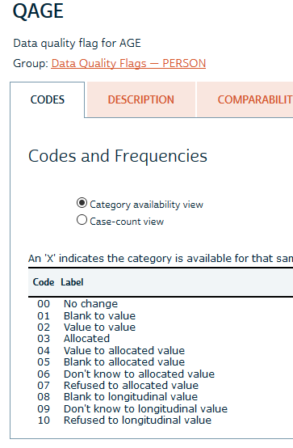
Data Quality Flags

Slide 32
Age Perturbation

Slide 33
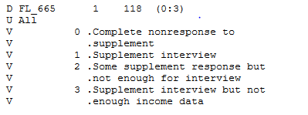
Full Line Impute: FL_665
| any_alloc
fl665 | 0 1 | Total
----------------------+----------------------+----------
Supplement interview | 1,108,053 507,425 | 1,615,478
Not enough for interv | 173,541 0 | 173,541
Not enough income dat | 14,408 0 | 14,408
----------------------+----------------------+----------
Total | 1,296,002 507,425 | 1,803,427

Slide 34
Income
FL_665
Union

Slide 35
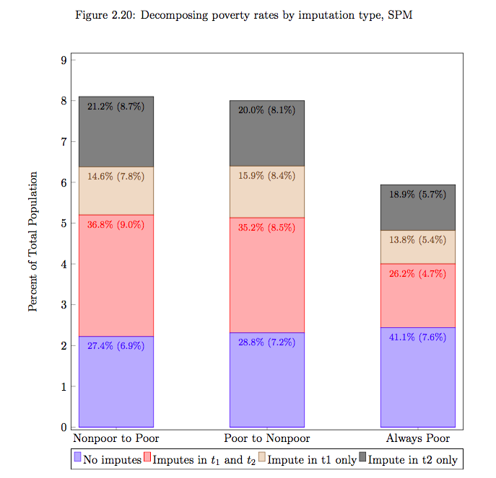
Income Changes with Imputations
Self-report → Self-report
Self-report → Imputed
Imputed → Self-report
Imputed → Imputed

Slide 36
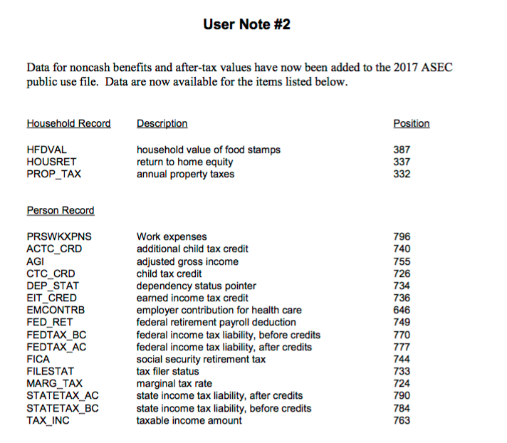
Taxes are modeled
O’Hara, Amy. "New methods for simulating CPS taxes." US Census Bureau Technical Paper (2004)
O’Hara, Amy. "Tax variable imputation in the current population survey." Department of the Treasury Internal Revenue Service 169 (2006)
Wheaton, Laura, and Kathryn Stevens. "The effect of different tax calculators on the Supplemental Poverty Measure." Urban Institute, April (2016)

Slide 37
Trivia?

Slide 38
Question 1
A dwelling is selected to be in the CPS. What is the potential maximum number of times that a person in that dwelling could be contacted for a CPS-related interview? Assuming no attrition and no non-response.
11
Hispanics in November
8 Basic Monthlies, 2 ASECs, 1 ATUS

Slide 39
Question 2
What does Stata stand for?
Nothing!
Portmanteau of statistics and data.
The correct spelling is “Stata”, please, not “STATA”. Several of the most active experts on the list can get a little irritated if you get that wrong, although you are free to regard them as pedantic. More importantly, if you write “STATA” you are making it obvious that you didn't read this guide carefully and to the end. (https://www.statalist.org/forums/help#spell)

Slide 40
Ih-PUMS or Eye-PUMS?
Ih-PUMS

Slide 41
Questions?

