Slide 1
Panel Conditioning Effects in the CPS (and Elsewhere)
Rob Warren
University of Minnesota
Andrew Halpern Manners
Indiana University

Slide 2
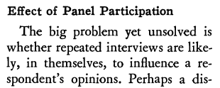
(Public Opinion Quarterly, 1940)

Slide 3
Anecdotes? Parlor Tricks?

Slide 4
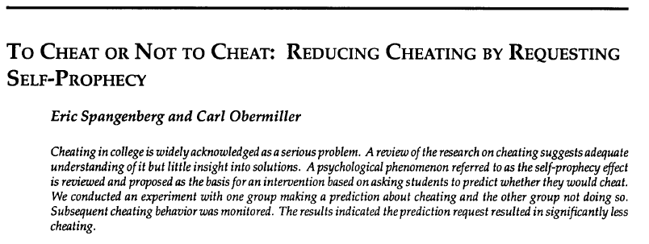
Spangenberg, E. R. and C. Obermiller. 1996. ‘‘To Cheat or Not to Cheat: Reducing Cheating by Requesting Self-Prophecy.’’ Marketing Education Review 6:95-103.

Slide 5
Godin, G., P. Sheeran, M. Conner, and M. Germain. 2008. "Asking Questions Changes Behavior: Mere Measurement Effects on Frequency of Blood Donation." Health Psychology 27:179-84.

Slide 6
Clausen, Aage. R. 1968. "Response Validity: Vote Report." Public Opinion Quarterly 32:588-606.

Slide 7
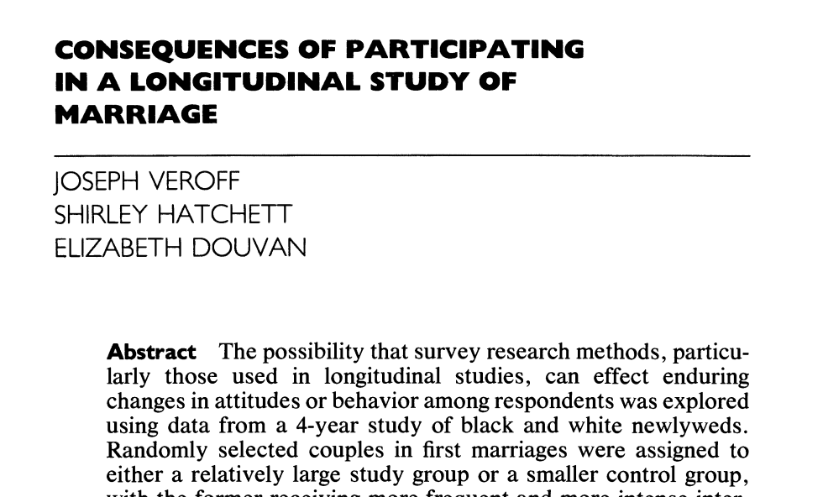
Veroff, J., S. Hatchett, and E. Douvan. 1992. "Consequences of Participating in a Longitudinal-Study of Marriage." Public Opinion Quarterly 56:315-27.

Slide 8
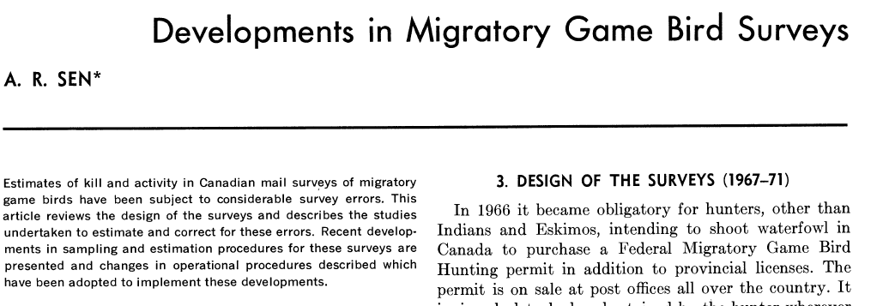
Sen, A. R. 1976. "Developments in Migratory Game Bird Surveys." Journal of the American Statistical Association 71:43-48.

Slide 9
Conceptual Cousins

Slide 10
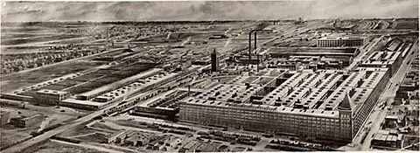
Hawthorne Effect

Slide 11
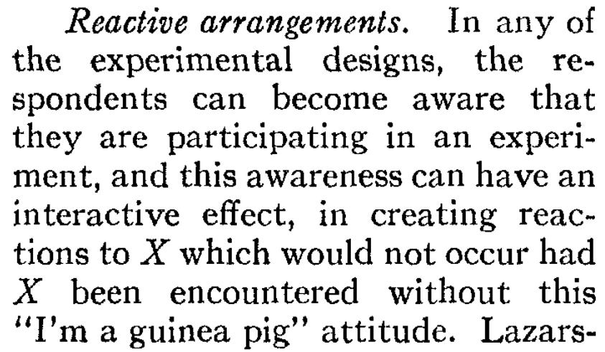
Reactivity

Slide 12
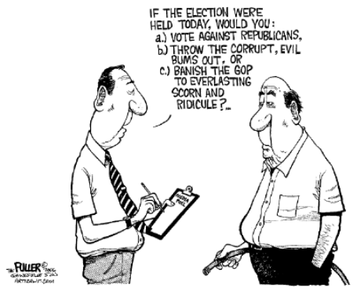
Push Polls

Slide 13
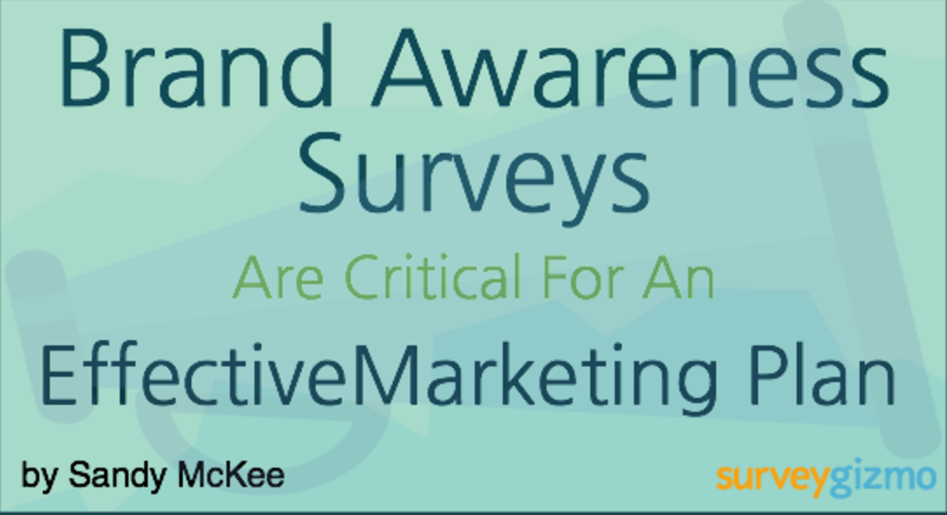
Marketing Surveys

Slide 14
Asking People Questions May
Change the Object of Study
(or at the quality of responses)

Slide 15
But This Doesn’t Happen in
the Kinds of Surveys We Care About

Slide 16
But This Doesn’t Happen in
the Kinds of Surveys We Care About
Right ?!?

Slide 17
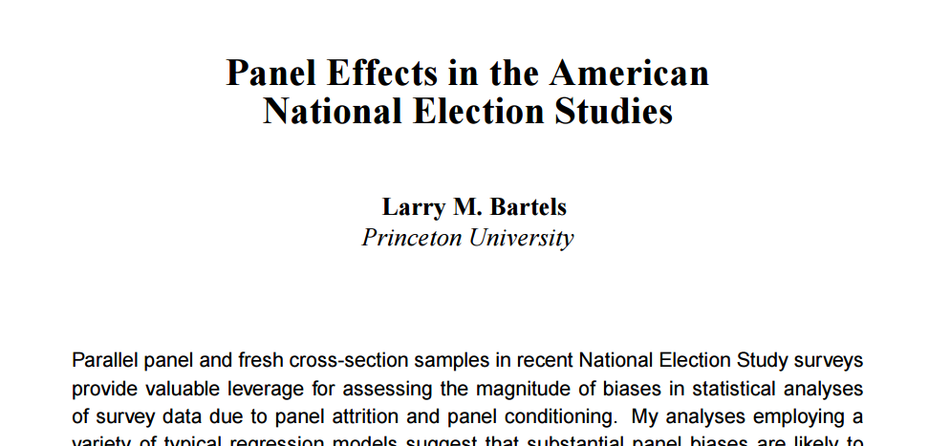
Bartels, Larry M. 1999. ‘‘Panel Effects in the American National Election Studies.’’ Political Analysis 8:1-20.

Slide 18
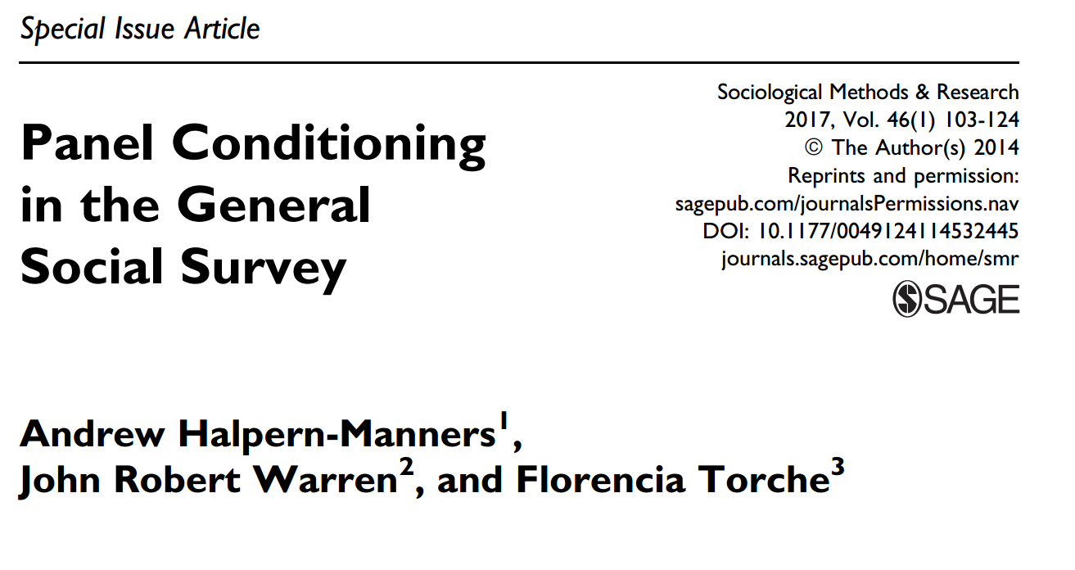
Halpern-Manners, Adrew, John Robert Warren, and Florencia Torche. 2017. “Panel Conditioning in the General Social Survey.” Sociological Methods & Research 46: 103-124.

Slide 19
Corder, Larry S. and Daniel G. Horvitz. 1989. "Panel Effects in the National Medical Care Utilization and Expenditure Survey." Pp. 304-318 in Panel Surveys, edited by D. Kasprzyk, G. J. Duncan, G. Kalton, and M. P. Singh. New York: Wiley.

Slide 20
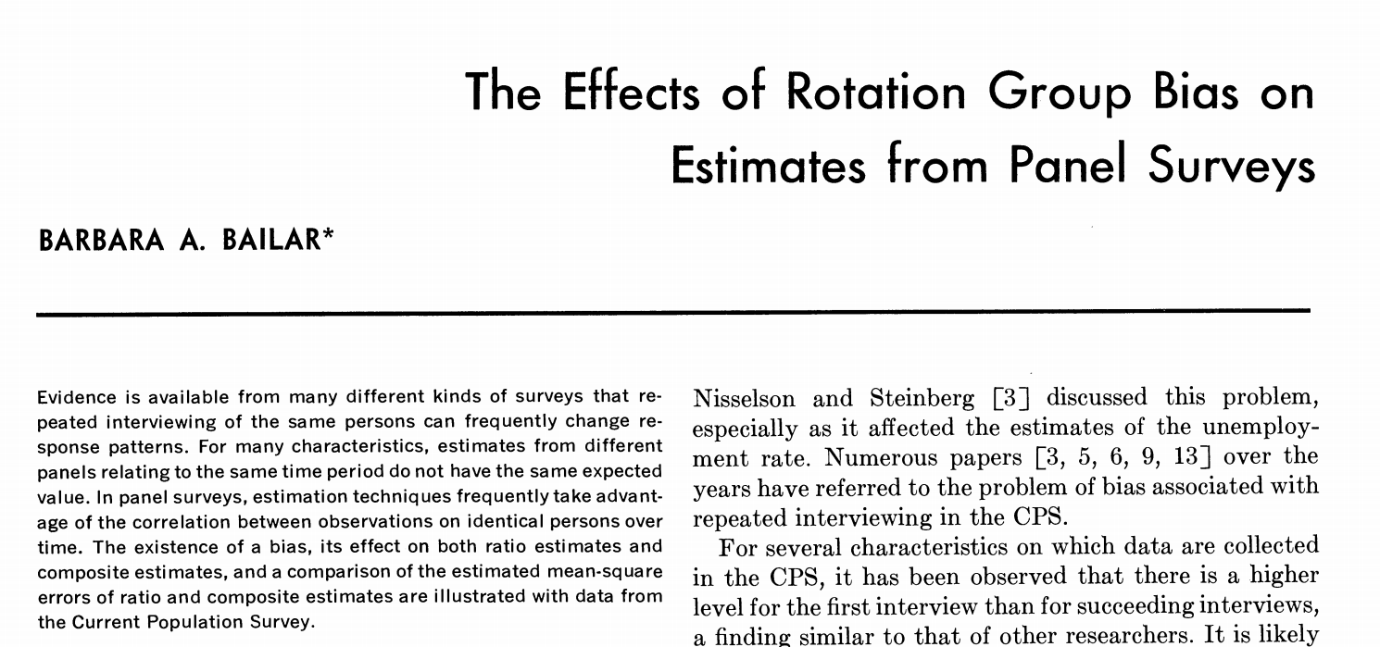
Bailar, Barbara A. 1975. "Effects of Rotation Group Bias on Estimates from Panel Surveys." Journal ofthe American Statistical Association 70:23-30.

Slide 21
Why Does This Happen?

Slide 22
Measuring Non-Existent Attitudes
“Do you think NASA spends too much or too little money developing the technology to send people to Mars?”
Time 1: “Too much!”
Interim: Thought, attention to news, research
Time 2: “About right.”

Slide 23
Generating Knowledge of or Interest in Behaviors
“Have You Enrolled in the National ‘Do Not Call’ Registry?”
Time 1: “No”
Interim: Thought, research
Time 2: “Yes”

Slide 24
Forcing People to Confront Socially Non-Normative Attitudes or Behaviors
“Do You Watch Pornographic Movies?”
Time 1: “Yes”
Interim: Feelings of shame
Time 2: “No”

Slide 25
Building Trust Relationships Over Time
“Do You Watch Pornographic Movies?”
Time 1: “No … that would be wrong”
Interim: Enhancement of trust
Time 2: “OK … yes”

Slide 26
Teaching People to Manipulate Surveys
Time 1:
Q: “Are you unemployed?”
A: “Yes”
Q: “Please answer the following 17 questions about your unemployment”

Slide 27
Teaching People to Manipulate Surveys
Time 2:
Q: “Are you unemployed?”
A: “No”

Slide 28
Teaching People to Be Better Respondents
“What is Your Home Worth?”
Time 1: “I don’t know. Maybe $250,000?”
Interim: Research
Time 2: “$221,500.”

Slide 29
The Role of Time

Slide 30
The Role of Time
Panel conditioning effects may be especially pronounced when survey waves are closer together in time.

Slide 31
Methods for Assessing
Panel Conditioning Bias

Slide 32
Time 1
Time 2
X_{A,1}
X_{A,2}
Group A
Panel Conditioning =

Slide 33
Time 1
Time 2
X_{A,1}
X_{A,2}
Group A
Panel Conditioning = X_{A,2} – X_{A,1}

Slide 34
Conflates panel conditioning with actual change and with panel attrition
Time 1
Time 2
X_{A,1}
X_{A,2}
Group A
Panel Conditioning = X_{A,2} – X_{A,1}

Slide 35
Time 1
Time 2
X_{A,1}
X_{A,2}
Group A
X_{B,2}
Group B
Panel Conditioning =

Slide 36
Time 1
Time 2
X_{A,1}
X_{A,2}
Group A
X_{B,2}
Group B
Panel Conditioning = X_{A,2} – X_{B,2}

Slide 37
Conflates panel conditioning with panel attrition
Time 1
Time 2
X_{A,1}
X_{A,2}
Group A
X_{B,2}
Group B
Panel Conditioning = X_{A,2} – X_{B,2}

Slide 38
Time 1
Time 2
X_{T,1}
X_{T,2}
Group T
X_{C,1}
X_{C,2}
Group C
Panel Conditioning =

Slide 39
Time 1
Time 2
X_{T,1}
X_{T,2}
Group T
X_{C,1}
X_{C,2}
Group C
Panel Conditioning = X_{T,2} – X_{C,2}

Slide 40
OK if treatment is unrelated to risk of attrition
Time 1
Time 2
X_{T,1}
X_{T,2}
Group T
X_{C,1}
X_{C,2}
Group C
Panel Conditioning = X_{T,2} – X_{C,2}

Slide 41
Experimental Designs
Mainstay of research in marketing, political science, cognitive psychology, internet panels
Costly for larger longitudinal surveys to implement

Slide 42
Torche, Florencia, John Robert Warren, and Andrew Halpern-Manners. 2012. ‘‘Panel Conditioning in a Longitudinal Study of Chilean Adolescents’ Substance Use: Evidence from an Experiment.’’ Social Forces. 90:891-918.

Slide 43
Time 1
Time 2
Time 3
X_{T,1}
X_{T,2}
Group T
X_{C,2}
X_{C,3}
Group C
Panel Conditioning =

Slide 44
Time 1
Time 2
Time 3
X_{T,1}
X_{T,2}
Group T
X_{C,2}
X_{C,3}
Group C
Panel Conditioning = X_{T,2} – X_{C,2}

Slide 45
Some loss of external validity
Time 1
Time 2
Time 3
X_{T,1}
X_{T,2}
Group T
X_{C,2}
X_{C,3}
Group C
Panel Conditioning = X_{T,2} – X_{C,2}

Slide 46
Rotating Panel Designs
Current Population Survey; General Social Survey; Consumer Expenditure Survey; Medical Expenditure Panel Survey
Little cost for at least checking for panel conditioning

Slide 47
Month 1
Month 2
Month 3
X_{T,1}
X_{T,2}
Group T:
Start CPS in
Month 1
X_{C,2}
X_{C,3}
Group C:
Start CPS in
Month 2

Slide 48
= Second Month in CPS

Slide 49
= Second Month in CPS
= First Month in CPS

Slide 50
= Second Month in CPS
= First Month in CPS

Slide 51
= Second Month in CPS
= First Month in CPS

Slide 52
= Second Month in CPS
= First Month in CPS

Slide 53
= 1st Month in CPS — 2nd Month in CPS

Slide 54
= 1st Month in CPS — 2nd Month in CPS

Slide 55
= 1st Month in CPS — 2nd Month in CPS

Slide 56
-1%
0%
+1%
+2%

Slide 57
-1%
0%
+1%
+2%

Slide 58
-1%
0%
+0.32%
+1%
+2%

Slide 59
Recommendation
Always check for panel conditioning!

Slide 60
Analogy to Random Measurement Error
We all know it is a potential problem
We almost never think about it

Slide 61
Thank you

Slide 62
Thank you
John Robert Warren and Andrew Halpern-Manners. 2012. “Panel Conditioning Effects in Longitudinal Social Science Surveys.” Sociological Methods and Research 41: 491-534.
Andrew Halpern-Manners and John Robert Warren. 2012. “Panel Conditioning in the Current Population Survey: Implications for Education, Labor Force, and Demographic Statistics.” Demography 49: 1499-1519.
Florencia Torche, John Robert Warren, Andrew Halpern-Manners, and Eduardo Valenzuela. 2012. “Panel Conditioning in a Longitudinal Study of Chilean Adolescents' Substance Use: Evidence from an Experiment.” Social Forces 90:891-918.
Andrew Halpern-Manners, John Robert Warren, and Florencia Torche. 2014. “Panel Conditioning in a Longitudinal Study of Illicit Behaviors.” Public Opinion Quarterly 78:565-590.
Andrew Halpern-Manners, John Robert Warren, and Florencia Torche. 2017. “Panel Conditioning in the General Social Survey.” Sociological Methods and Research 46: 103-124.

