Slide 1
CPS Rotation Pattern

Slide 2
Defining Terms
Rotation Pattern: The way households move through the CPS
Month in sample (MIS): The term CPS uses to index where a household is in the CPS rotation pattern
CPS Cohort: The term we use to describe a group of households that started the CPS at the same time and move through the CPS together

Slide 3
Rotation Pattern
4-8-4
In 4 months
MIS 1, 2, 3, 4
Out 8 months
No MIS values because not in survey
In 4 months
MIS 5, 6, 7, 8

Slide 4
Rotation Groups
Indexed by MIS
8 rotation groups (cohorts) in the sample during every month (overlap of cohorts)
In every month, 1/8 of sample is interviewed for the
First time
Second time
… Eighth (last) time
The 1/8 interviewed for the first time replaces the 1/8 interviewed for the last time in the previous month
Rotation groups 4 & 8 are called “outgoing rotation groups” because they are exiting the survey

Slide 5
Notes:
A household, let's call it 'A', enters the survey…

Slide 6
Notes:
…and is surveyed for four consecutive months

Slide 8
Notes:
This household is then not surveyed for the next 8 months.

Slide 9
Notes:
Household 'A' then re-enters the survey for the next 4 months.
After which, the household exits the survey for good.

Slide 13
Notes:
A household's position in this rotation pattern is indicated by the variable "month-in-sample"

Slide 15
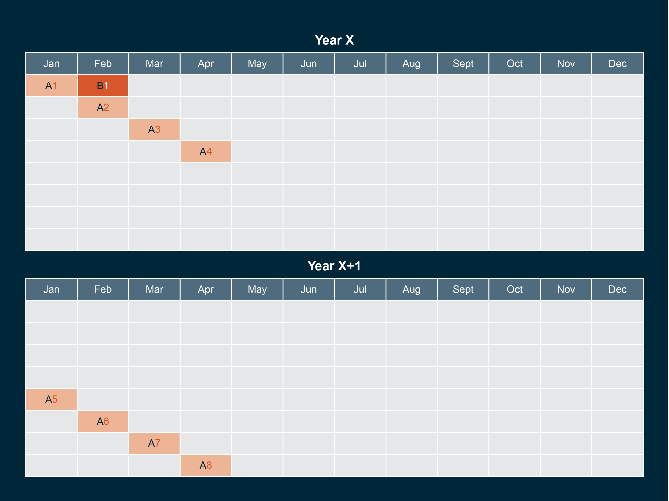
Notes:
New households enter and already-surveyed households exit the CPS every month

Slide 16
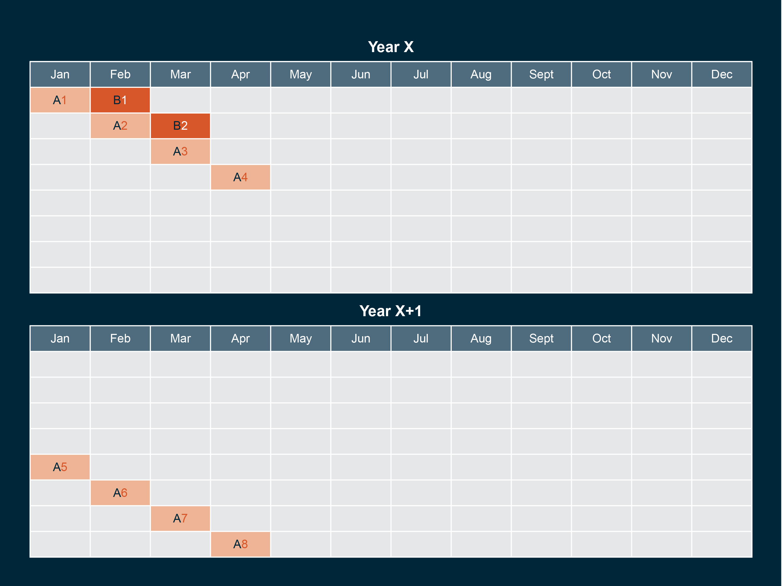

Slide 17
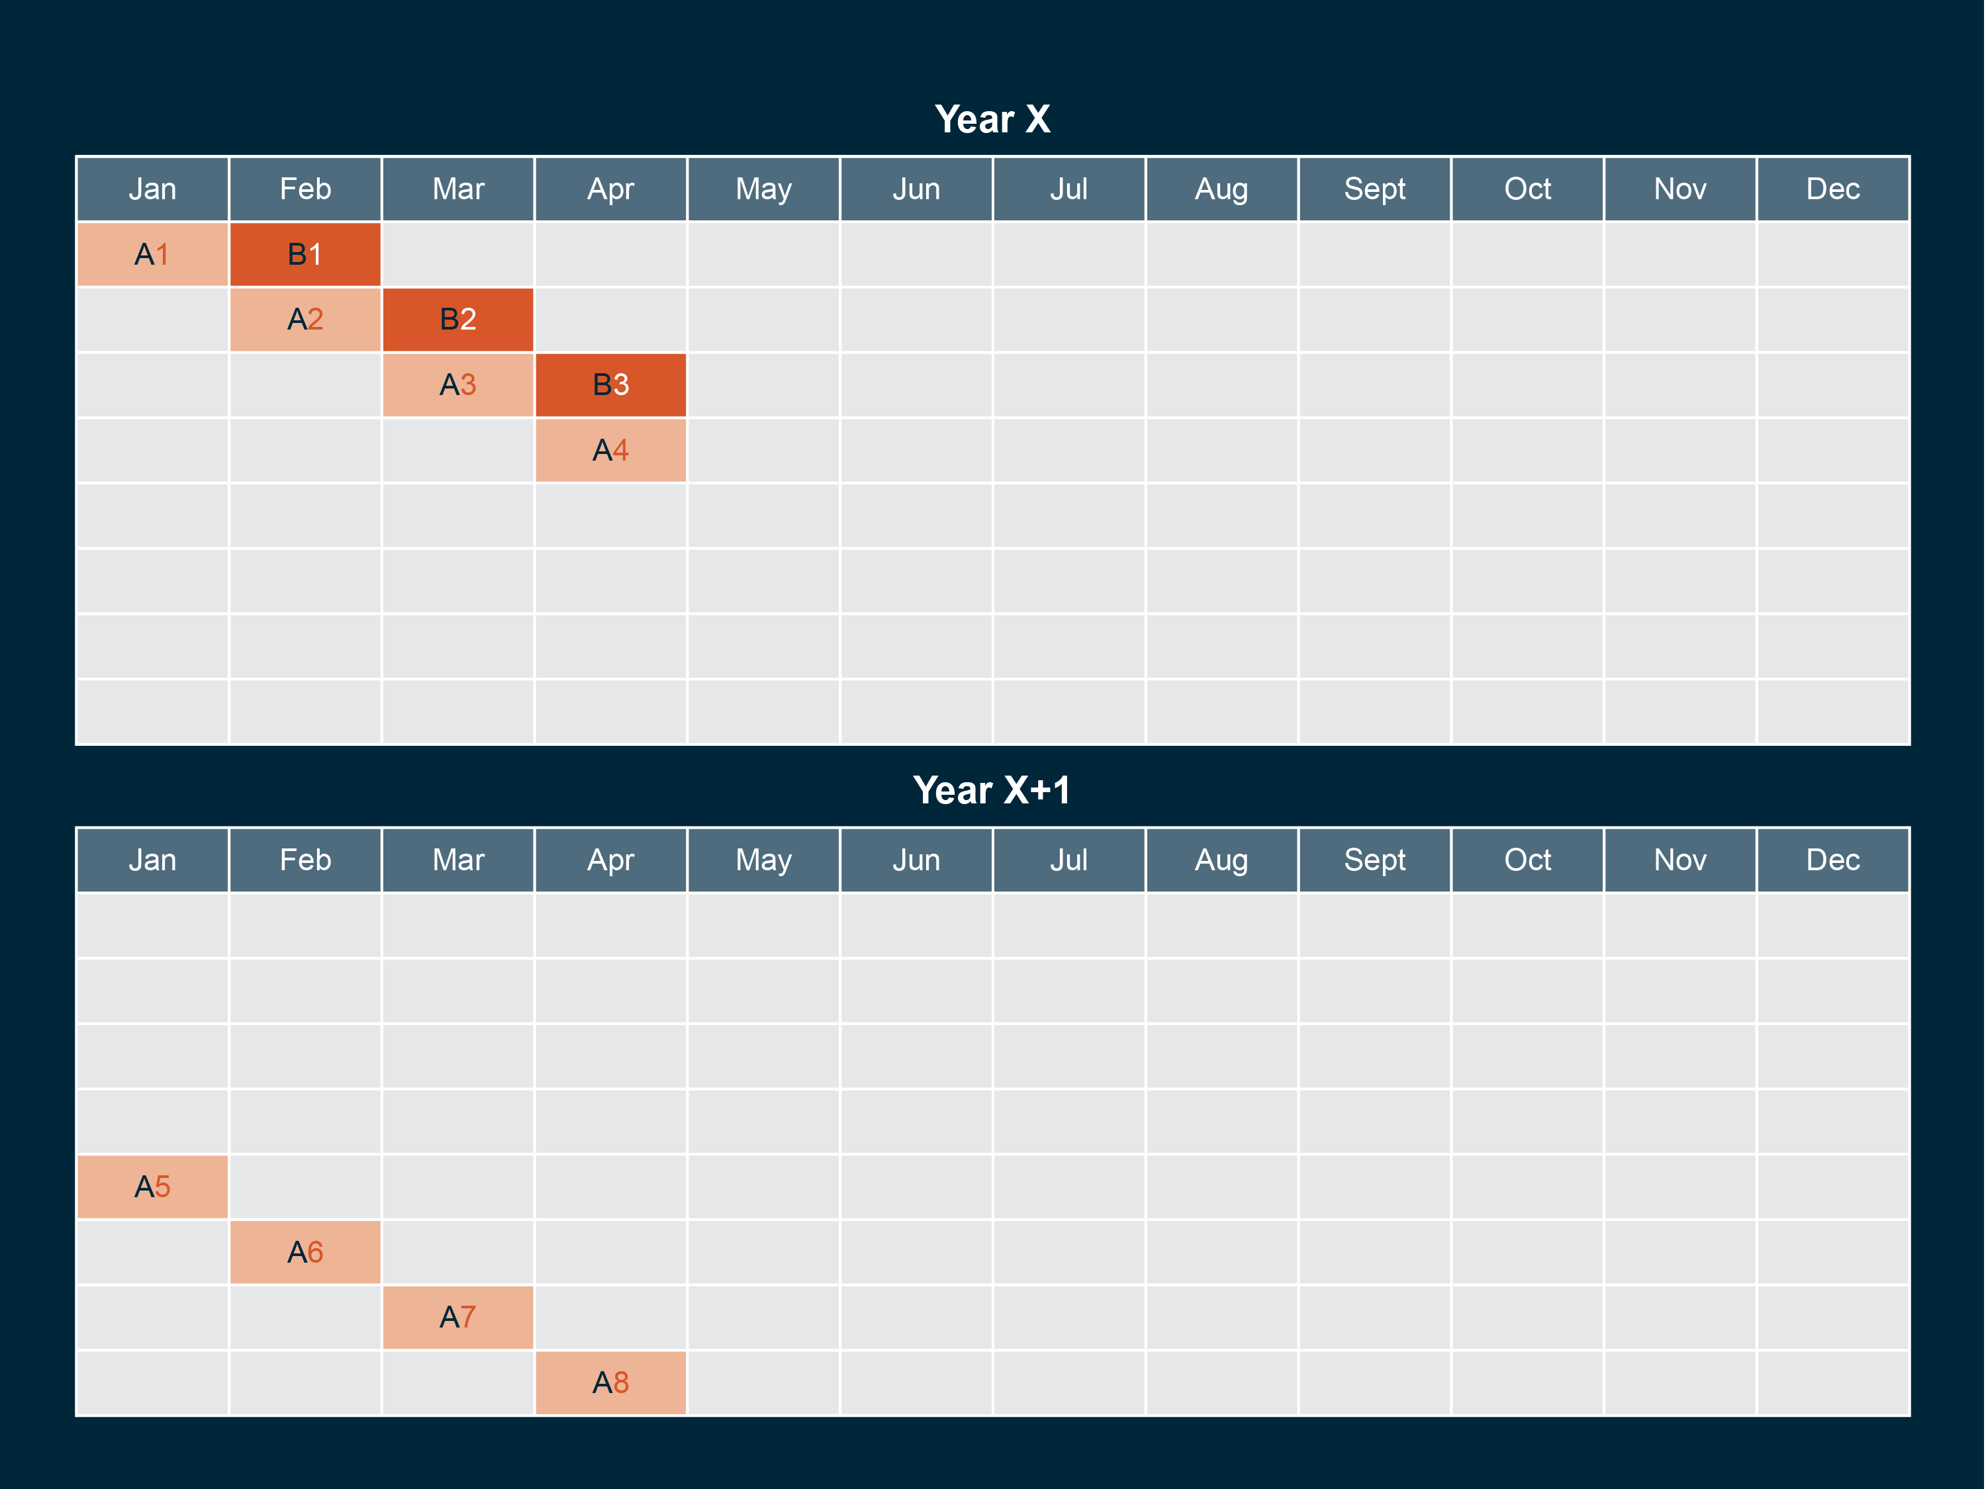

Slide 18
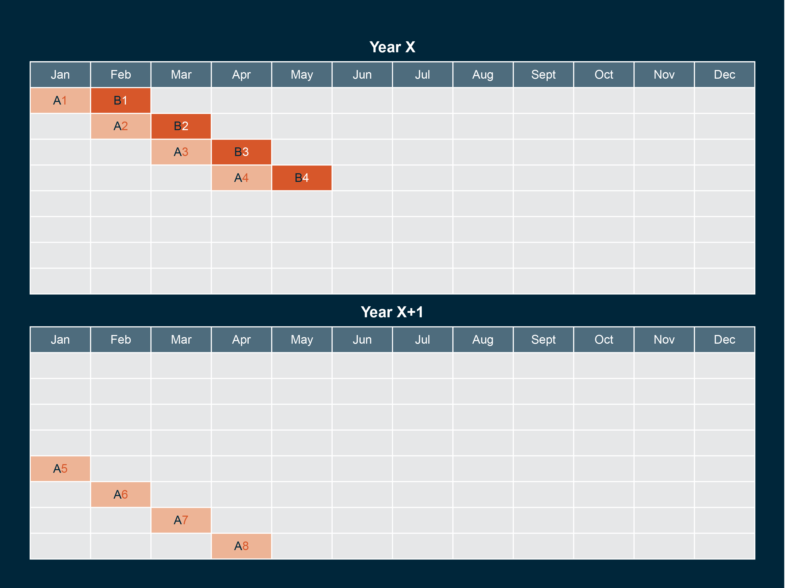

Slide 19
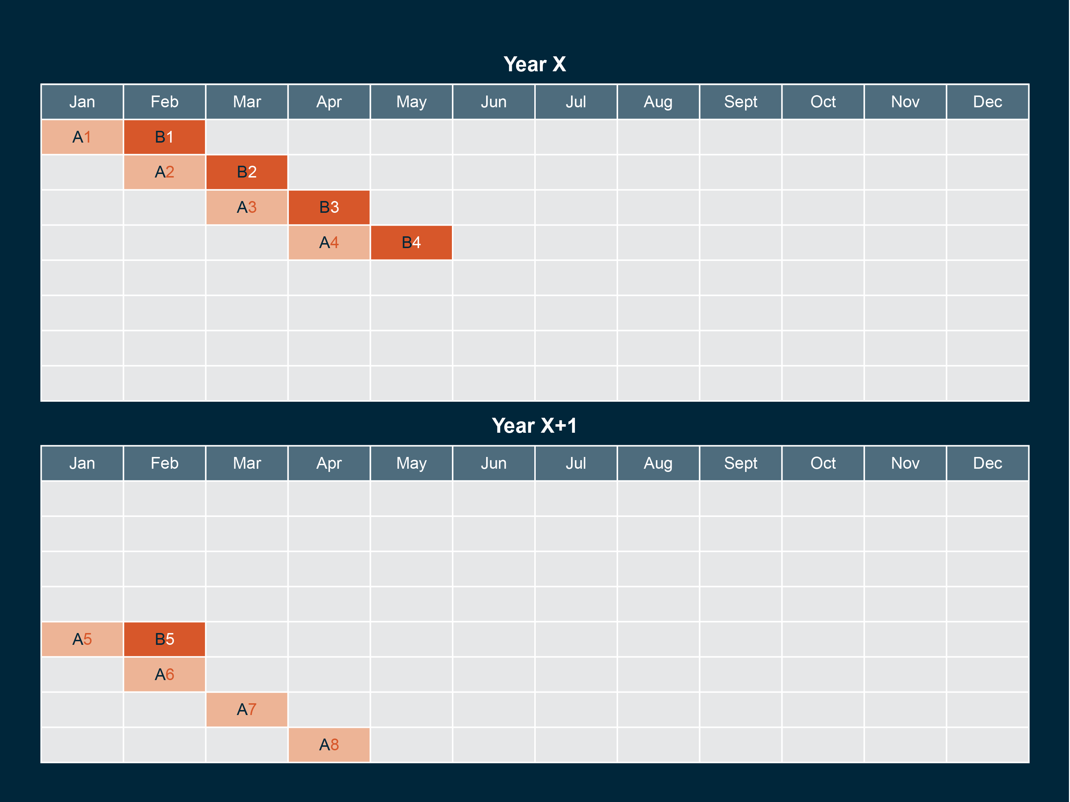

Slide 20
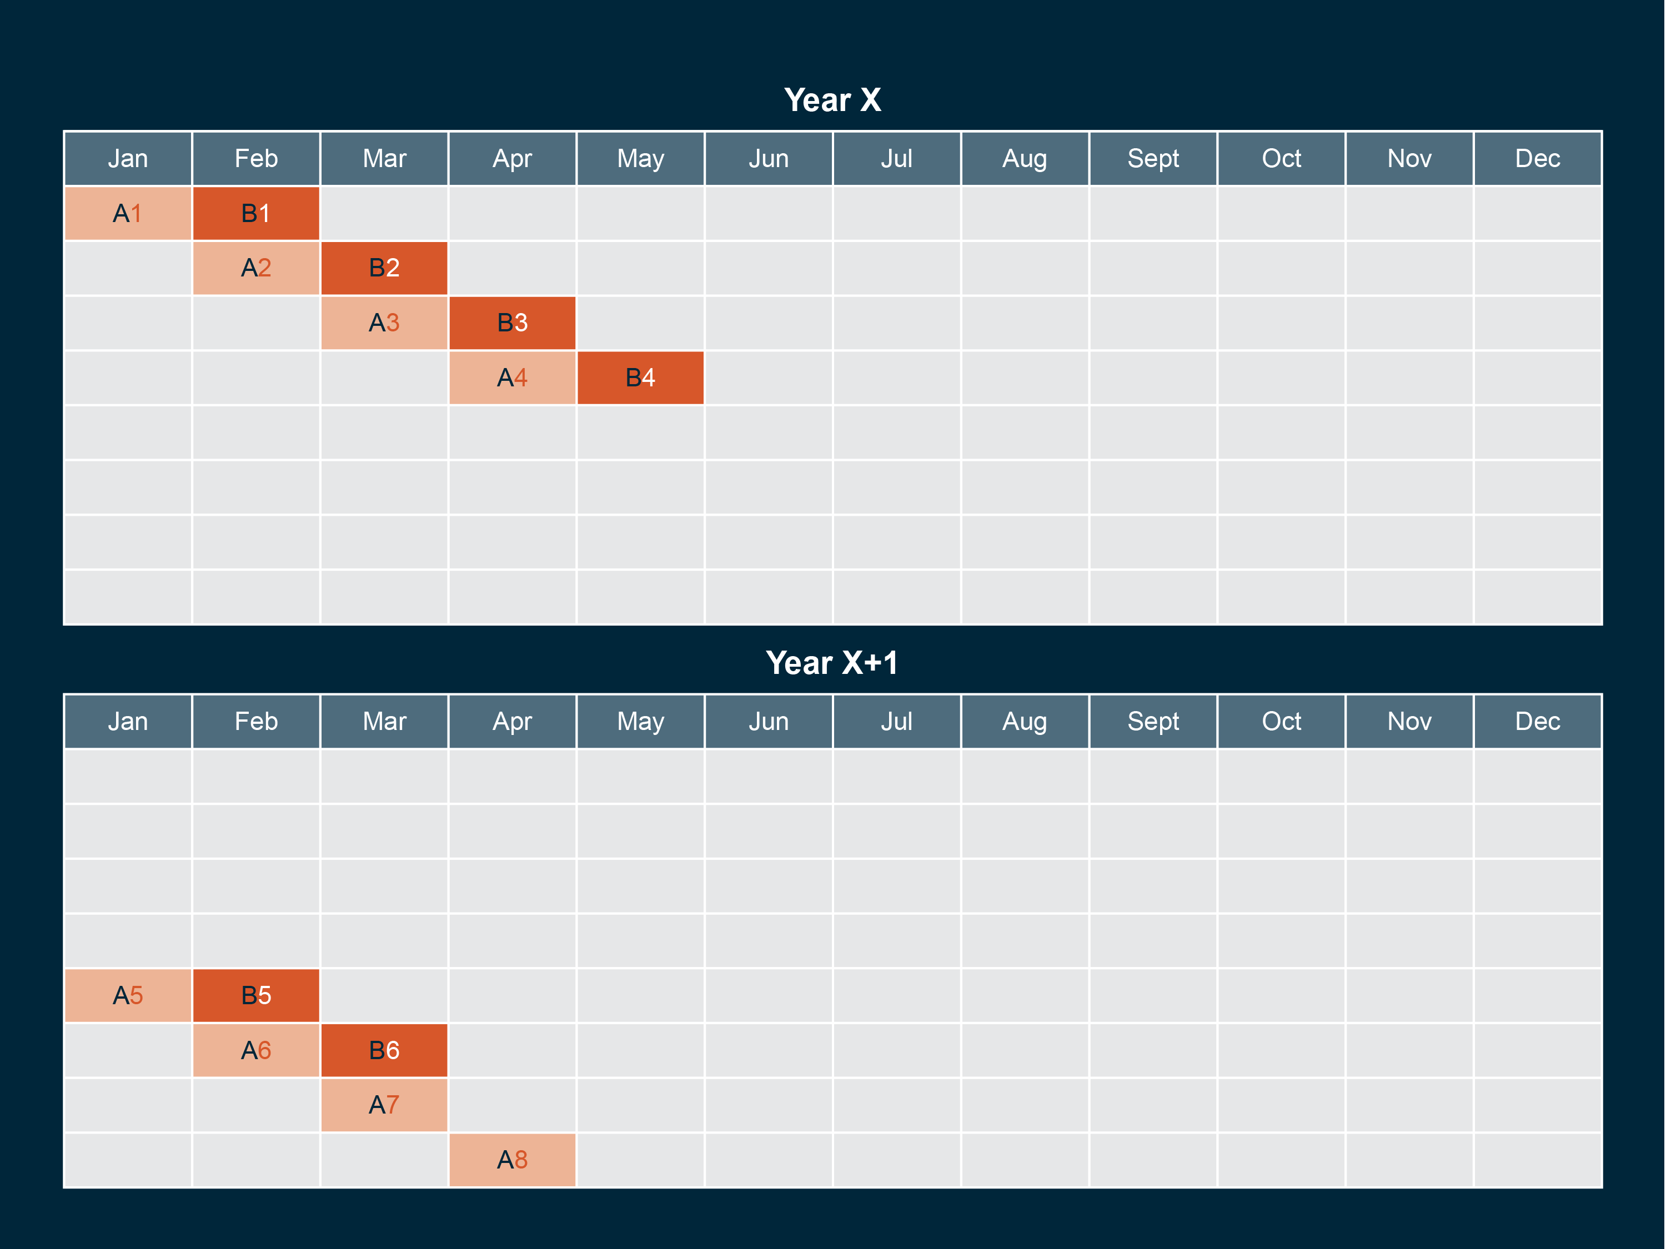

Slide 23
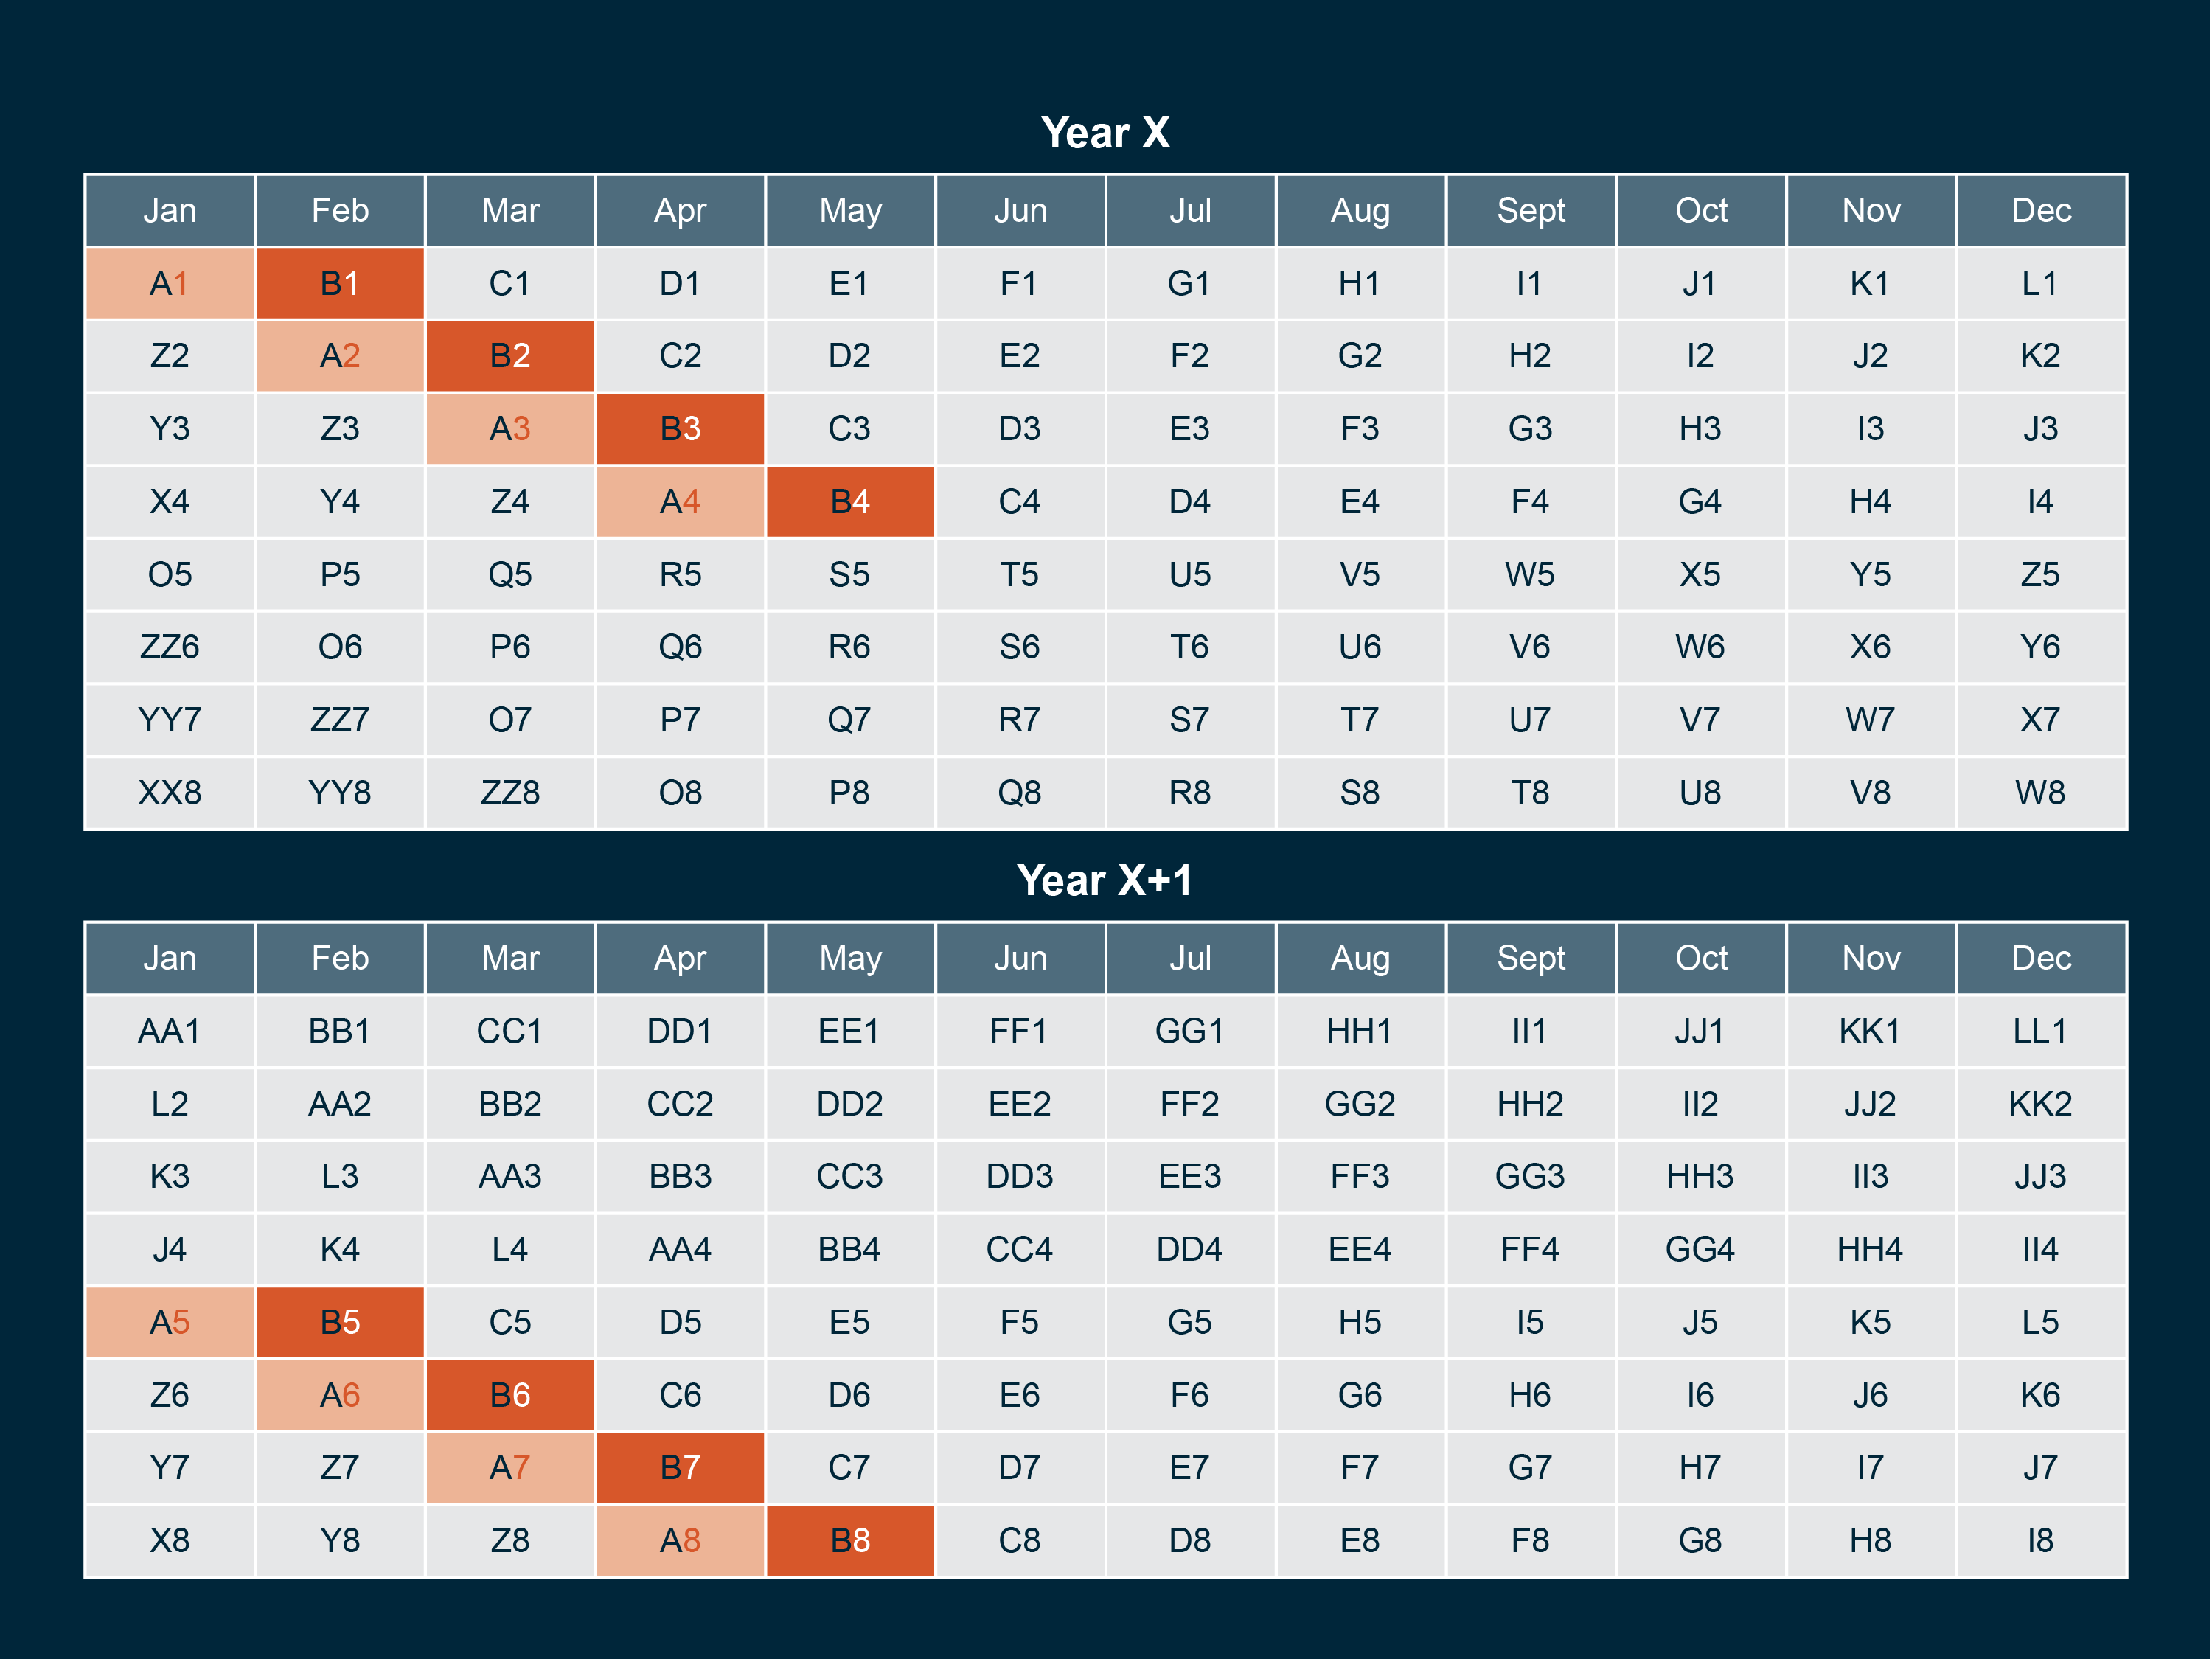

Slide 24
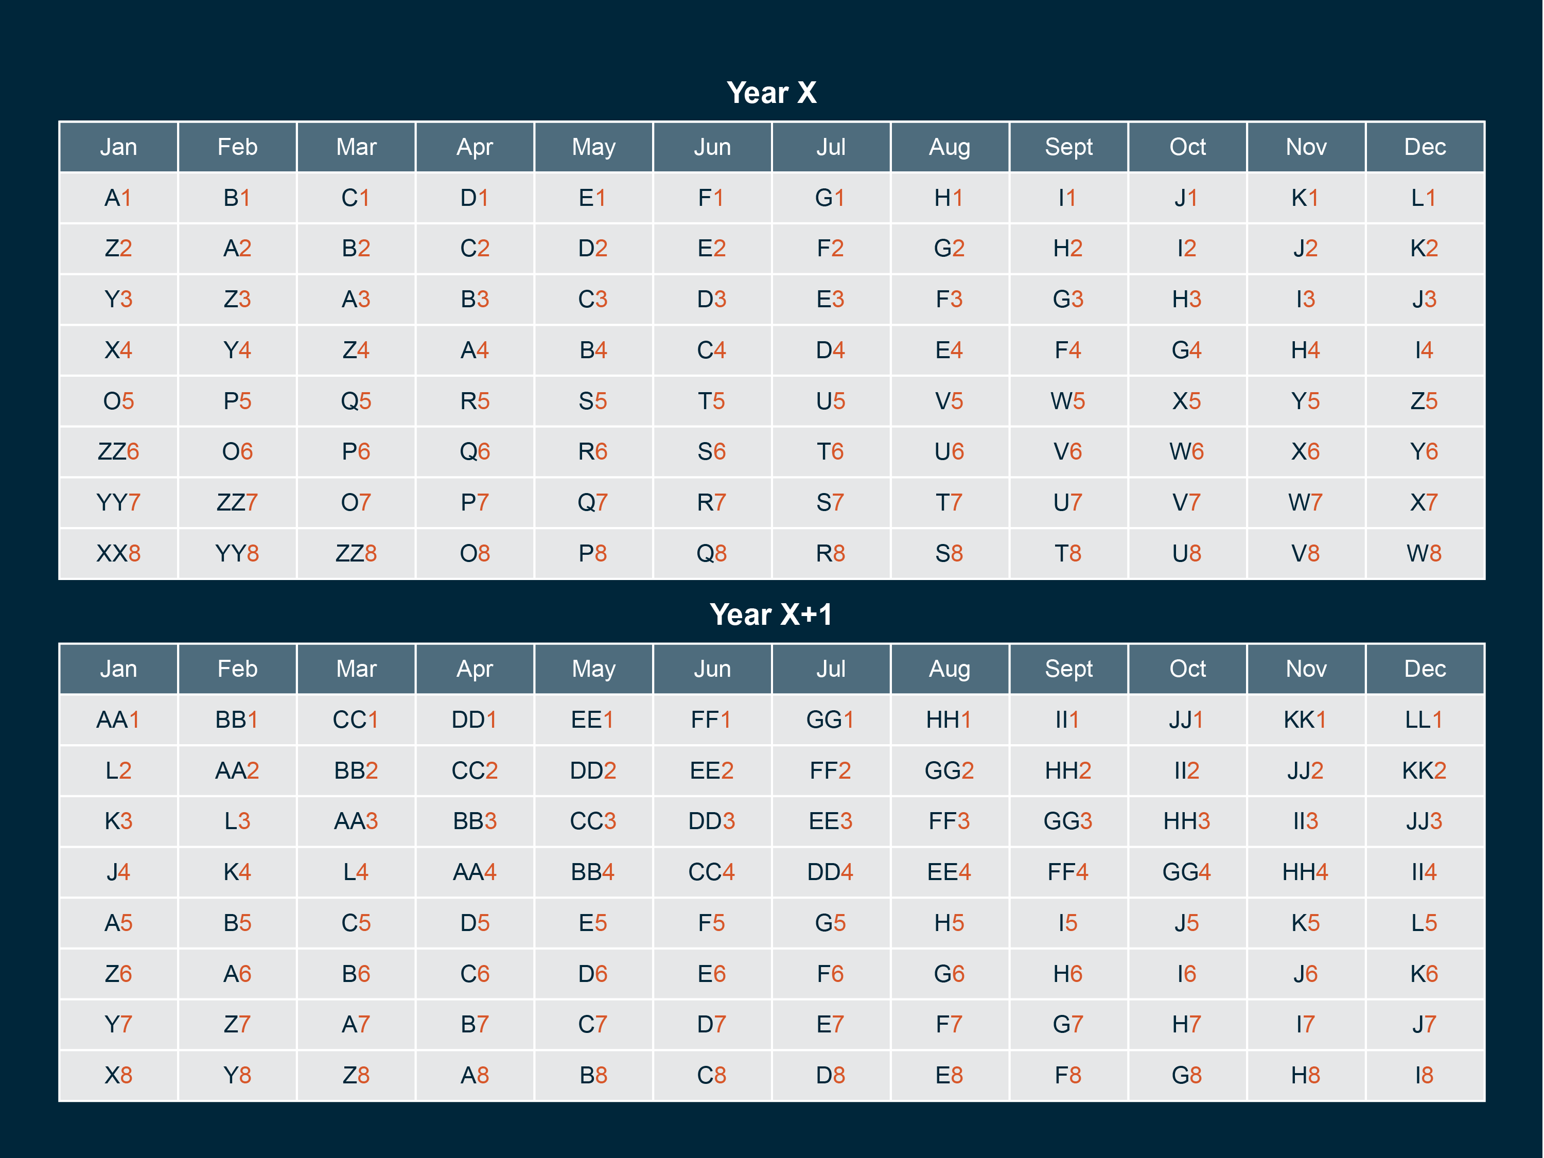
Notes:
Therefore, each month of the Current Population survey contains households at every stage of the panel rotation (that is, with every value of "month-in-sample")

Slide 25
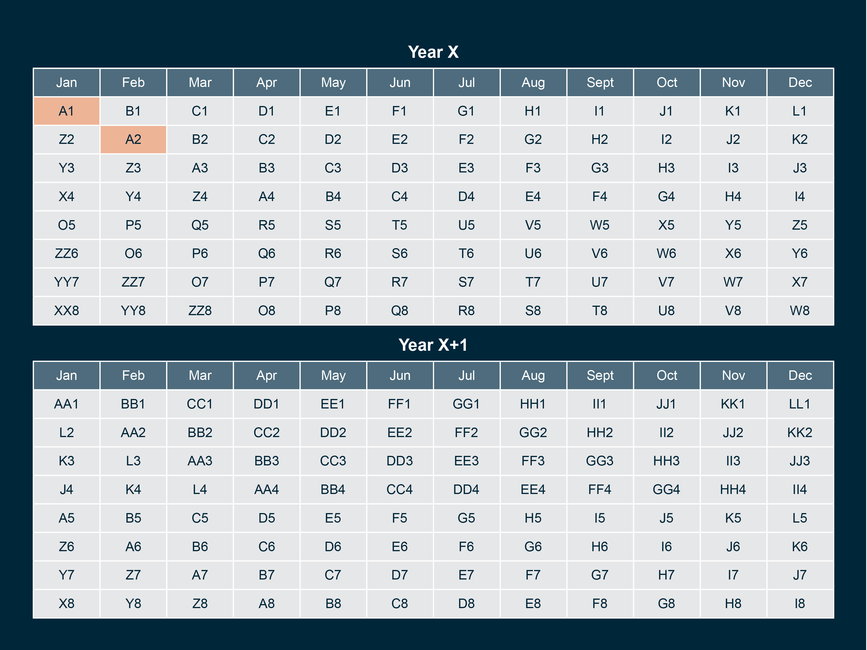
Notes:
Cohorts can link across months. As you can see, cohort A from January can link to cohort A in February,

Slide 26
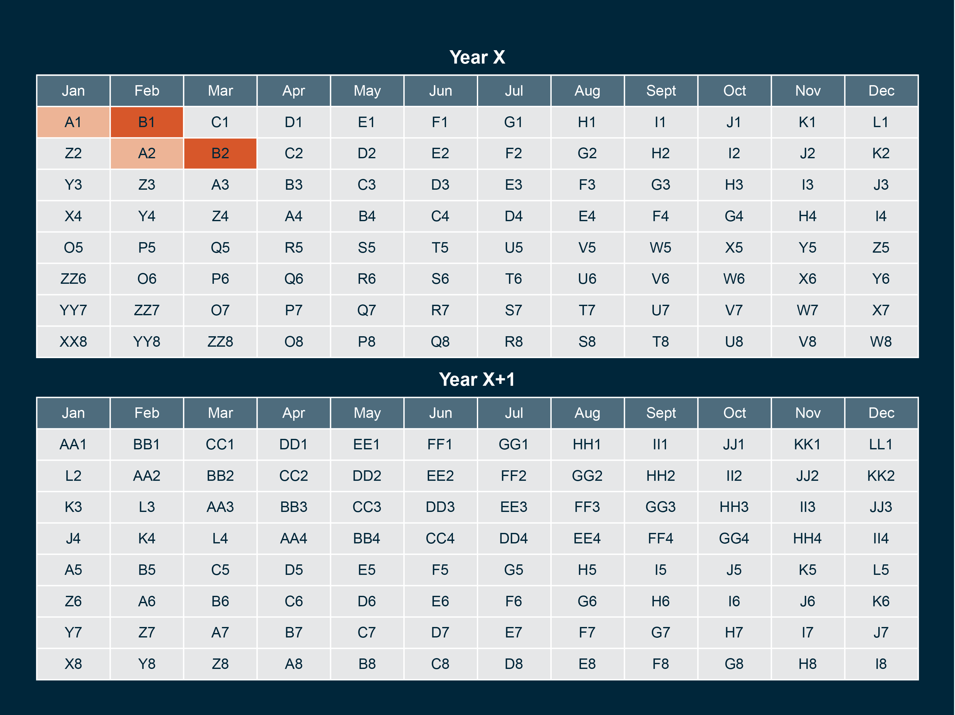
Notes:
and cohort B in February can link to cohort B in March. However, the panel rotation pattern has important implications for which months are linkable and linkage rates between linkable samples.

Slide 27
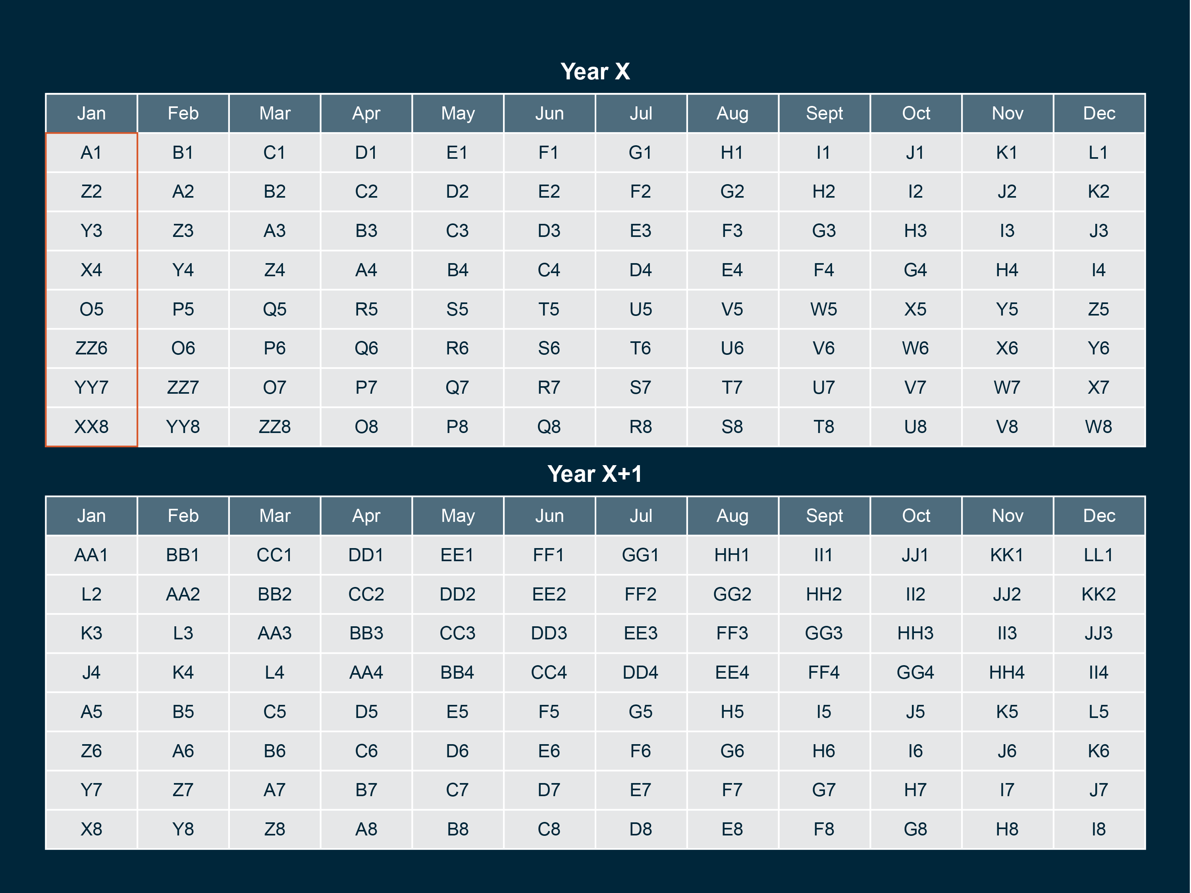
Notes:
This is “overlap” of cohorts. At any given time there are 8 cohorts in the CPS. To illustrate, let's choose January of Year X as our focal month

Slide 28
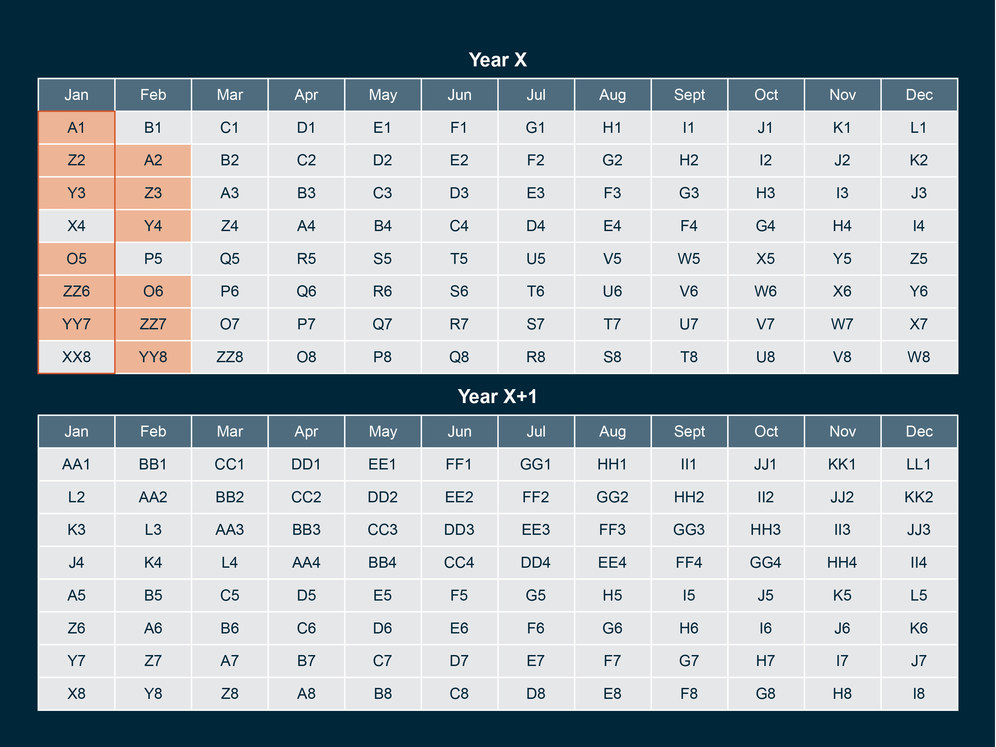
Notes:
A subset of those cohorts appear in the next month. Cohorts in MIS 1-3 in January of year X and cohorts in MIS 5-7 in January of Year X can be linked to February of year X

Slide 29
Notes:
However, cohorts X and XX in January of Year X, cannot be linked to February of Year X, as cohort X begins the 8-month break, and cohort XX exits the survey for good
Thus, even in adjacent months, only 75% of the records from the focal month will link across months.

Slide 30
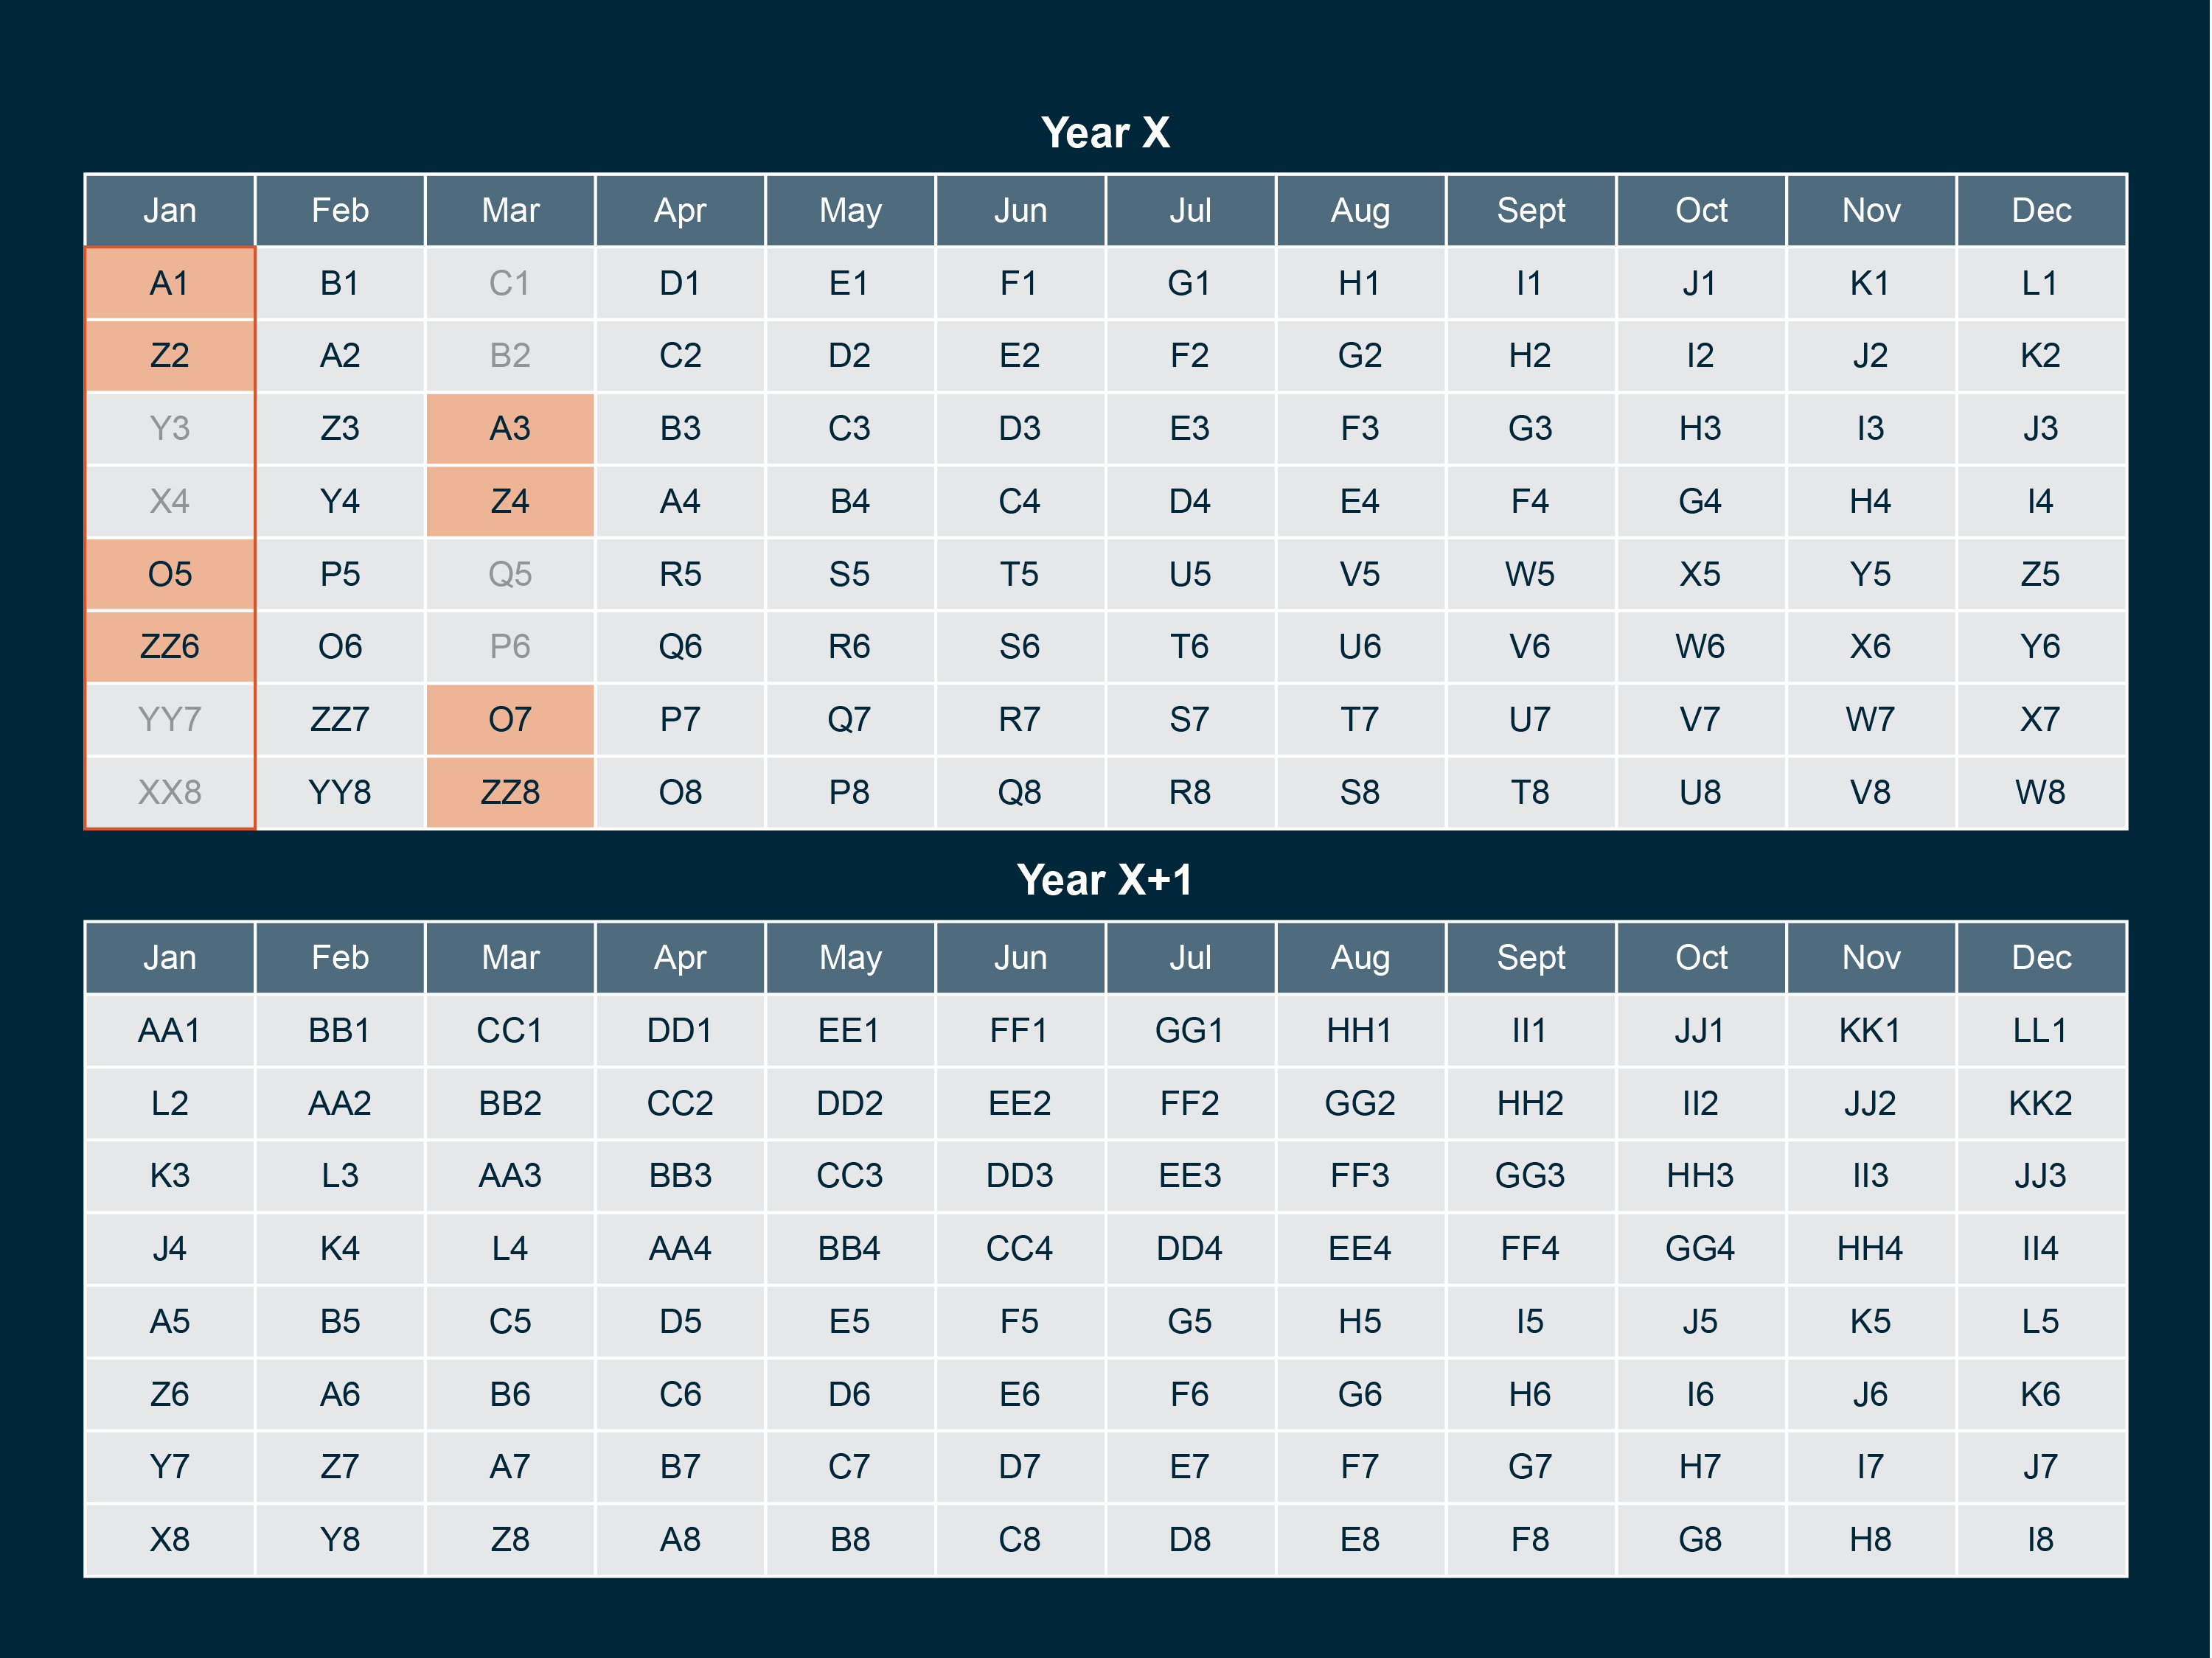
Notes:
A smaller subset appears two months ahead. When we link January to March of Year X, only half of the cohorts appear in both months.

Slide 31
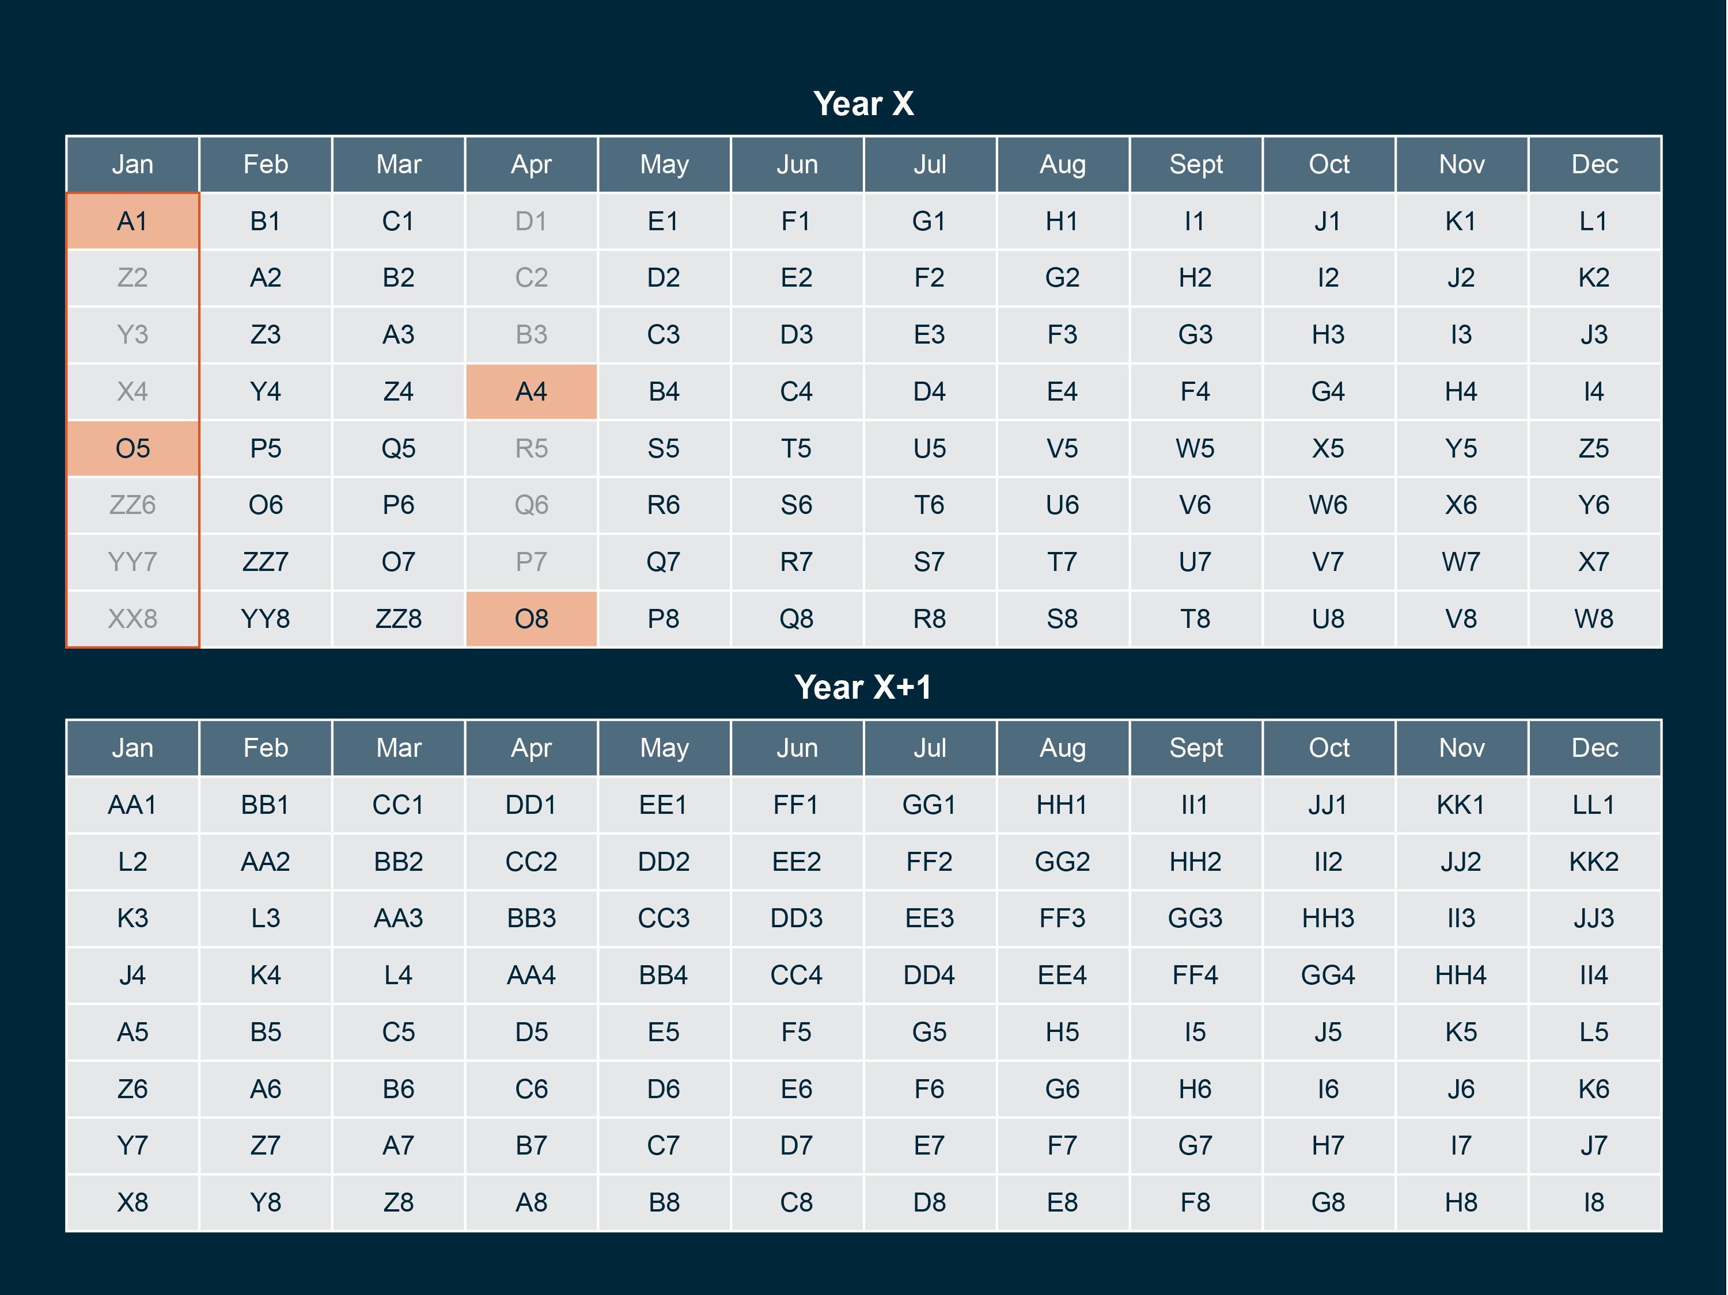
Notes:
An even smaller subset appears three months ahead. If we link January to April of Year X, only 2 of 8 cohorts overlap.

Slide 32
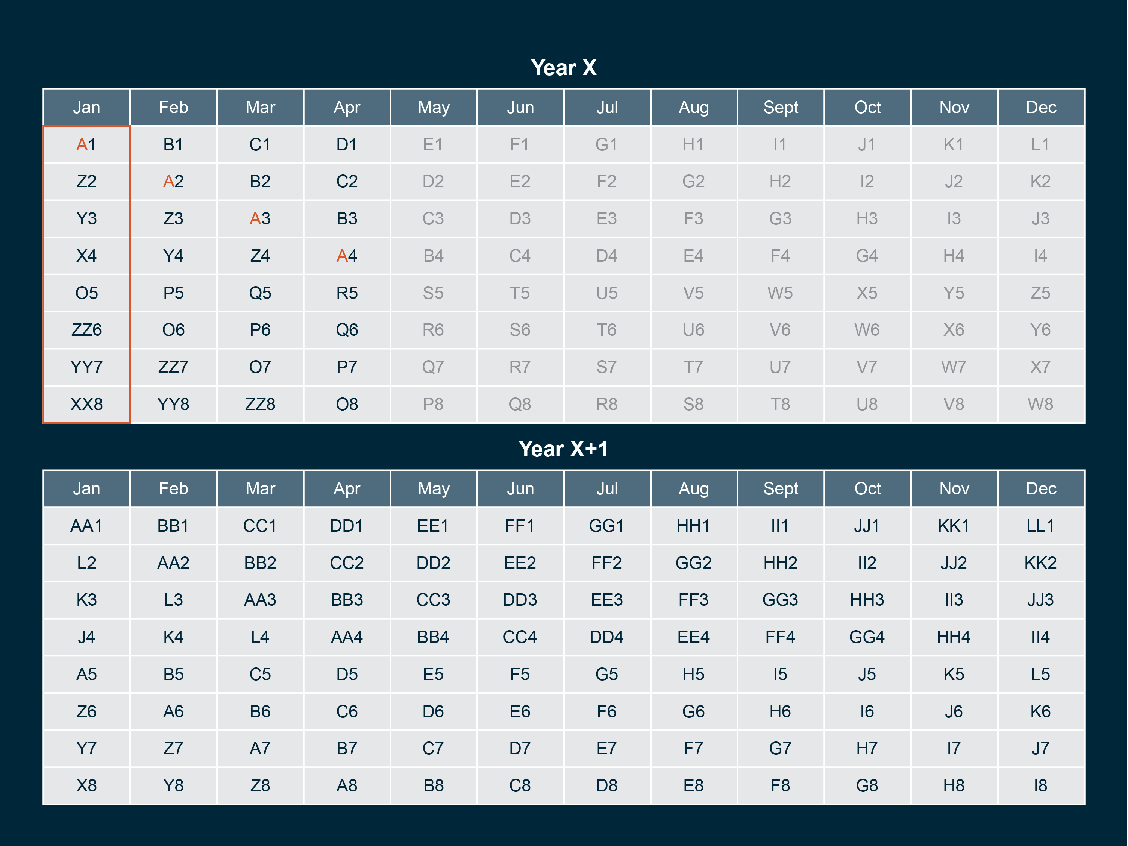
Notes:
Notice that cohort A does not appear in year X after April. Cohort A is thus not linkable to months May-Dec of Year X

Slide 33
Notes:
The next possible month to which cohort A can be linked is January of Year X+1
Understanding which months can and cannot link, and how big the resulting linked sample will be is important for knowing what information can and cannot be combined in the CPS.

Slide 34
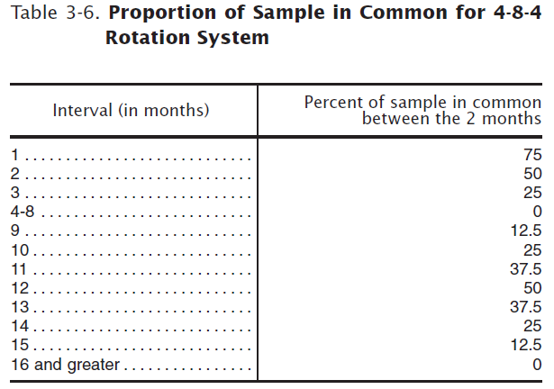
Notes:
This is a reference table that communicates the overlap between months that I just showed you visually. 16 months after a focal month, no one who was in the focal month will remain in CPS.

Slide 35
RoPES
Rotation Pattern Exploration Station
(we’re open to other names, so please suggest!)

Slide 36
Time in the CPS

Slide 37
Month in Sample
Month in sample (MISH in IPUMS): The term CPS uses to index where a household is in the CPS rotation pattern
Values range from 1 to 8 for households
Theoretically MIS is a reliable indicator of time
…But because of non-response, you might not always see the same individual in the CPS 8 times

Slide 38
Time as distinct from MIS
Number of times an individual is observed
# of distinct MIS values per person is fine
Maximum MIS value may mask individual non-response
Creating a new time variable to index each time you see a person
Maximum value of new time variable would indicate number of times an individual was observed
Combining two months of data
MIS is useful for figuring out who is eligible
A more generic variable indicating time (1 or 2) might be better for looking at change

Slide 39
Ex. Month to Month Linkage
MIS (January) | MIS (February)
1 | 2
2 | 3
3 | 4
4 | OUT
5 | 6
6 | 7
7 | 8
8 | OUT
TIME 1 TIME 2
TIME as Relative (months) instead of as MIS
Notes:
In this simple example, it doesn’t really matter which MIS people are in as long as they are in both months. So it makes more sense to think about time in the CPS as time 1 and time 2 rather than MIS ½, 2/3, etc.

Slide 40
Questions?

