Slide 1

A Brief History of

Slide 2
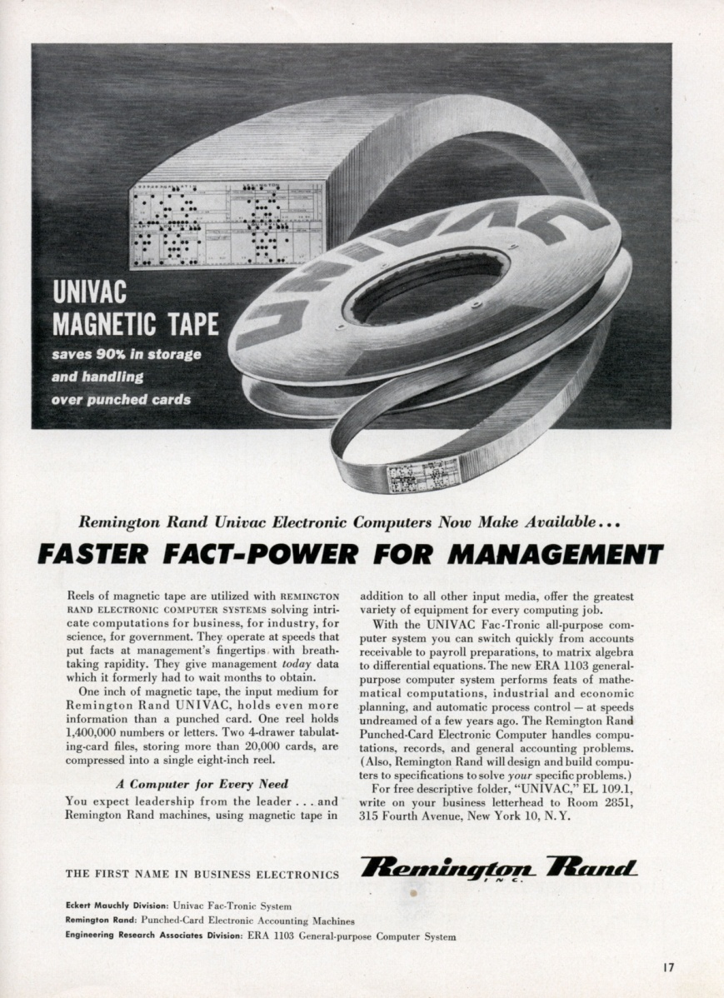
The First Microdata: The 1960 Census Samples
Distributed on 13 Univac Tapes
(or 18,000 punchcards)
Cover, 1960 Census Microdata Codebook

Slide 3
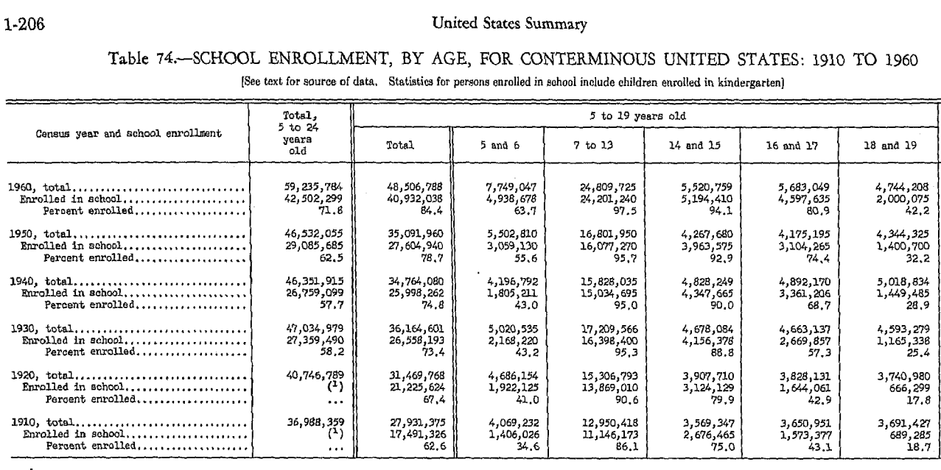

Slide 4
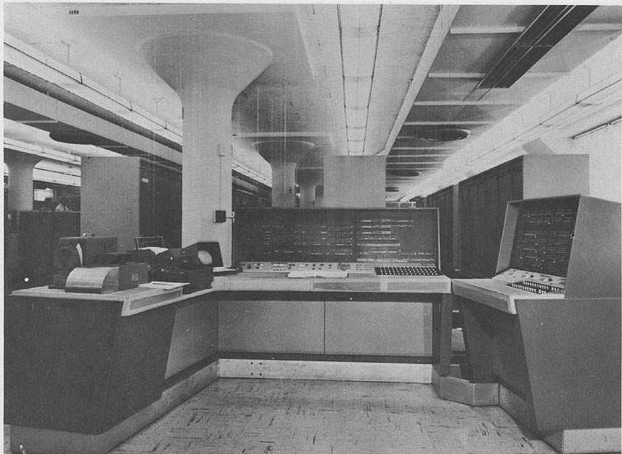
Univac 1105 at Census, 1960

Slide 5
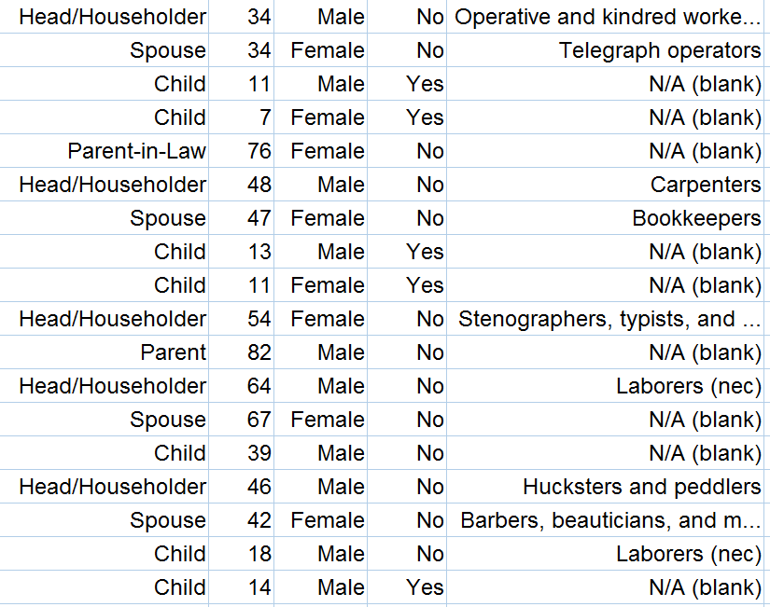
Relationship Age Sex School Occupation

Slide 6
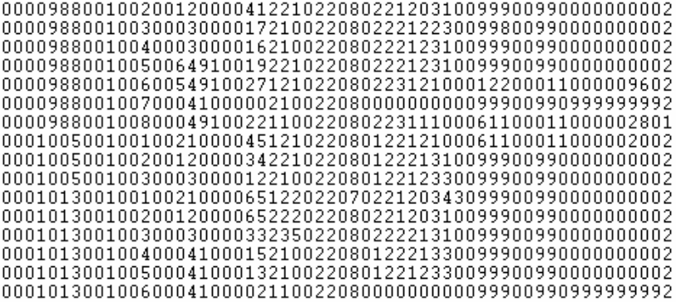
Microdata
Relation to head
Marital status
Education
Occupation

Slide 7
The Power of Microdata
Customized measures: Variables based on combined characteristics of family and household members, capitalizing on the hierarchical structure of the data
Multivariate analysis: Analyze many individual, household, and community characteristics simultaneously
Interoperability: Harmonize data across time and space
Age classification for school enrollment
in published U.S. Census

Slide 8
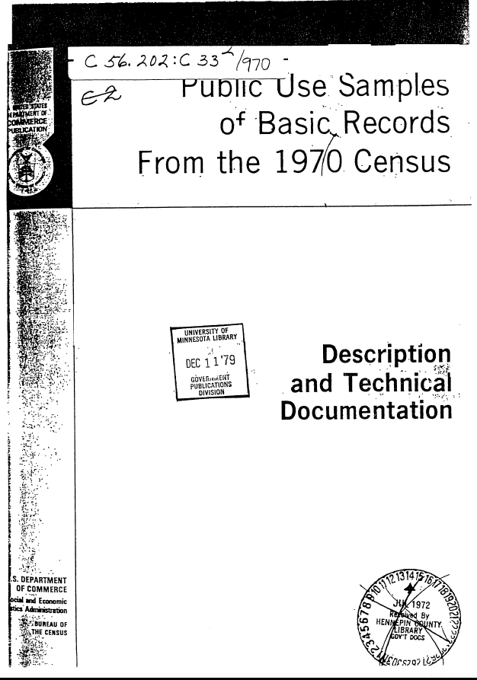

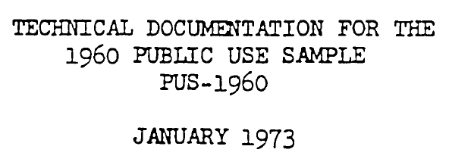
The 1970 Public Use Samples
60 times the size of 1960
Much more detail
(especially geography)
1960 sample expanded 10-fold
Same format and coding as 1970
Led to an explosion of research on
change

Slide 9
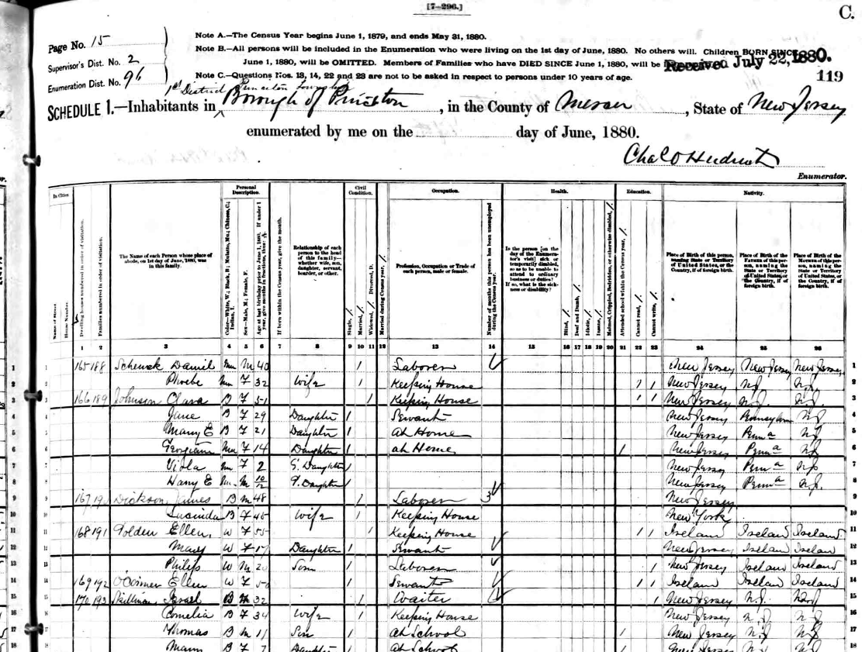
The Minnesota
Historical Census Projects

Slide 10

1991: Eight Census Years, All Incompatible

Slide 11
Relationship Variable (part):
1900 Public Use Sample
72 categories

Slide 12
Relationship Variable:
1940 Public Use Sample
23 categories

Slide 13
Relationship Variables:
1960 Public Use Sample
12 categories, excluding redundancies

Slide 14
Relationship Variables:
1980 Public Use Sample
20 unique categories

Slide 15
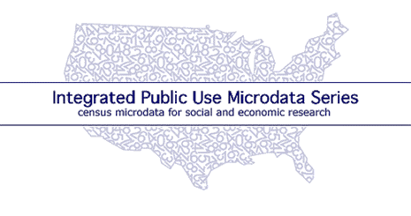
1991 IPUMS proposal: An integrated database for
1880, 1900, 1910, 1940, 1950, 1960, 1970, 1980, 1990
        Harmonized codes
        Consistent record layout
        Integrated documentation
        No loss of information
.

Slide 16
Percent of elderly (65+) residing with own children:
United States, 1850-2000

Slide 17
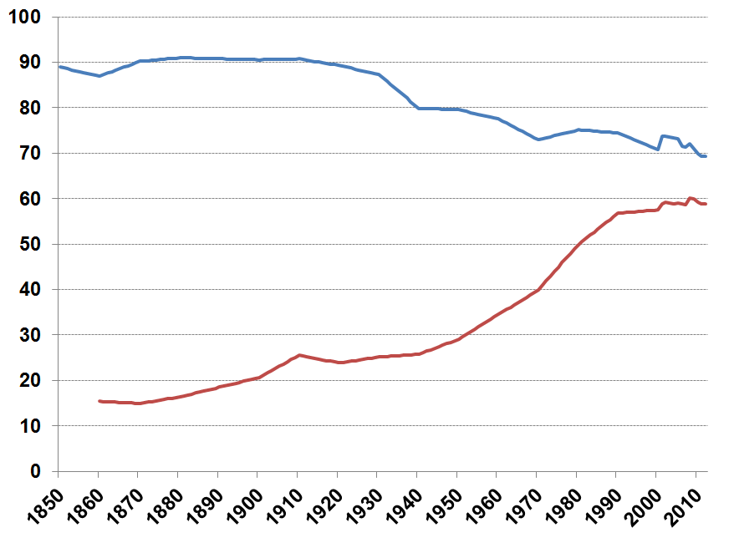
U.S. Labor Force Participation: 1850-2012
Men
Women

Slide 18

IPUMS Graph from “A Century of Women in Science and Engineering,” History Day project by Abby Norling-Ruggles, age 12

Slide 19
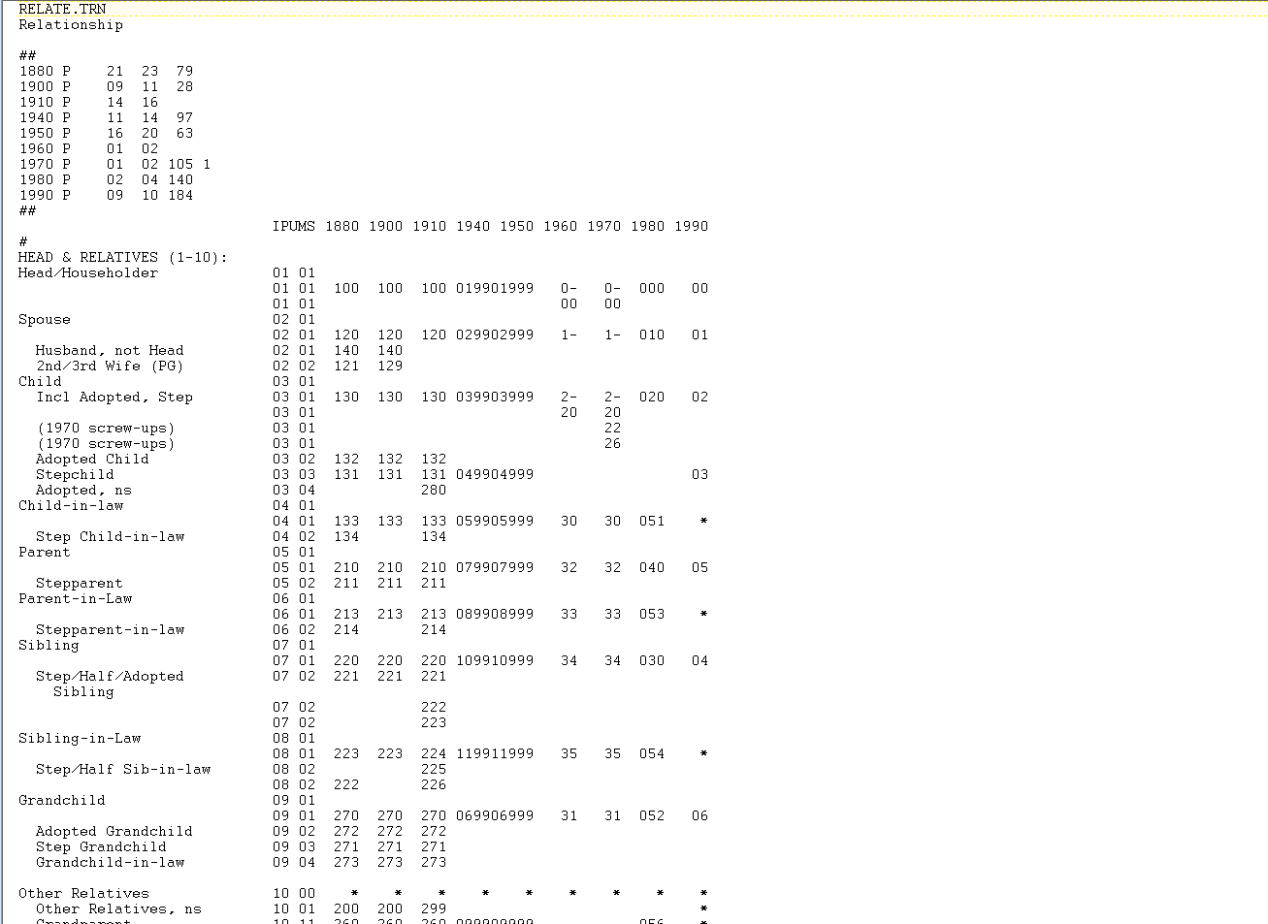
1991: First structured metadata system for data integration
Input data locations
Data quality flag locations
Original codes
Standardized composite code
Standardized labels

Slide 20
Internet dissemination
Excerpt from budget justification
1991 IPUMS proposal to NSF

Slide 21
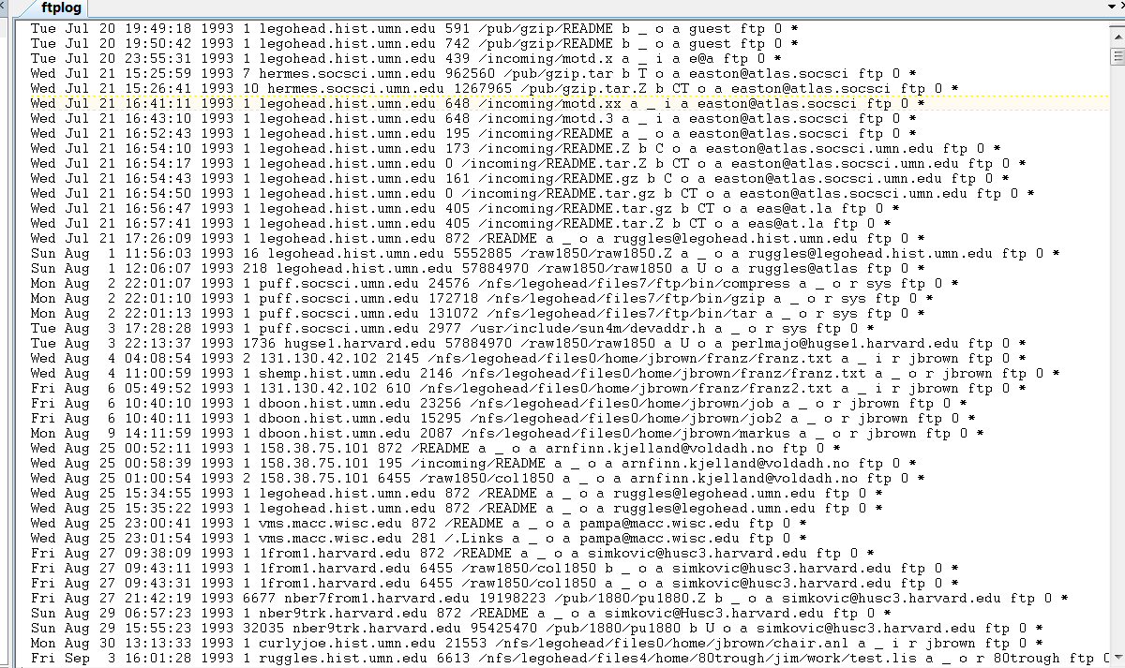
July 20, 1993: first IPUMS data dissemination
via anonymous ftp

Slide 22
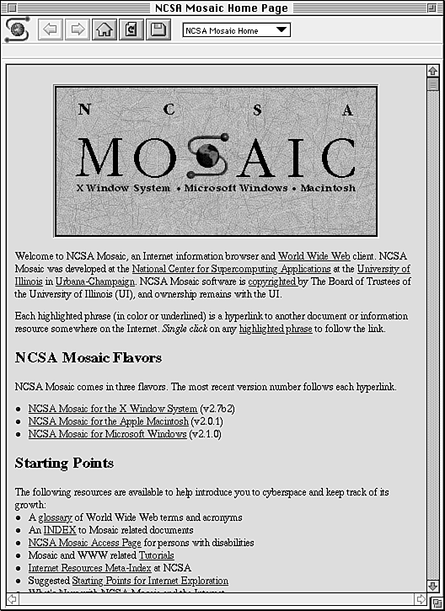
April 1993

Slide 23
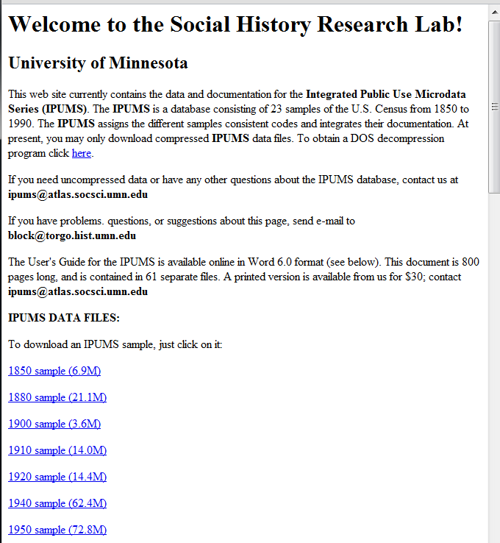
1994:
The first IPUMS website

Slide 24
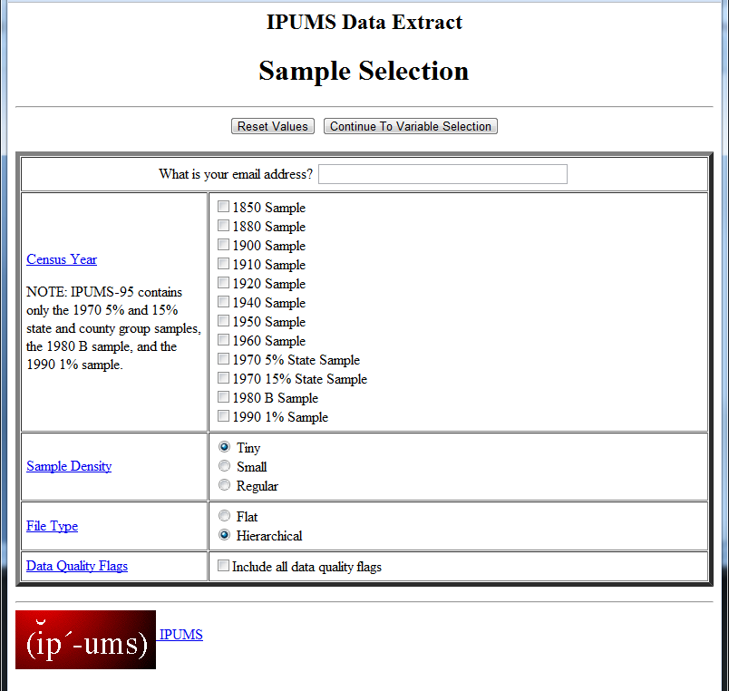
November 1995: Interactive data extract system
Step 1:
select census years, sample density, and desired format

Slide 25
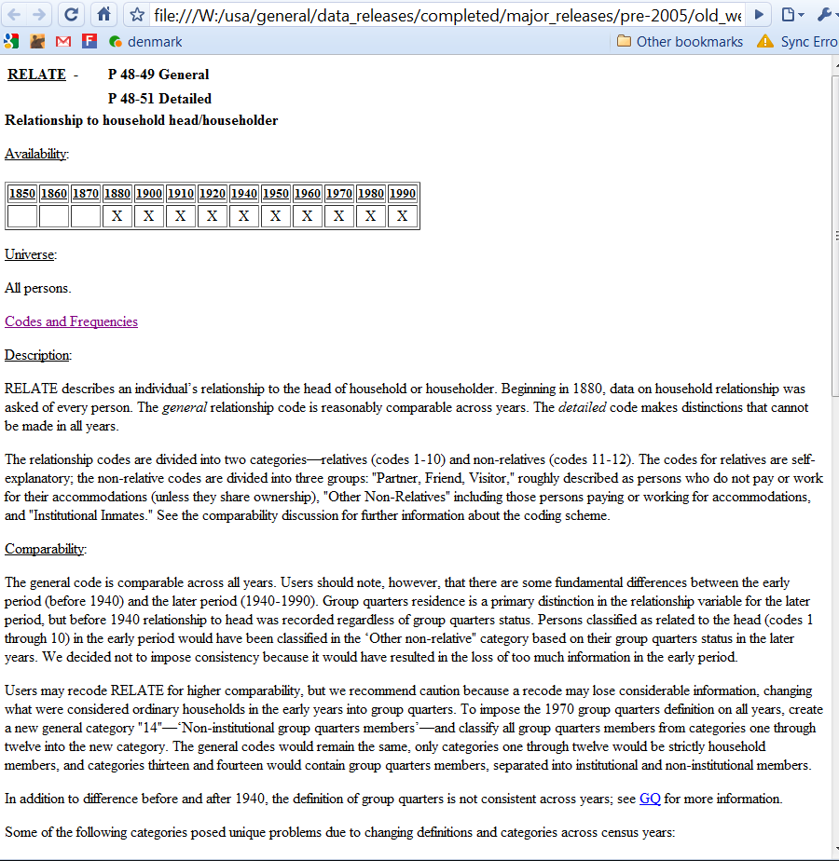
1997:
Hypertext variable-level documentation accessible from every stage of the extract system

Slide 26
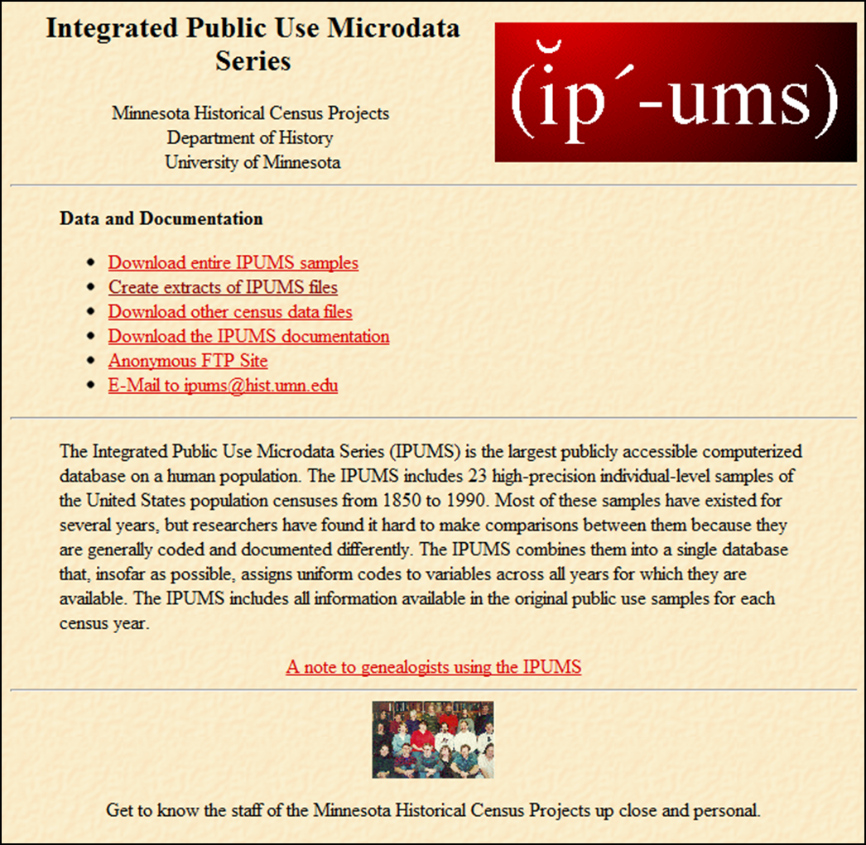

Slide 28
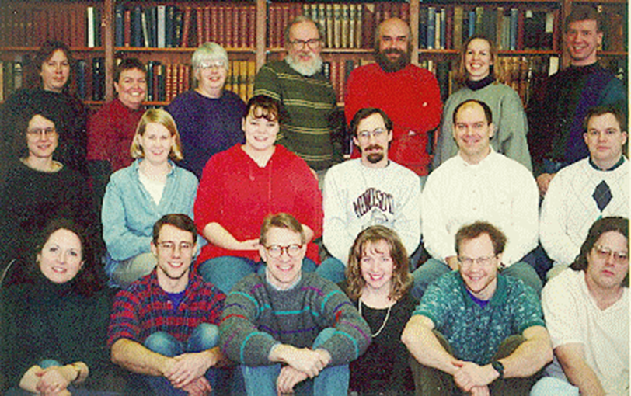
IPUMS Team, 1996

Slide 30

Finis Welch
Founded Unicon Research, 1979
Founded Stata Corporation, 1985
Founded Center Ranch, 1987
(87,000 Acres)

Slide 31
Finis Welch
1989: Unicon creates CPS Utilities
1993-2003: Unicon receives 15 SBIR awards to develop CPS Utilities
($5.1 million total)

Slide 32
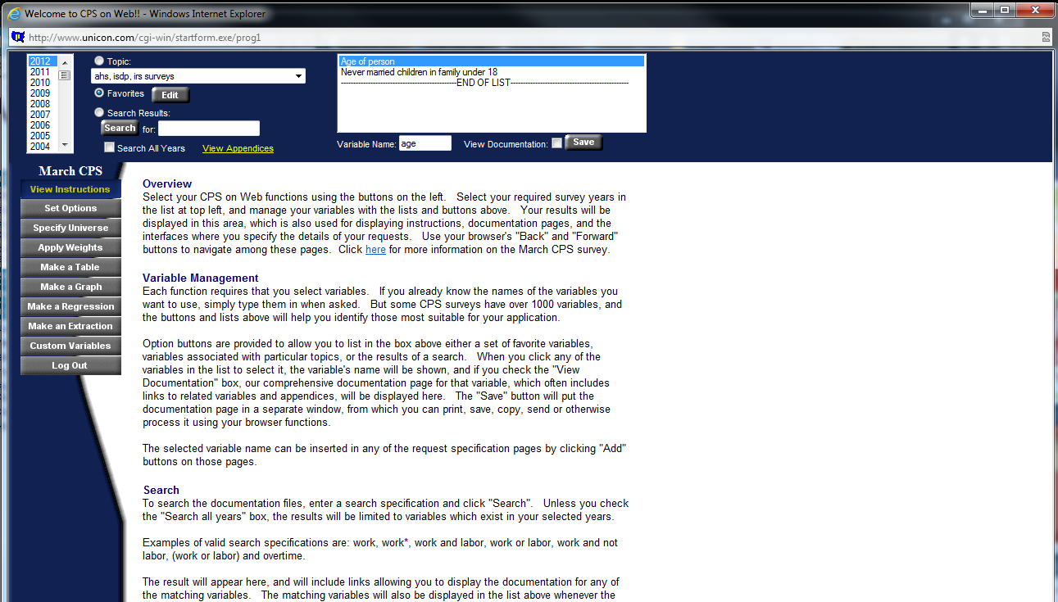

Slide 33
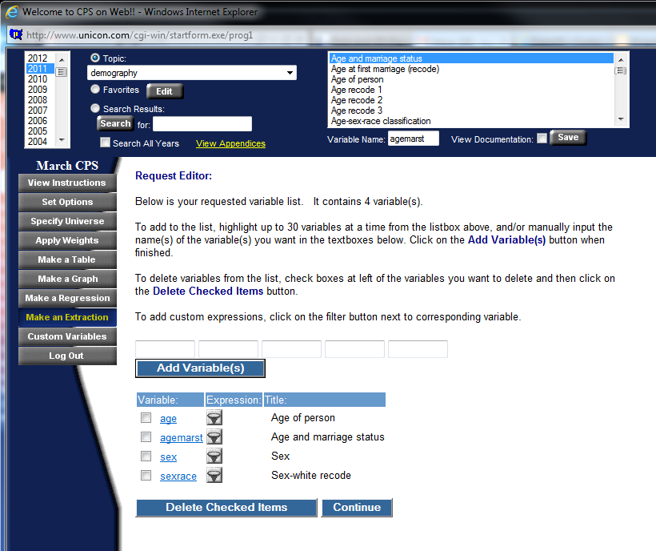

Slide 34

Bob McCaa

Slide 35

“International Integrated Microdata Access System”
Microdata samples for 21 censuses in Brazil, China, Kenya, France, Mexico and Vietnam
March CPS (ASEC) samples for 40 years

Slide 36
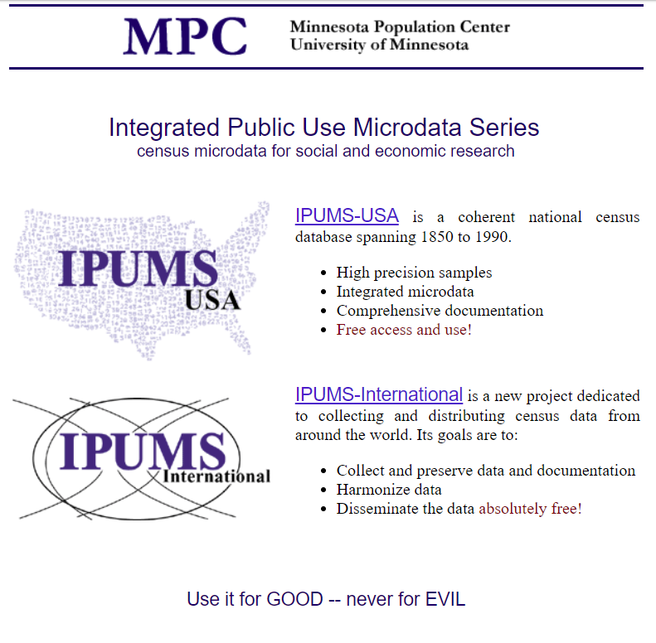

Slide 37
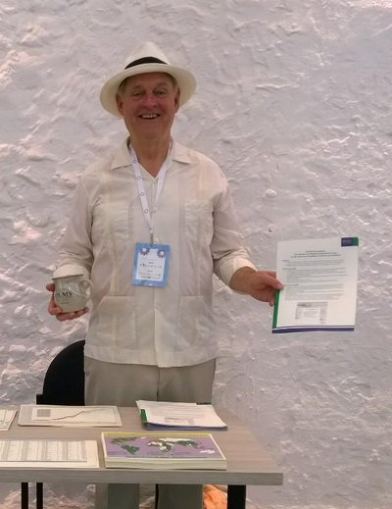

Slide 38


Slide 39
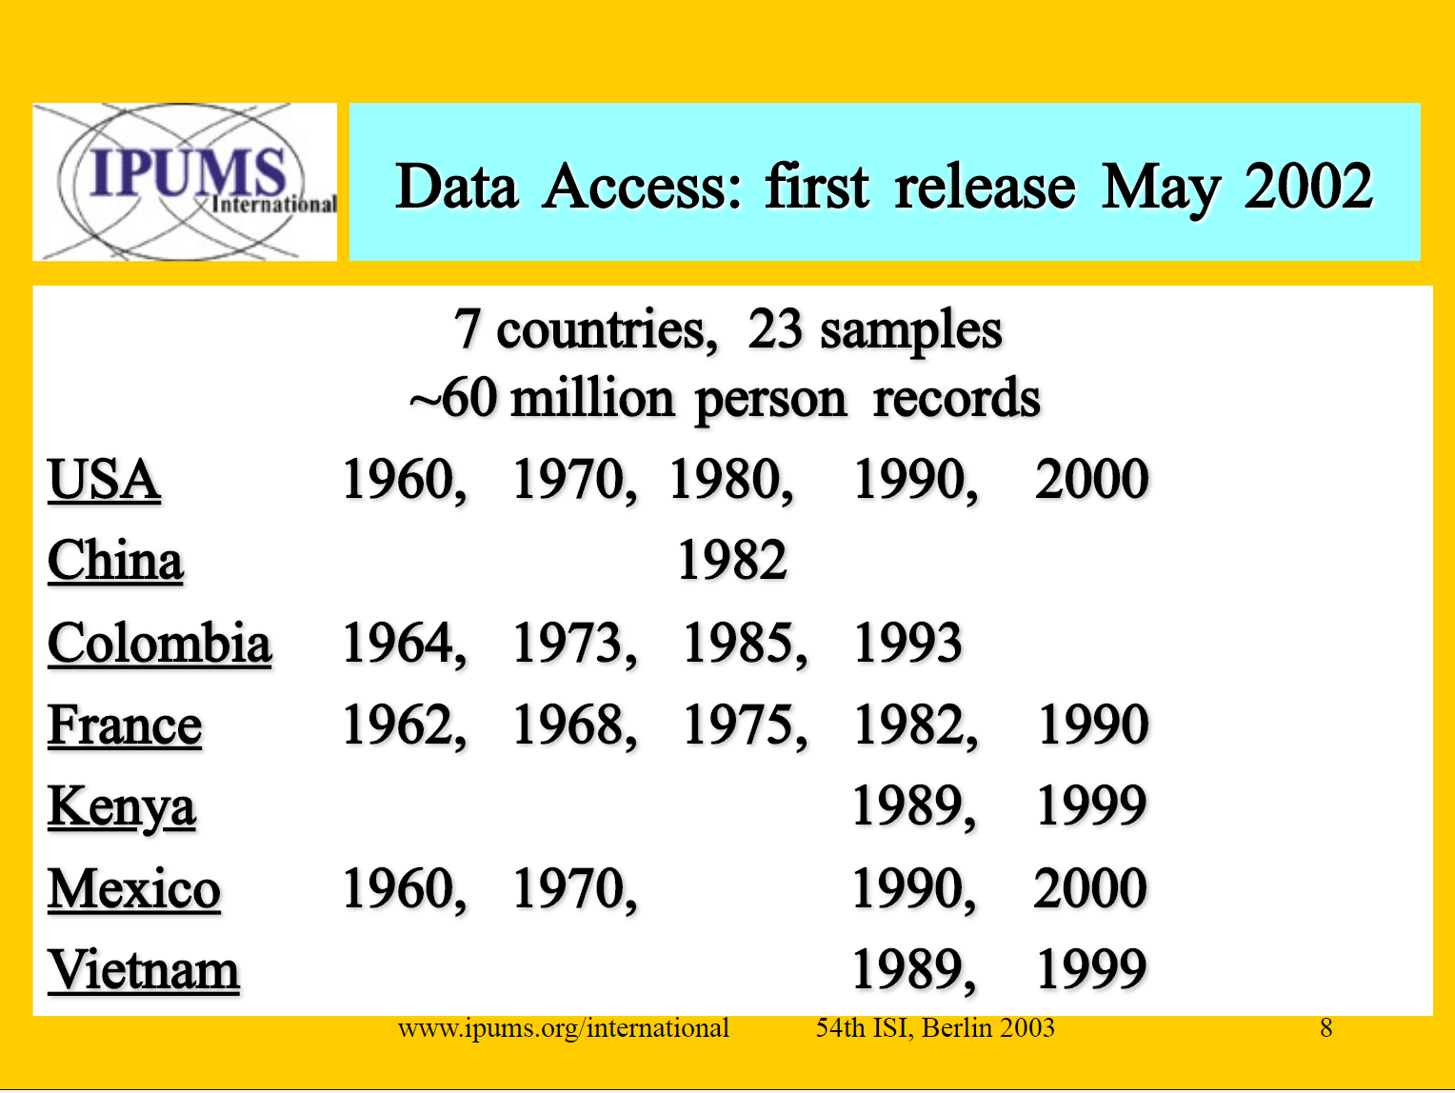

Slide 40
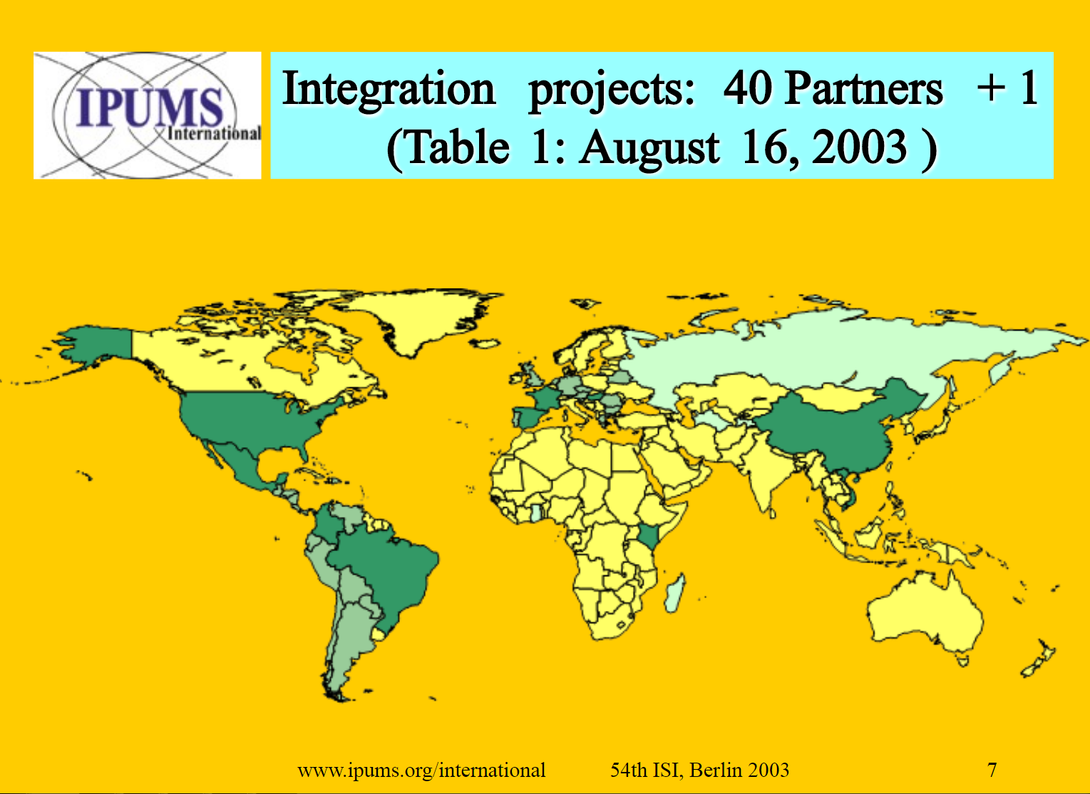

Slide 41
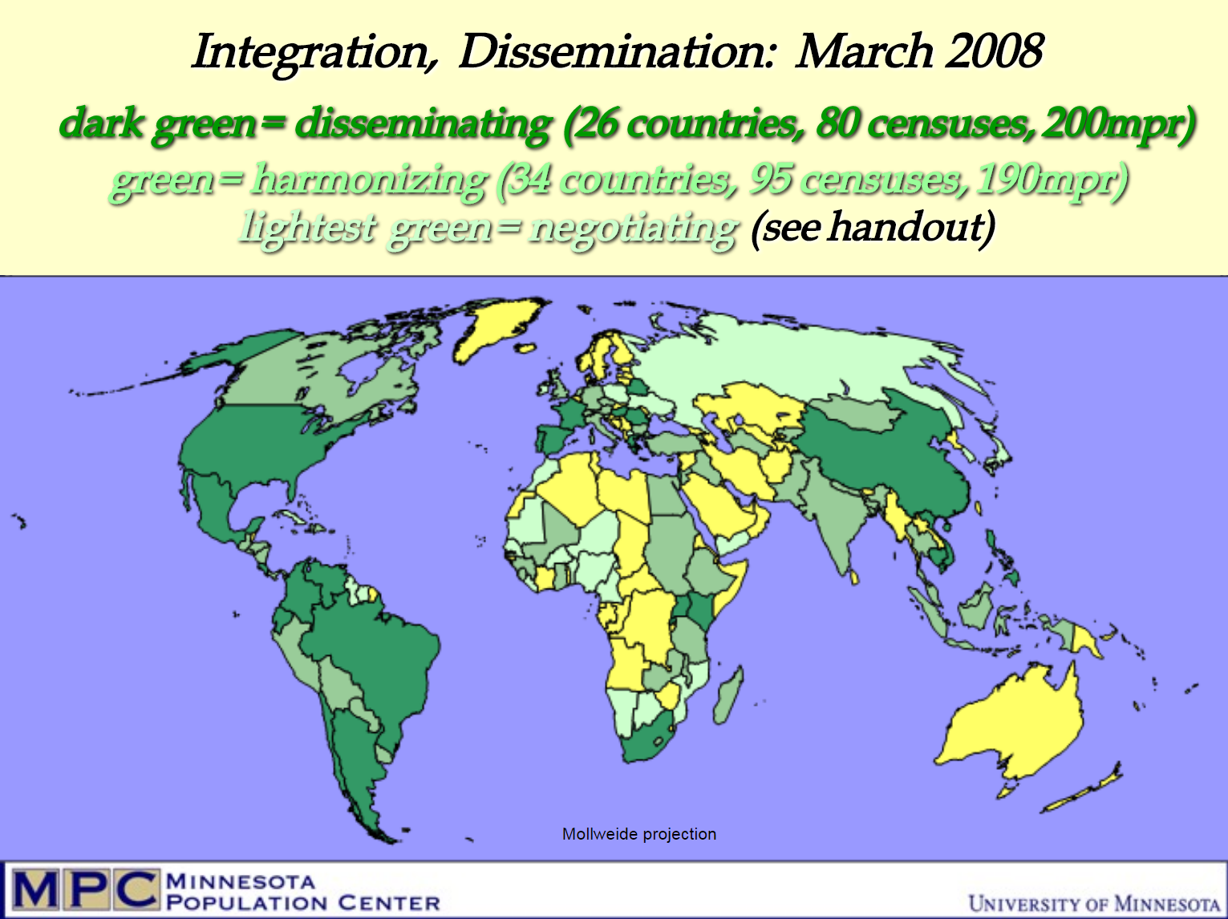

Slide 42
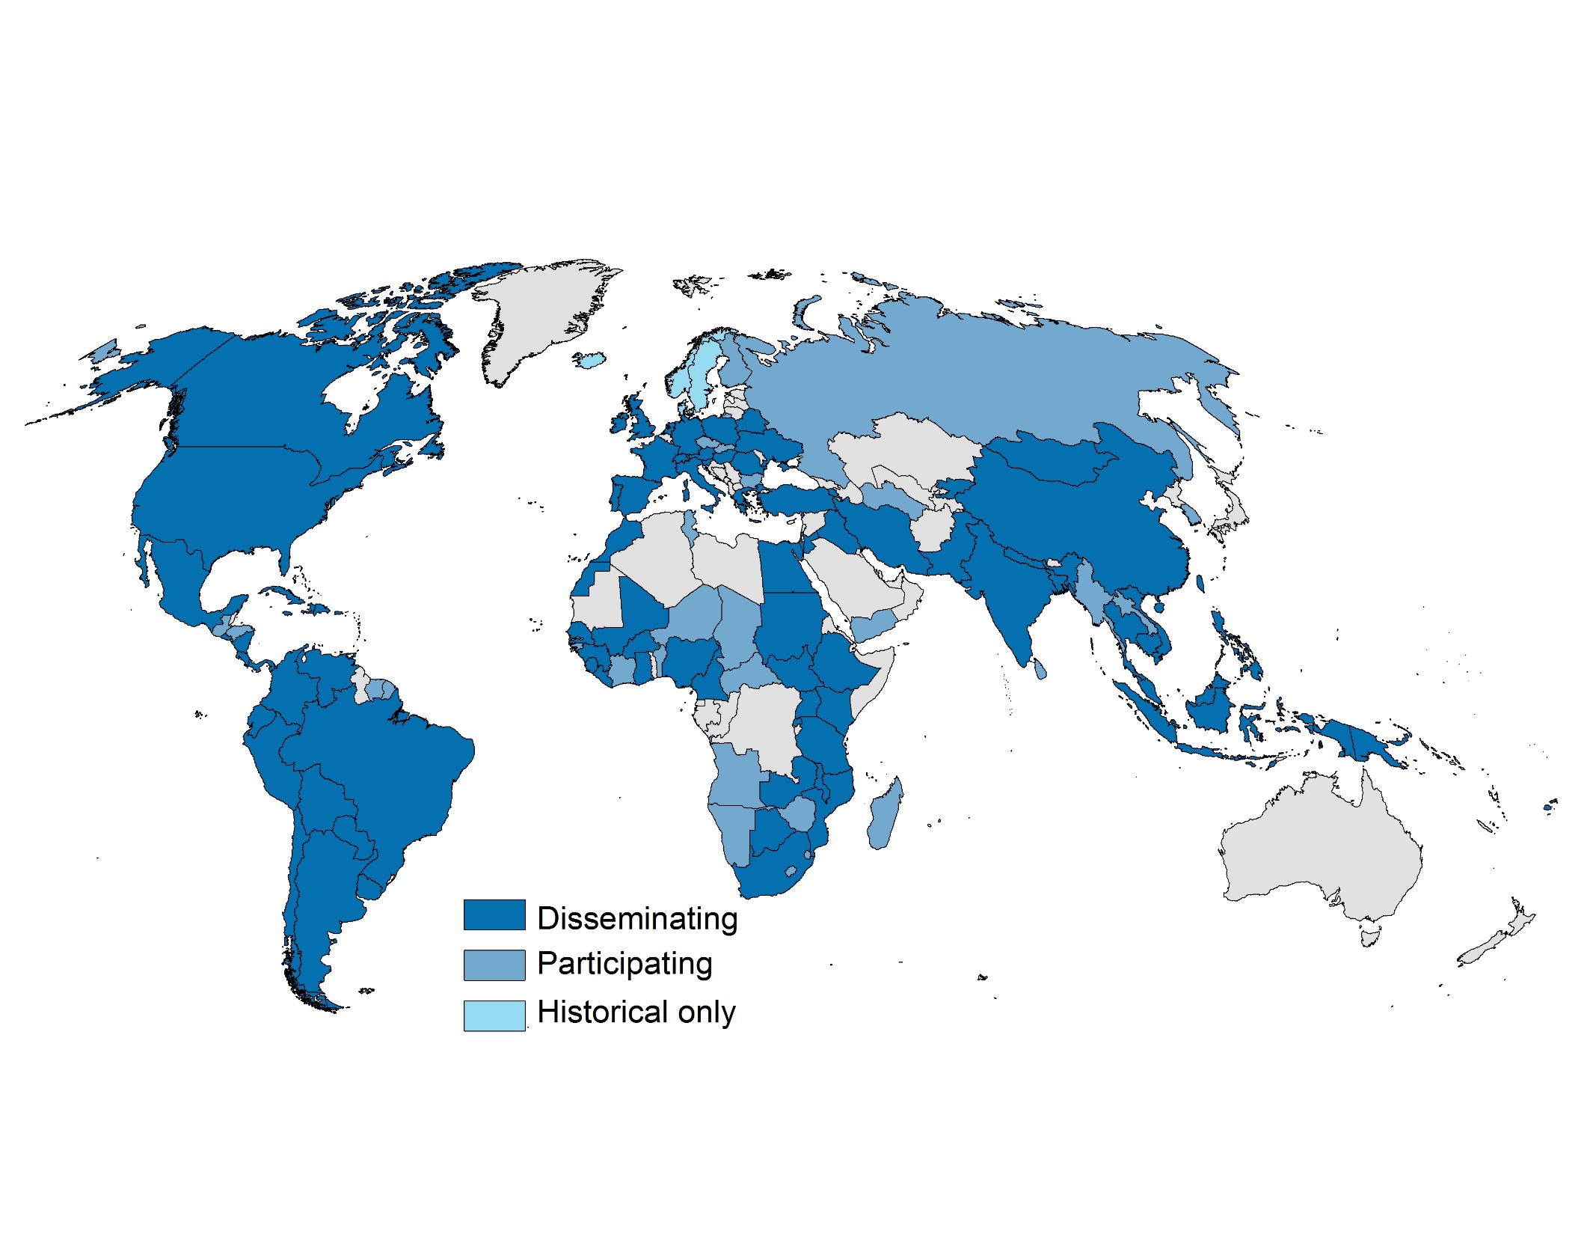

IPUMS Collaborating Countries

Slide 43

2004

Slide 44
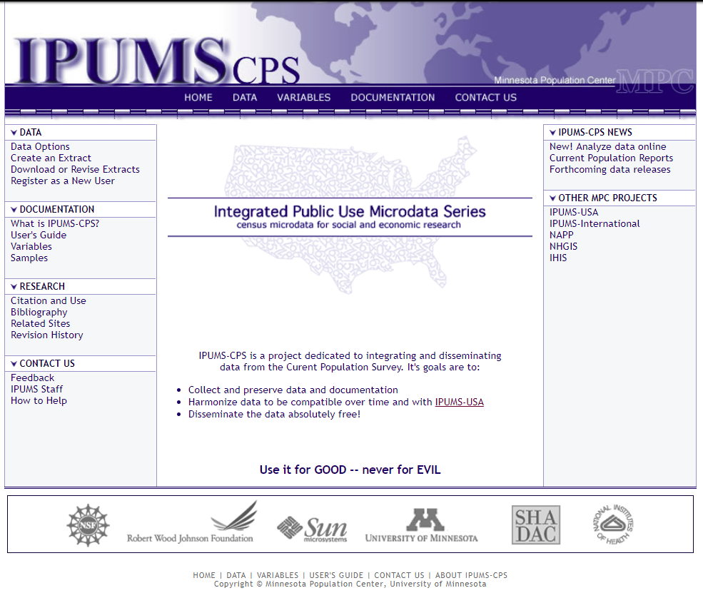

Slide 45



2010 IPUMS-CPS Project
Alexander Flood Warren
Partnered with Unicon, leveraging their investments
Add basic monthly surveys and supplements
Make it easy to use longitudinal dimension

Slide 46
Current Population Survey
Basic Monthly Surveys, 1976-2016
Annual Social Economic Supplement (ASEC), 1962-2016
CPS Supplements, 1976-2016 :
  Education
  Voter
  Fertility
  Veterans
  Volunteer
  Tobacco Use
  Internet Use
  Child Support
  Food Security
  Work Schedules
  Job Tenure
  Displaced Worker
Notes:
Administered starting 1940
Household survey was designed to measure unemployment
Source of the official Government statistics on employment and unemployment
About 57,000 households interviewed monthly
Additional Supplements given throughout year

Slide 47
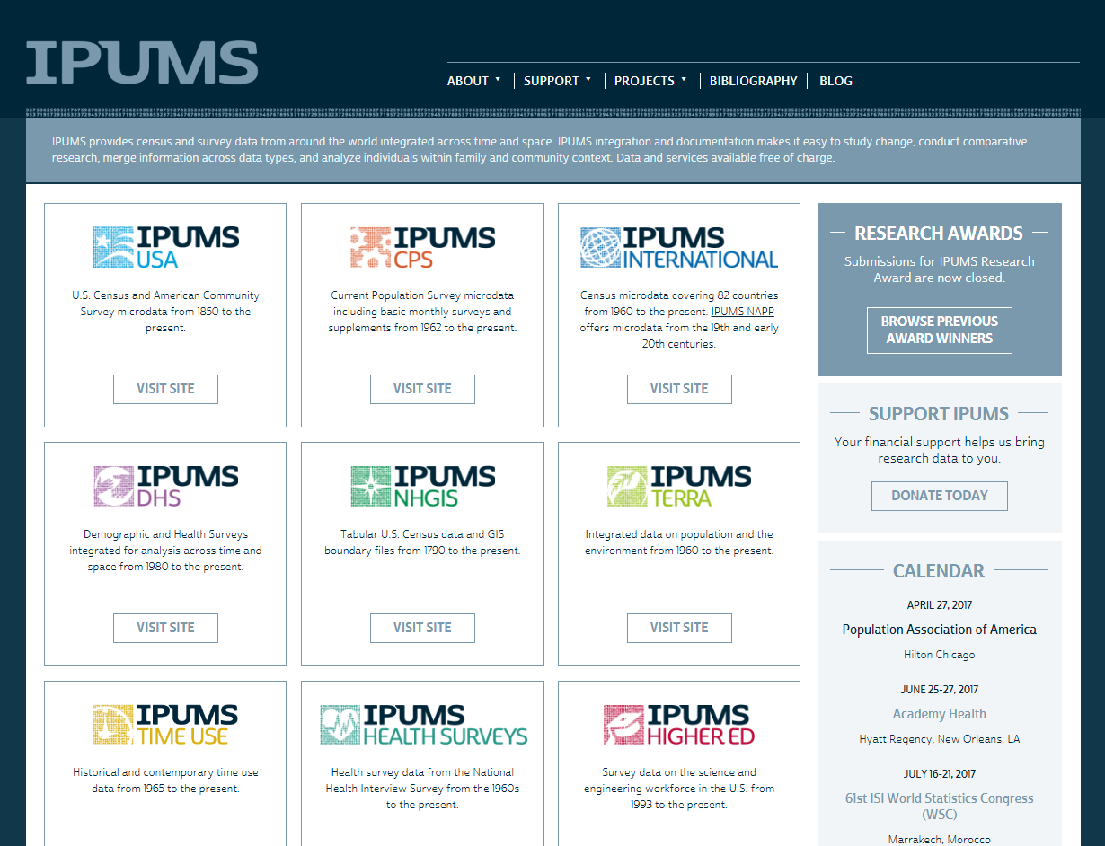
IPUMS Workshop
Population Association of America
April 27, 2017
Presented by
Catherine Fitch, Sarah Flood & David Van Riper

Slide 48
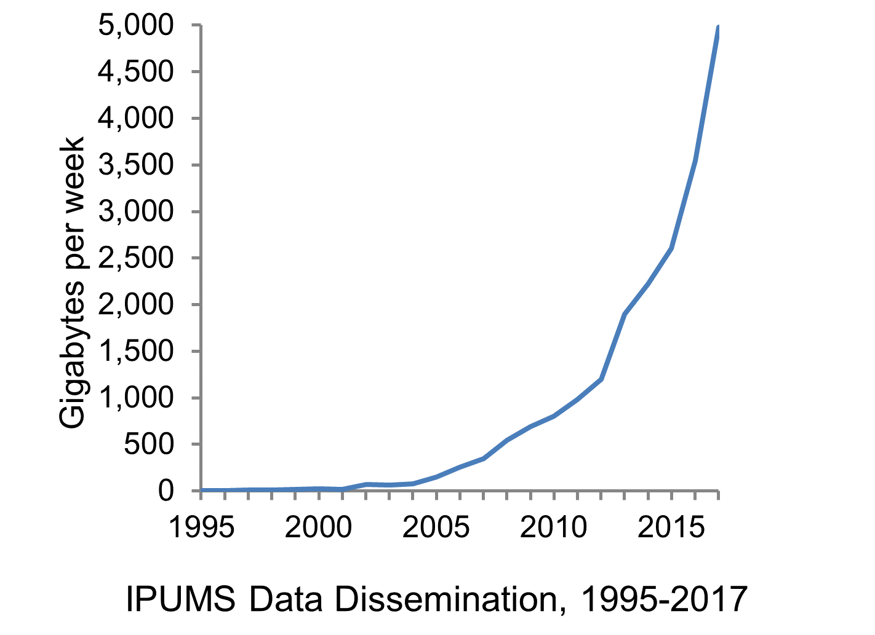
5 Terabytes per week

Slide 51
13% of all Demography articles are now based on IPUMS

Slide 52
IPUMS Data Recovery

Slide 53
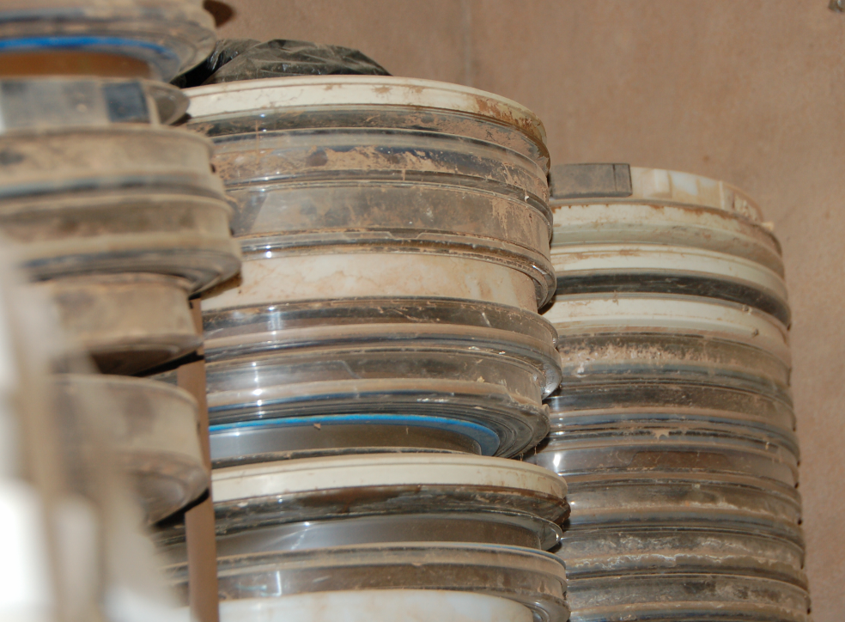
Khartoum, CBS-Sudan

Slide 54
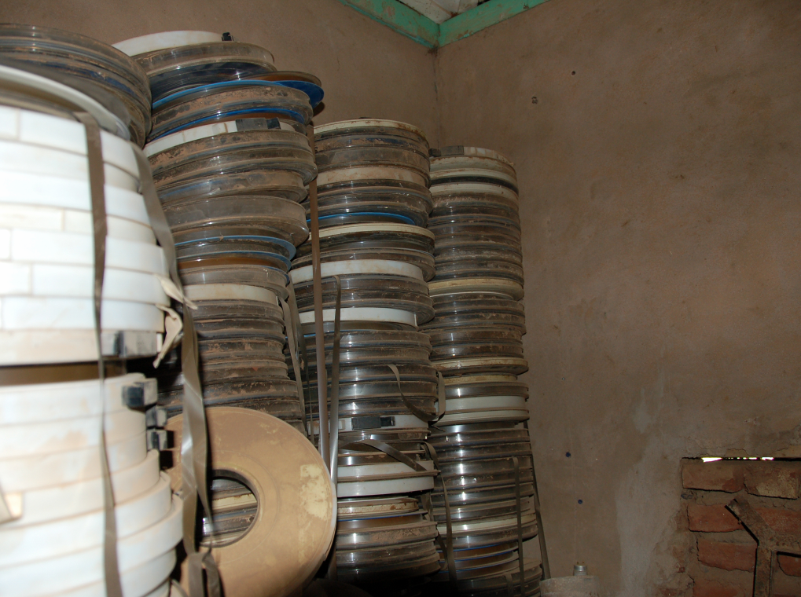

Slide 55
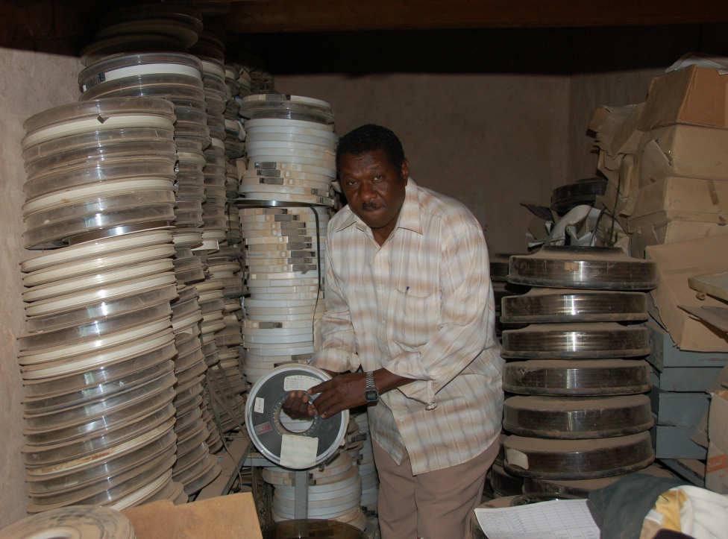

Slide 56
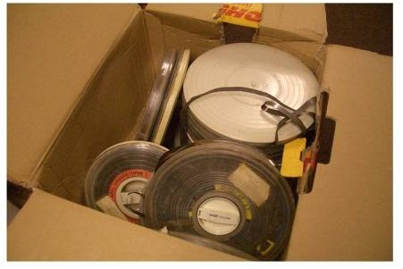
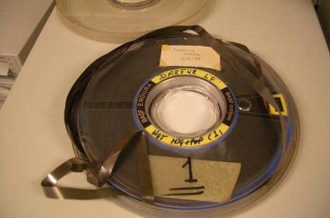
1973 Sudan Census Tapes arrive

Slide 57
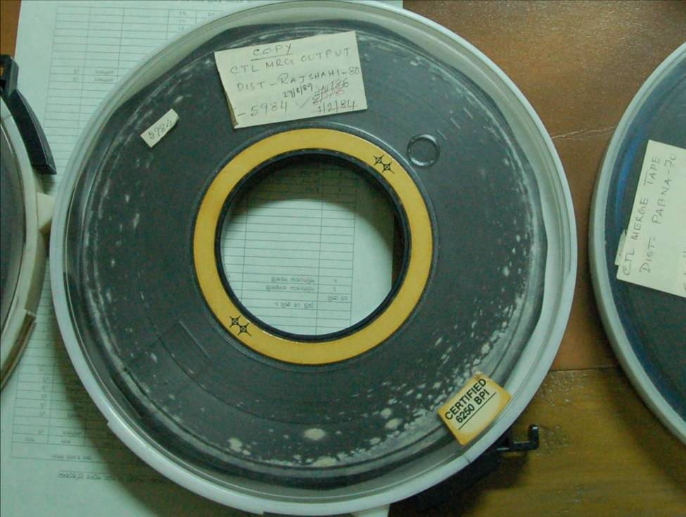
Dhaka, Bangladesh Bureau of Statistics

Slide 58
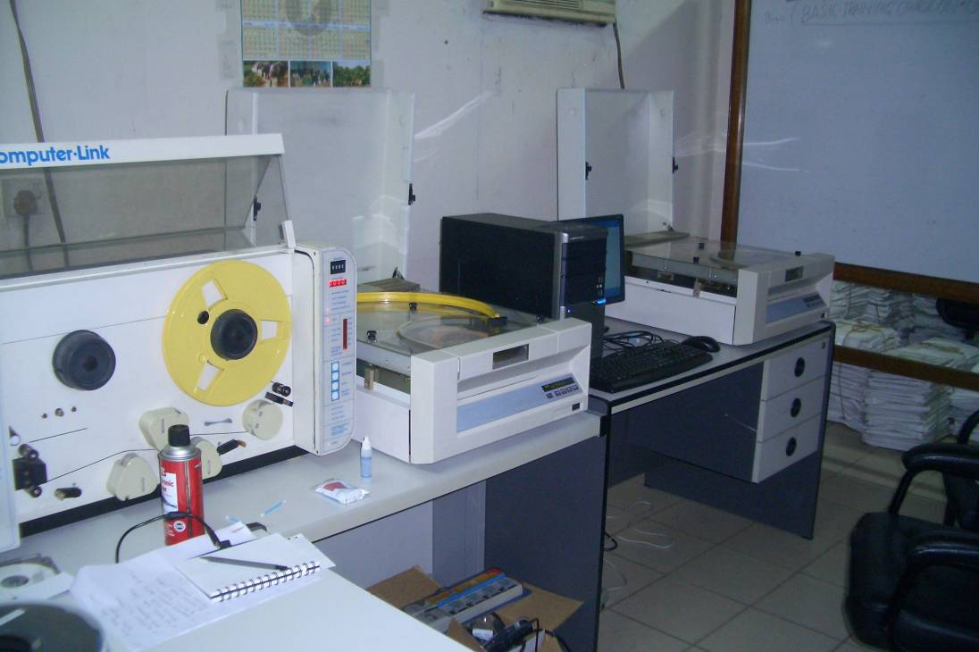

Slide 59
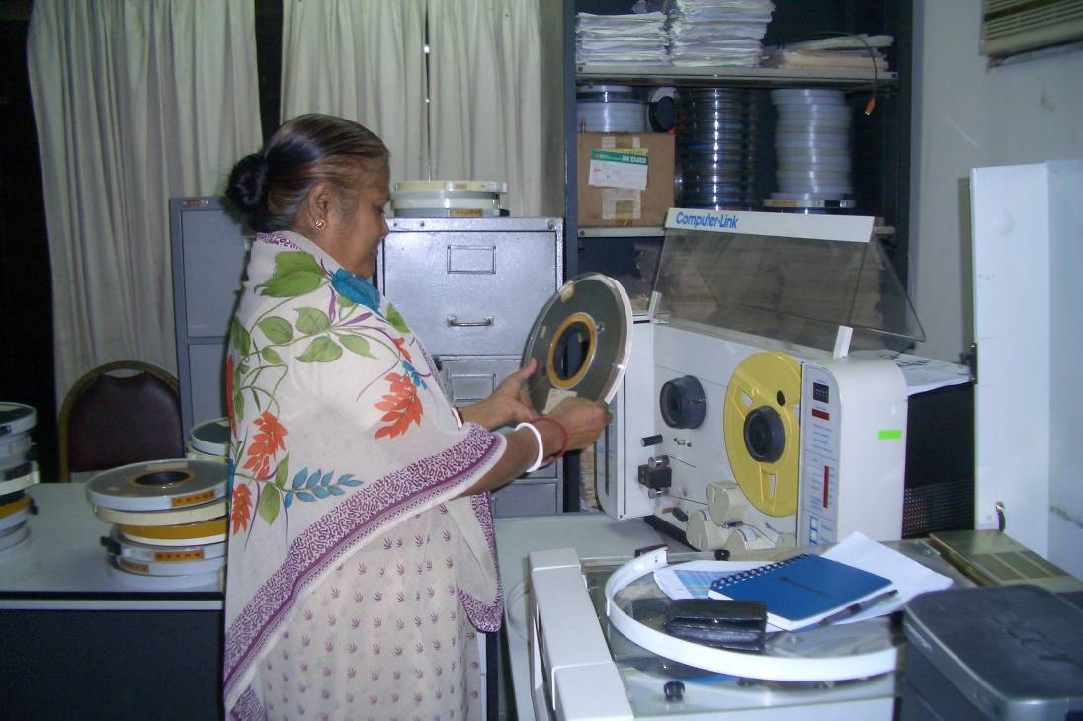

Slide 60
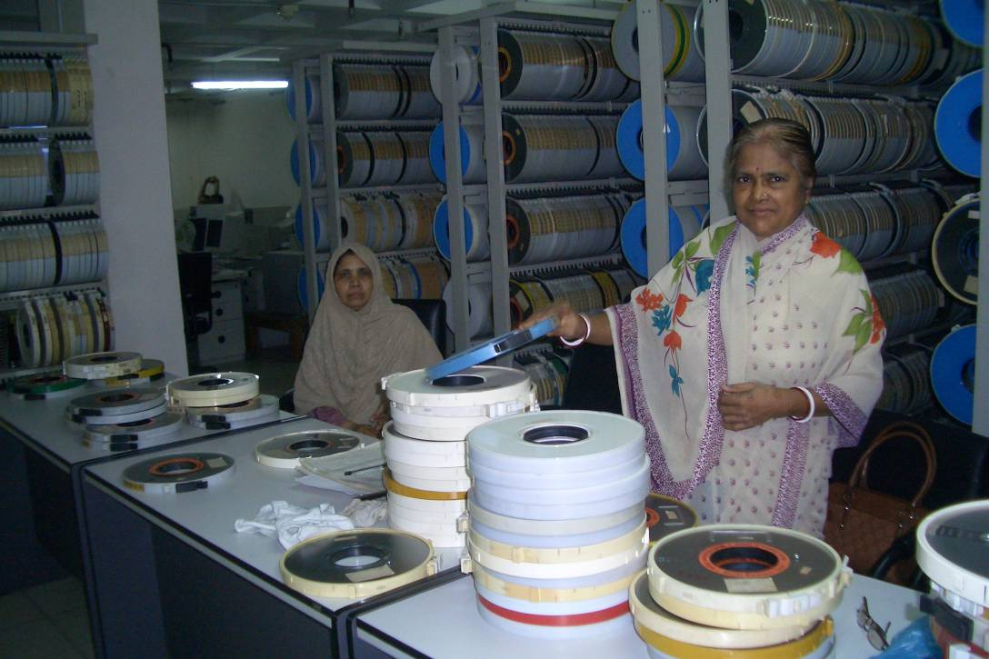

Slide 61
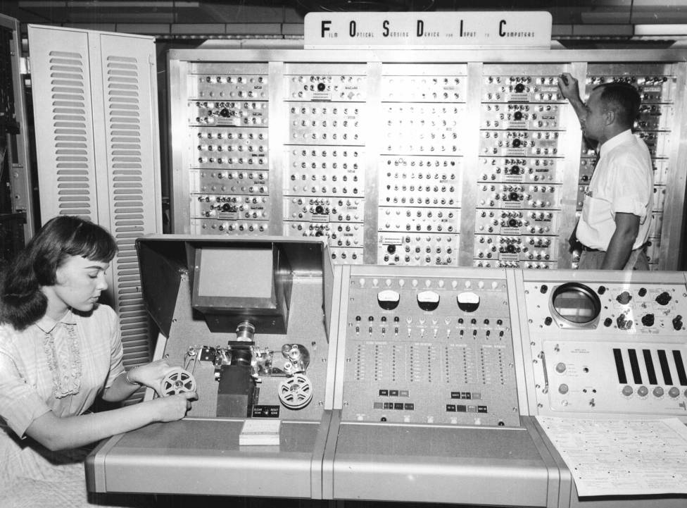
1960 Data Recovery Project

Slide 62
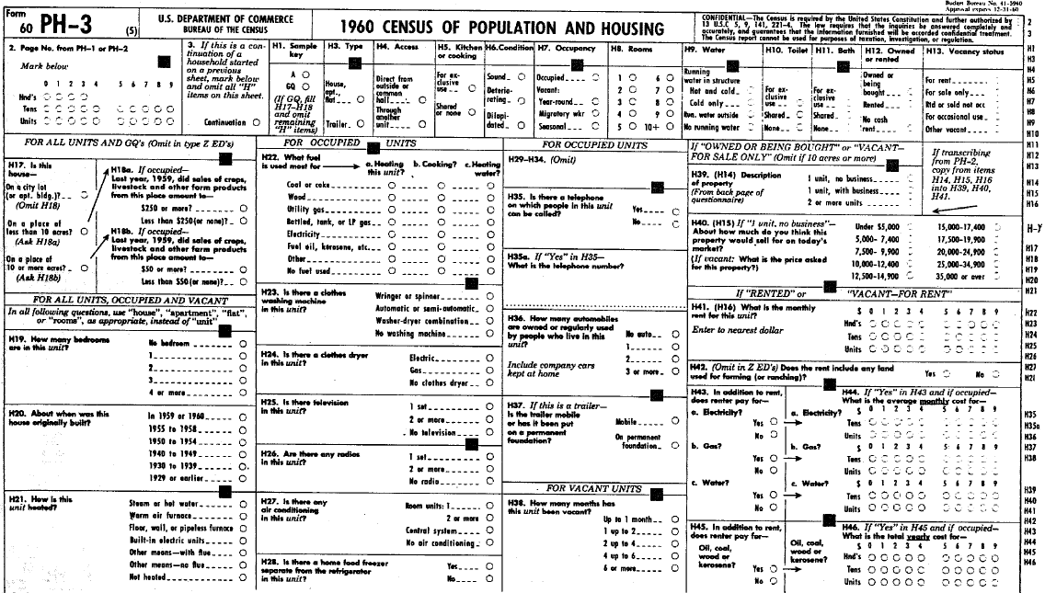

Slide 63
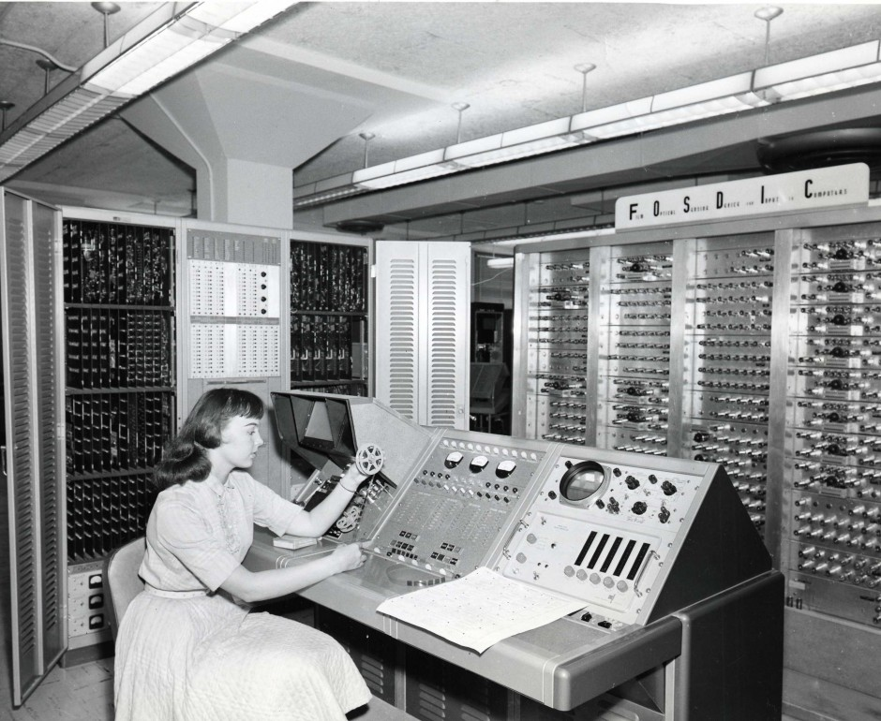

Slide 64
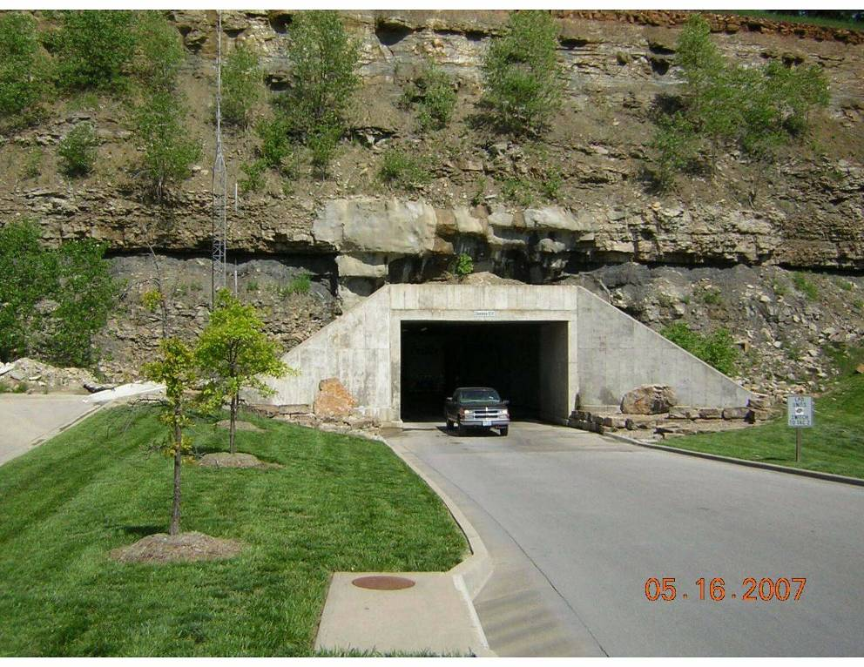

Slide 65
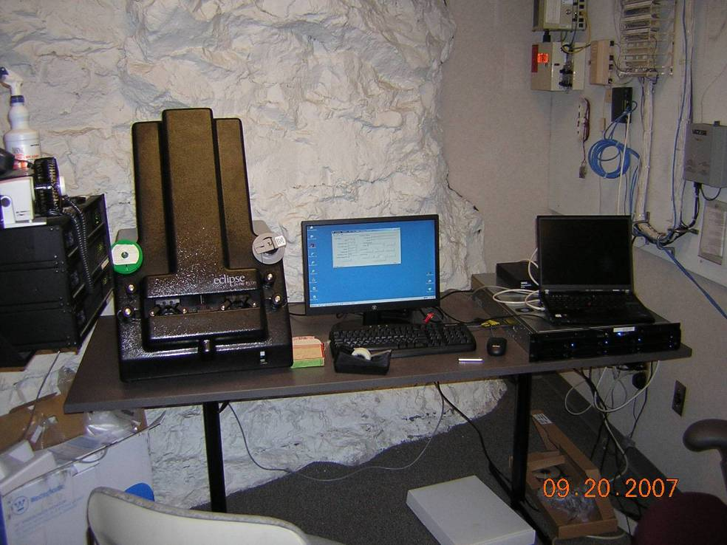

Slide 66
IPUMS Big Data

Slide 67


Big Historical Microdata Project
Complete microdata for the United States, 1790-1940
  750 million records
  Data-entry required over 10,000 years of effort
  Donated data would cost $520 million to replicate
Status: underway, to be complete in 2019
Notes:
67

Slide 68

Census Longitudinal Infrastructure Project
(CLIP)
Link all Census Records, 1850-2020
Link Administrative Records
Social Security, Medicare, Military
Link Births, Marriages, Deaths
Notes:
68

Slide 69
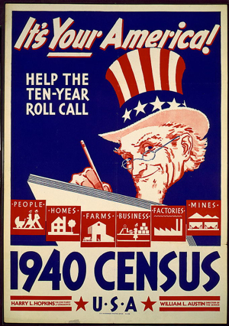
1960-2020 Censuses and Surveys
1940 Census
Social Security
Medicare
Medicaid
WW II Military
1850-1930 Censuses
WW I Military
1881-2020
Deaths
1881-1930
Births
Marriages
CLIP Linking Strategy

Slide 70
Census Longitudinal Infrastructure Project
(CLIP)
Life histories for each person
  Impact of early life conditions on later health and well-being
Social, economic, geographic mobility
Life course transitions
Notes:
70

Slide 71
Census Longitudinal Infrastructure Project
(CLIP)
Understanding the great transformations:
demographic transition, family transition, urbanization, immigration, industrialization
Notes:
71

Slide 72
We are here

Slide 73
