Slide 1
History of CPS
IPUMS CPS Summer Data Workshop
June 4, 2018
Kari Williams

Slide 2
Outline
Forerunners of CPS
Major Milestones
CPS Today
IPUMS CPS
Redesigns
Linking

Slide 3
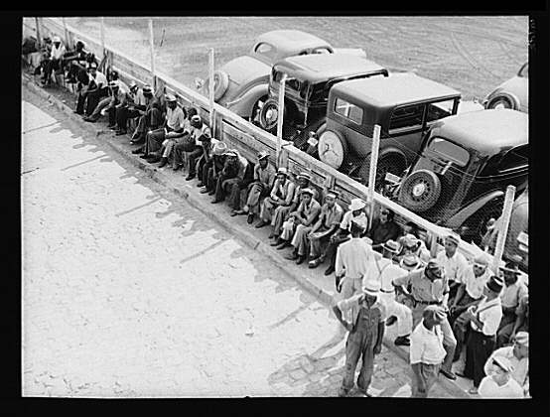
Courtesy of the Library of Congress

Slide 4
Forerunners of the CPS
1930 Census unemployment estimates were controversial (5.0% of gainful workers unemployed)
August 1937
Voluntary registration of the unemployed
Enumerative Check Census
Late 1930s
Civil Works Administration and Works Progress Administration sponsor surveys of unemployed persons
Initial forays into probability sampling and activity concept for measuring & defining unemployment

Slide 5
Major CPS Milestones
March 1940, combine Enumerative Check Census and WPA techniques to create “Sample Survey of Unemployment”
August 1942, transfers to Census Bureau, renamed “Monthly Report on the Labor Force”
1947-1948, renamed “Current Population Survey” reflects broader topical coverage
July 1953, 4-8-4 rotation pattern introduced
Mid-1950s, sample revision after decennial census

Slide 6
Major CPS Milestones
July 1959, Planning, analysis, and publication transfers to Bureau of Labor Statistics; Census retains data collection and processing
1960, Alaska and Hawaii added
September 1975, state supplementary samples added
October 1978, respondent-reported race
April 1987, CATI introduced
January 1994, CAPI introduced

Slide 7
CPS Today
Multi-stage, stratified, probability sample
National and state estimates of labor force characteristics of the civilian noninstitutional population aged 16 and older
Independent state samples
Uses 4-8-4 rotation pattern
Includes household roster
Labor force survey with topical supplements relevant to many social science disciplines

Slide 8
CPS Topical Coverage
Household and demographic information
DOB, marital status, AF status, education, race, ethnicity, nativity
Labor force information
Civilian adults aged 15 and older
Employment, multiple job holders, hours worked, FT/PT status, occupation, industry, class of worker earnings, unemployment
Supplement information

Slide 9
CPS Data Collection
Field representative establishes eligibility and conducts initial interview in person
Interviews 2-4 and 6-8 may be done via telephone
Personal-visit for fifth month interview
Subsequent interviews
Update roster
Periodic update items
Dependent interviewing

Slide 10
IPUMS CPS
Basic Monthly Surveys, 1976-2018
Annual Social Economic Supplement (ASEC), 1962-2018
CPS Supplements, 1976-2018 :
Education
Voter
Fertility
Veterans
Volunteer
Tobacco Use
Internet Use
Child Support
Food Security
Work Schedules
Job Tenure
Displaced Worker

Slide 11
Redesigns
1962-1975
Data not officially released as public use files
1976
November Hispanic Oversample introduced to augment ASEC (continued through 2000)
1977
First public use file released by Census Bureau

Slide 12
Redesigns
1994
Major redesign including question wording
CAPI introduction incorporates skip patterns programmatically
2001
ASEC SCHIP oversample introduced
2014
Split sample to test new income questions

Slide 13
General Linking Challenges
1962-1978
Most housing unit identifiers are unique
Person-level identifiers are not reliable
1976-1981
Basic monthly data does not include individuals under 14, but supplement data does
1979-1993
Unique housing unit and person identifiers
1994-present
Reuse housing unit identifiers after first four months in sample

Slide 14
General Linking Challenges
Changes in numbering schemes, cannot link housing units between:
1962 & 1963
1971 & 1972
1972 & 1973
1976 & 1977
1984 & 1985
1985 & 1986
1994 & 1995
1995 & 1996
Additional linking validation to account for migration, mortality, non-response, recording errors

Slide 15
ASEC Linking Challenges
Some years omit linking keys necessary to link ASEC to Basic Monthly data
2001-2004
Duplicate housing unit identification numbers because of SCHIP expansion (adjacent month identifiers may match “true” March cases)
In addition to general linking challenges

Slide 16
Linking with IPUMS
CPSID(P) identifies mechanical links between Basic Monthly samples
MARBASECID identifies mechanical links between March Basic Monthly and ASEC data of the same year
MARBASECID requires persons are in both ASEC and March Basic Monthly file
Enables CPSID(P) onto ASEC files, allowing to other Basic Monthly data

