Slide 1
Flavors of CPS Data
IPUMS CPS Summer Data Workshop
June 4, 2018
Jose Pacas
Notes:
https://www.census.gov/programs-surveys/cps/visualizations/non-response-rates-visualization.html

Slide 2
Overview
CPS Basic Monthlies
CPS Supplements
ASEC: A special case
ORGs
All together now
Notes:
Administered starting 1940
Household survey was designed to measure unemployment
Source of the official Government statistics on employment and unemployment
About 57,000 households interviewed monthly
Additional Supplements given throughout year

Slide 3
CPS: An employment survey

Slide 4
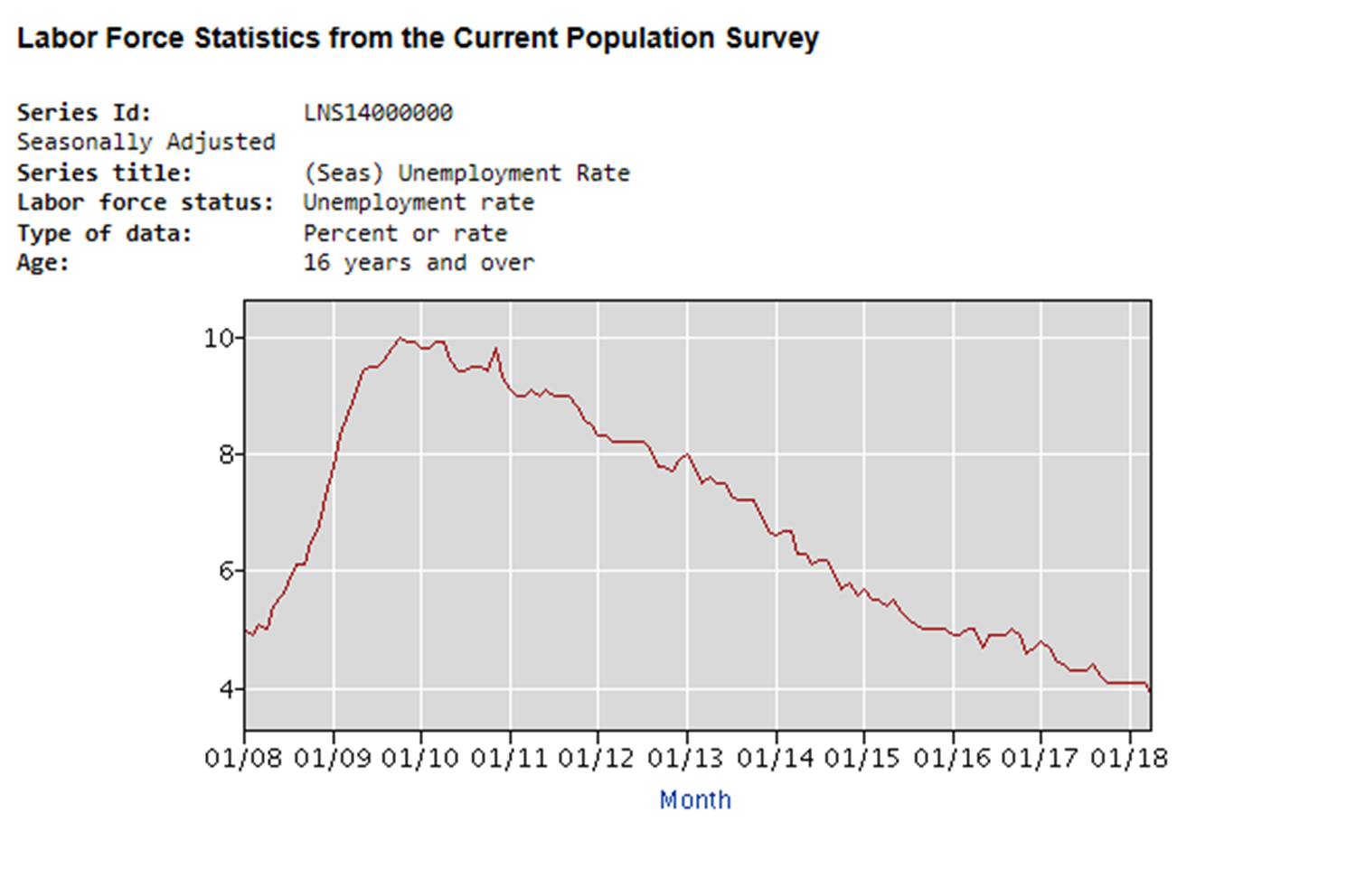
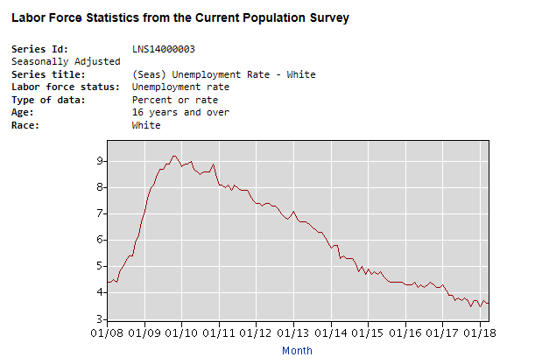
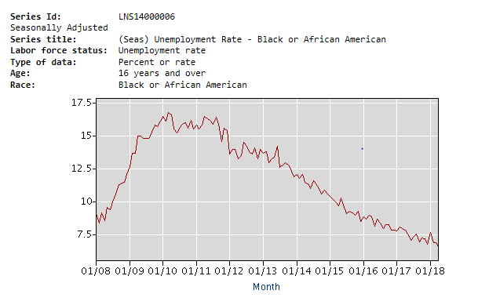
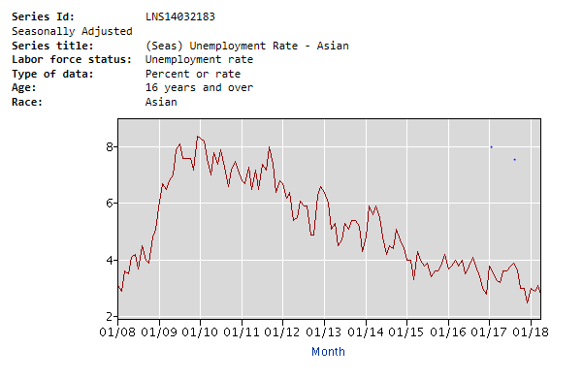
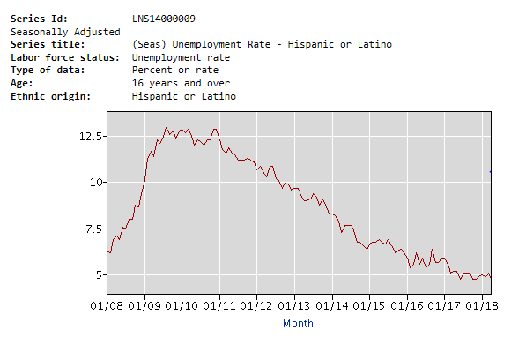
Monthly unemployment rates
Jobs Day! First Friday of every month at 8:30am EST

Slide 5
What’s in a Basic Monthly?
Household information
Geographic information
Demographic information: Age, sex, race/ethnicity, nativity
Labor force items (week including the 12th)
ORG: Earnings, usual hours, union membership

Slide 6
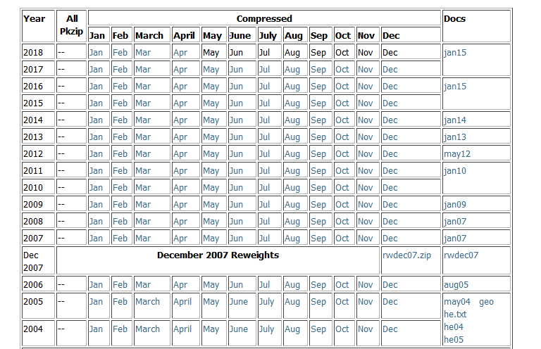
Accessing Basic Monthlies - NBER

Slide 7
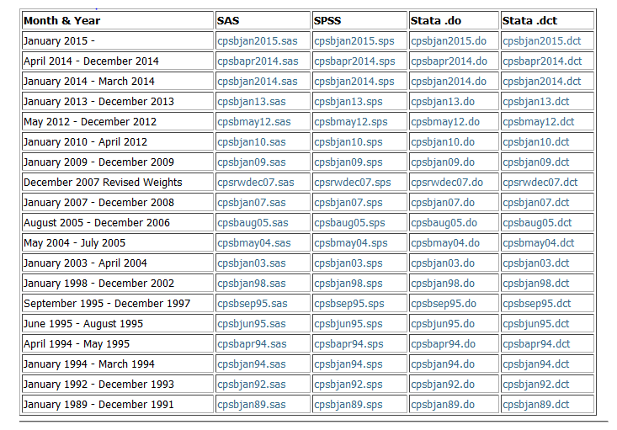
Accessing Basic Monthlies - NBER

Slide 8
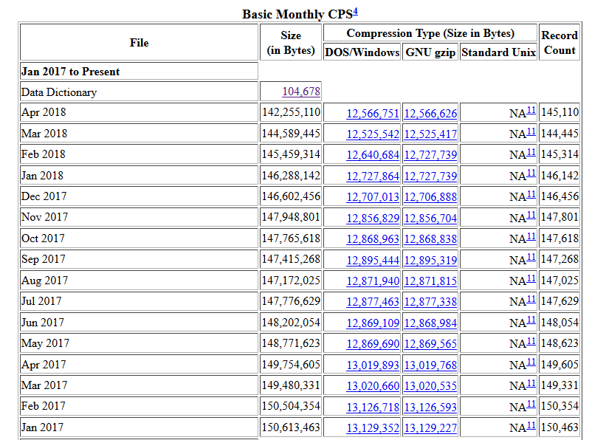
Accessing Basic Monthlies - CPS FTP

Slide 9
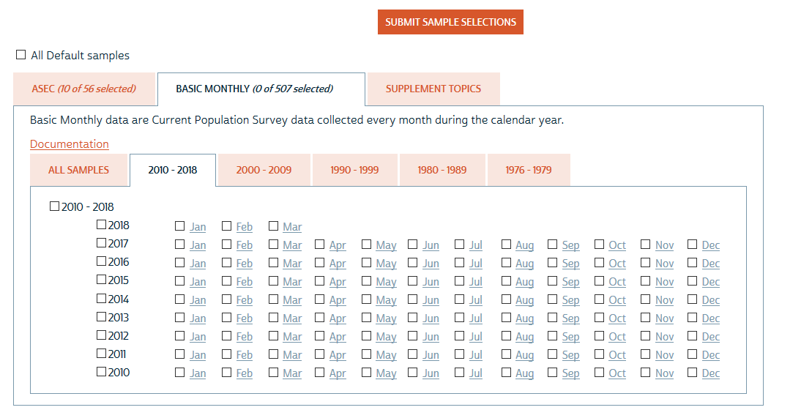
Accessing Basic Monthlies - IPUMS-CPS
Notes:
Here, go to cps.ipums.org. Show how we can select all the monthlies. Show how we treat these Basic Monthlies separate from the supplement. Reinforces the idea that BMSs are the building blocks of the CPS family.

Slide 10
CPS Supplements

Slide 11
Lots of supplements
Notes:
http://www.nber.org/data/current-population-survey-data.html
Show them ours.
Supplement documentation:
https://cps.ipums.org/cps/tobacco_sample_notes.shtml

Slide 12
Things to keep in mind
Be aware of the universes, reference periods, reference units (household, family, person)
Food security: universe varies (April 2001: not MIS 1 or 5), past year, household-level
Tobacco: Age 15 or 18 plus, broader reference period, person-level
Supplements are fielded within one given CPS Basic Monthly except for:
Child Support supplement
ASEC
ATUS

Slide 13
Annual Social and Economic Supplement (ASEC)

Slide 14
Basic Monthly v. ASEC
Basic Monthly
Demographic
Labor force questions
Last week
ASEC
Demographic
Income, taxes, health insurance, gov’t subsidies, migration
Last calendar year

Slide 15
Reference periods
2017 ASEC
2 INTRODUCTION and WORK EXPERIENCE
Pr_incom
?[F1] Importance of responding Wording of introduction is optional.
The questions you just answered were about your job and economic status last week. The next set of
questions ask about your job and economic status last year.
1 Enter 1 to Continue
Q29a
Did (name/you) work at a job or business at any time during 2016?
1 Yes
2 No

Slide 16
Differing Reference Periods
2016 Food Security Supp.
2017 Food Security Supp.
2017 ASEC
2018 ASEC
F
A
F
A
B
B
B
B
B
B
Dec
Jan
Mar
Jan
Mar
Jan
Mar
2016
2017
2018
Notes:
Basics fielded in this month. ASEC is fielded in March also but ref period is…

Slide 17
What’s in an ASEC? 1947-1955
April Basic
ASEC

Slide 18
What’s in an ASEC? 1956-1975
March Basic
ASEC

Slide 19
1976 on: Oversamples

Slide 20
What’s in an ASEC? 1976 - 2000
March Basic
ASEC

Slide 21
What’s in an ASEC? 1976 - 2000
March Basic
ASEC
Hispanic oversample

Slide 22
Where do they come from?
“Hispanic Oversample”: 1976 – on
Improve the reliability of the estimates on people of Spanish Origin

Slide 23
1976 on: Oversamples

Slide 24
What’s in an ASEC? 2001 - present
March Basic
Hispanic oversample
ASEC

Slide 25
What’s in an ASEC? 2001 - present
March Basic
ASEC
SCHIP Oversample
Hispanic oversample

Slide 26
Where do they come from?
“Hispanic Oversample”: 1976 – on
Improve the reliability of the estimates on people of Spanish Origin
State Children’s Health Insurance Program Oversample: 2001 – on
Produce reliable state-level estimates on low-income children without health insurance and study SCHIP

Slide 27
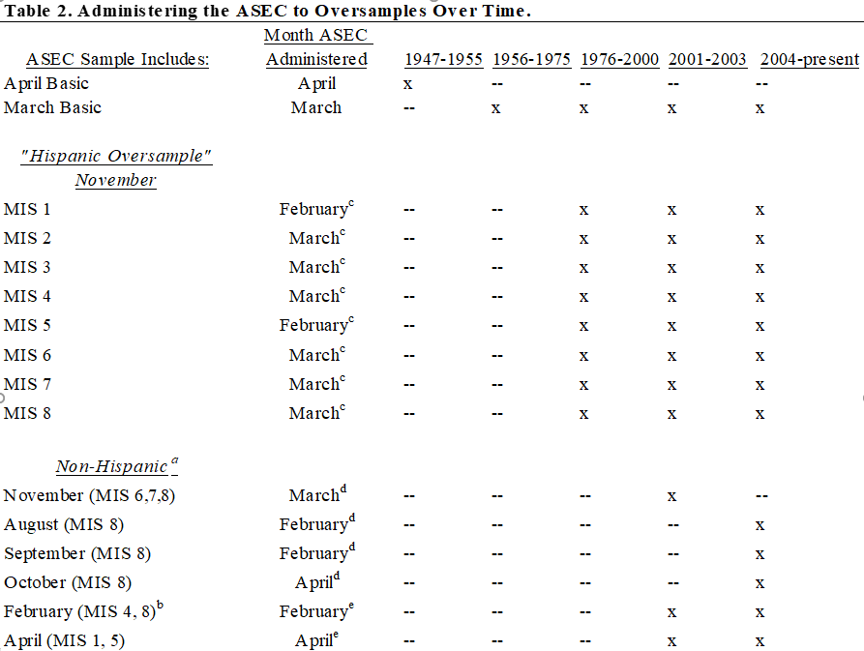

Slide 28
ASEC: Built up from CPS Basics
March Basic
ASEC
SCHIP Oversample
Hispanic oversample
NOV
MIS 1
MIS 2
MIS 3
MIS 4
MIS 5
MIS 6
MIS 7
MIS 8
NOV
MIS 6
MIS 7
MIS 8
AUG, SEP, OCT
MIS 8
Feb
MIS 4, 8
Apr
MIS 1, 5
Notes:
Take time here to use RoPES

Slide 29
ASEC: Built up from CPS Basics
ASEC
March Basic
Hispanic oversample
SCHIP Oversample

Slide 30
March Basic to ASEC
MARBASEC

Slide 31
The Task
If every person in the March Basic is given the ASEC, then we should be able to link all the March Basic respondents to their ASEC responses
It gets complicated quickly

Slide 32
MARBASECID
ASEC
March Basic
Hispanic oversample
SCHIP Oversample
MARBASECID

Slide 33
MARBASECID is for CPSID!
Goal: Find all the March Basic respondents in ASEC based on linking keys
CPSID assigned using MARBASECID (documentation only)
MARBASECID is an intermediary linking key
MARBASECID
Matches - 11 + 2-digit Year + sequence
Non-matches – Basic – 00 + Year + sequence
Non-matches – ASEC – 00 + Year + (500,000 + sequence)
(Flood and Pacas, JESM 2017)

Slide 34
MARBASECID
ASEC
March Basic
CPSID
MARBASECID

Slide 35
Oversample linking
Scrambled household ids => Can’t link to Basics
Reverse engineering difficult
Validation even more difficult: Sampling for oversample leads to similar demographics
IPUMS-CPS: Link ASEC to ASEC with CPSID.
Future: ASEC to ASEC with oversample
No ASEC oversamples and Basic Monthly

Slide 36
How to link ASECs across years?
CPSID
ASEC
March Basic
Hispanic oversample
SCHIP Oversample
ASEC
March Basic
Hispanic oversample
SCHIP Oversample
2016
2017

Slide 37
Outgoing Rotation Groups: A special case

Slide 38
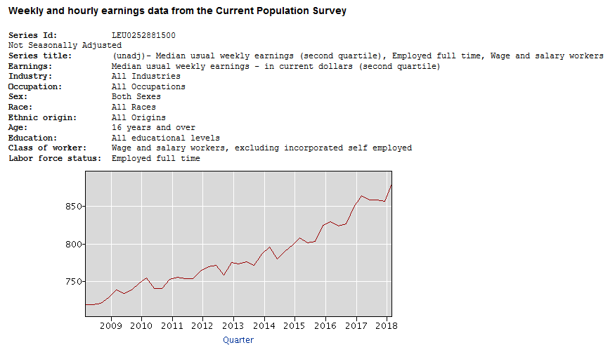
Outgoing Rotation Group/Earner Study

Slide 39
Outgoing Rotation Group/Earner Study
Data on weekly earnings, usual hours (weekly), union membership
May 1973-1981
ORGs post-1981

Slide 40
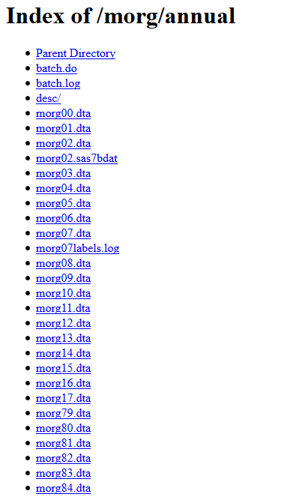
Accessing ORGs – NBER
NBER MORGS

Slide 41
Accessing ORGs – IPUMS-CPS
Create your own MORG with case selection

Slide 42
Linking with Basics and ORGs
Every month there is a Basic and an ORG. It’s a perfect subset.
25% of any given Basic monthly. Can we leverage the panel aspect to increase ORG responses?

Slide 43
Example
Brady, D., Baker, R.S., and Finnigan R. (2013).
“When Unionization Disappears: State-Level Unionization and Working Poverty in the United States.”
American Sociological Review 87(5):872-896.
“the CPS asks the union membership question only for one-fourth of the sample (the two outgoing rotation groups). As a result, the CPS samples are much smaller” (p. 886)

Slide 44
MIS | Sep
1
2
3
4 | ORG
5
6
7
8 | ORG

Slide 45
MIS | Sep | Oct
1
2
3 |  | ORG
4 | ORG
5
6
7 |  | ORG
8 | ORG

Slide 46
MIS | Sep | Oct
1
2
3 | ORG | ORG
4 | ORG
5
6
7 | ORG | ORG
8 | ORG

Slide 47
MIS | Sep | Oct | Nov
1
2 |  |  | ORG
3 | ORG | ORG
4 | ORG
5
6 |  |  | ORG
7 | ORG | ORG
8 | ORG

Slide 48
MIS | Sep | Oct | Nov | Dec
1
2 | ORG |  | ORG
3 | ORG | ORG
4 | ORG
5
6 | ORG |  | ORG
7 | ORG | ORG
8 | ORG

Slide 49
MIS | Sep | Oct | Nov | Dec
1 |  |  |  | ORG
2 | ORG |  | ORG
3 | ORG | ORG
4 | ORG
5 |  |  |  | ORG
6 | ORG |  | ORG
7 | ORG | ORG
8 | ORG
Notes:
In this simple example, it doesn’t really matter which MIS people are in as long as they are in both months. So it makes more sense to think about time in the CPS as time 1 and time 2 rather than MIS ½, 2/3, etc.

Slide 50
MIS | Sep | Oct | Nov | Dec
1 | ORG |  |  | ORG
2 | ORG |  | ORG
3 | ORG | ORG
4 | ORG
5 | ORG |  |  | ORG
6 | ORG |  | ORG
7 | ORG | ORG
8 | ORG

Slide 51
MIS | Sep
1 | ORG
2 | ORG
3 | ORG
4 | ORG
5 | ORG
6 | ORG
7 | ORG
8 | ORG

Slide 52
Linking ORGs and Validation
MIS | Sep | Oct | Nov | Dec
1 | ORG |  |  | ORG
2 | ORG |  | ORG
3 | ORG | ORG
4 | ORG
5 | ORG |  |  | ORG
6 | ORG |  | ORG
7 | ORG | ORG
8 | ORG

Slide 53
Linking ORGs and Validation
MIS | Sep | Oct | Nov | Dec
1 | Sociologist |  |  | Sociologist
2 | Economist
3 | Economist
4 | Lawyer
5 | Judge |  |  | Judge
6 | Economist
7 | Economist
8 | Physician

Slide 54
Linking ORGs and Validation
MIS | Sep | Oct | Nov | Dec
1 | Sociologist |  |  | Sociologist
2 | Economist |  | Economist
3 | Economist
4 | Lawyer
5 | Judge |  |  | Judge
6 | Economist |  | Bartender
7 | Economist
8 | Physician

Slide 55
Linking ORGs and Validation
MIS | Sep | Oct | Nov | Dec
1 | Sociologist |  |  | Sociologist
2 | Economist |  | Economist
3 | Economist | Teacher
4 | Lawyer
5 | Judge |  |  | Judge
6 | Economist |  | Bartender
7 | Economist | Police
8 | Physician

Slide 56
Bringing it all together

Slide 57
Net Fiscal Impact of Union Membership
What is the association between individuals’ union membership status and the level of taxes they pay and cost of public benefits they receive?
Using Current Population Survey 1994-2015, pooled cross-sections & individual first-differences, we find union members:
Contribute between $600 and $1,300 in taxes net of public benefits

Slide 58
Increase Sample with Earnings Data from 20% of March Basic to 75%
ASEC
March MIS 4, 8
April
MIS 4, 8
May
MIS 4, 8
June
MIS 4, 8

Slide 59
ASEC to Basic with ORGs Across Years
ASEC
March MIS 4, 8
April
MIS 4, 8
May
MIS 4, 8
June
MIS 4, 8
ASEC
March MIS 4, 8
April
MIS 4, 8
May
MIS 4, 8
June
MIS 4, 8
Another validation issue: Occupation last year v. occupation last week

Slide 60
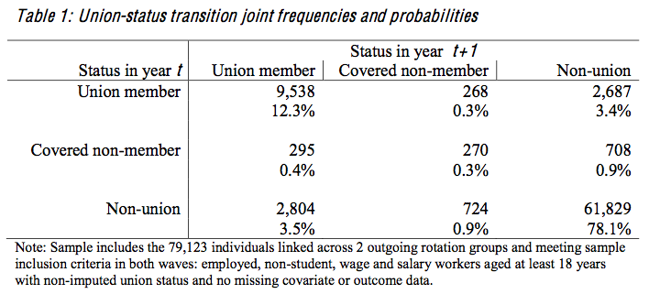

Slide 61
Summarizing
Basic Monthlies are the building blocks
Careful with universes and reference periods of supplements
ASEC is a special supplement
Cannot link oversamples…yet
ORGs can be linked
Linking these all together requires extra validation and thought

Slide 62
Questions?

